Slide 1


LEVEL 3: Advanced – Master Trainer Leadership & Certification
Module 1: Strategic Leadership in Learning
Lesson 1: The Evolving Role of a Master Trainer
“If training were removed from your organization today, what performance gaps would immediately appear—and what would that reveal about your role?”
This question reminds us that a Master Trainer is no longer simply a facilitator—they are an architect of capability, culture, and performance.

Slide 2

Learning Objectives
By the end of this lesson, participants will be able to:
Critically evaluate how the Master Trainer role has evolved beyond facilitation into strategic leadership.
Analyze emerging trends driving the transformation of modern learning ecosystems.
Differentiate between trainer-level competencies and advanced Master Trainer leadership capabilities.
Apply a strategic mindset to position themselves as high-value partners to business leaders.
Map their current responsibilities to future-facing expectations of the global Master Trainer role.

Slide 3
Why This Matters
Modern organizations face rapid change, global disruptions, digital transformation, shifting skills, and new talent expectations.
Today’s learning environment demands:
Leaders who can diagnose performance challenges
Strategists who can design capability systems
Influencers who can guide organizational learning culture
Master Trainers who can certify, develop, and elevate trainers
Experts who can connect learning to business outcomes
This lesson prepares participants to lead, innovate, and shape the future of learning—not just facilitate it.

Slide 4

Core Concepts
1. The Transition from Trainer to Master Trainer
Trainer: Focuses on delivery.
Senior Trainer Focuses on design + delivery.
Master Trainer: Focuses on strategy, capability development, certification, and organizational influence.

Slide 5

Core Concepts
Global Definition of a Master Trainer
A Master Trainer is a senior learning professional who:
Leads L&D strategy
Develops and certifies trainers
Influences performance outcomes
Ensures global quality standards
Shapes organizational learning culture
Integrates data, technology, and science into learning initiatives

Slide 6

Core Concepts
2. The New Dimensions of the Master Trainer Role
A. Strategic Leadership
Master Trainers now contribute to:
Talent strategy
Capability roadmaps
Workforce transformation
Learning governance
B. Systems Thinking
They view learning as an ecosystem, not an event.

Slide 7
Core Concepts
C. Coaching and Mentorship
They elevate trainers, facilitators, and SMEs into effective learning leaders.
D. Data-Driven Influence
They make decisions using: Learning analytics, KPIs, Performance dashboards
Business impact metrics
E. Digital & Blended Learning Expertise
They integrate technology, AI, LX design, microlearning, and virtual training.

Slide 8

Core Concepts
3.Global Trends Shaping the Future of Master Trainers
Trend 1: Digital Transformation & AI
Master Trainers must understand AI-driven personalization, automation, and adaptive learning.
Trend 2: Skills-Based Workforce Models
Organizations now train for skills, not roles.
Trend 3: Learning in the Flow of Work
Training is shifting from classrooms to integrated support tools.

Slide 9

Core Concepts
Trend 4: Demand for Learning ROI & Business Alignment
Executives want measurable improvement—not activity.
Trend 5: Globalization of L&D Standards
Master Trainers must operate using global frameworks such as:
ATD Talent Development Capability Model
CIPD Learning Standards
ISO 29993
ICF coaching competencies

Slide 10
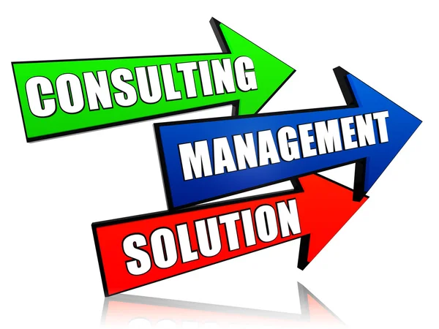
Relevant Examples & Scenarios
Scenario 1: The Master Trainer as an Organizational Advisor
The HR Director needs a capability roadmap for the next 12 months.
The Master Trainer analyzes business goals, workforce trends, and skill gaps to produce a strategic learning plan.

Slide 11

Relevant Examples & Scenarios
Scenario 2: The Master Trainer as a Quality Gatekeeper
A new trainer joins the L&D team.
The Master Trainer evaluates their facilitation, designs a development plan, and certifies them for delivery.

Slide 12

Relevant Examples & Scenarios
Scenario 3: The Master Trainer as a Change Leader
When rolling out new technology, the Master Trainer designs a blended adoption strategy that accelerates performance and minimizes resistance.

Slide 13

Practical Tools & Frameworks
1. The Evolving Master Trainer Capability Model (EMTCM)
Five Leadership Domains:
Strategic Alignment
Program Architecture & Systems Design
Trainer Development & Certification
Data-Driven Evaluation
Learning Culture Leadership

Slide 14
Practical Tools & Frameworks
2. The Future-Ready Master Trainer Mindset Shift Framework
From | To
Delivering sessions | Delivering business value
Training people | Building capability systems
Following strategy | Influencing strategy
Working in L&D | Leading L&D
Providing content | Creating ecosystems
Managing trainers | Developing leaders

Slide 15

Personalized Reflection Questions
Which dimension of the evolving Master Trainer role is most exciting for me—and why?
Which new competency do I currently lack but need for the future?
How well do I influence decisions in my organization today?
What mindset shift must I embrace to lead strategically?

Slide 16

Application Exercise / Activity
Activity: Create Your Master Trainer Evolution Map
Using the 5 leadership domains, map out:
Where you are today
Where you need to be
What skills or behaviors must change
What strategic value you aim to deliver
Submit a 1-page evolution roadmap.

Slide 17

Knowledge Check / Quiz
What distinguishes a Master Trainer from a senior trainer?
List two global trends shaping the future of L&D.
Why must Master Trainers adopt a systems-thinking approach?
What does it mean to align learning with business outcomes?

Slide 18

Mini Assessment / Practice Task
Task:
Choose a current training program you manage.
Rewrite its role from “trainer delivery activity” to “strategic capability initiative” by defining:
Business need
Strategic purpose
Capability outcome
Success metrics
Stakeholders
Trainer development requirements

Slide 19

Summary
The Master Trainer role is evolving rapidly in response to global business and workforce changes.
Modern Master Trainers must be strategic leaders, capability architects, and culture influencers.
They operate at a leadership level—driving business value, not just training sessions.
Their success is measured by performance improvement, capability growth, and organizational impact.
To thrive in the future, Master Trainers must embrace new competencies, mindset shifts, and strategic leadership behaviors.

Slide 20

Resources & Templates
Strategic Master Trainer Leadership Profile Template
Future-Ready Capability Roadmap Worksheet
Master Trainer Influence Map
Strategic Alignment Canvas

Slide 21
Module 1: Strategic Leadership in Learning
Lesson 2: Building a Learning Culture in Organizations
Learning Objectives
By the end of this lesson, participants will be able to:
Evaluate organizational systems, processes, and behaviors that support or hinder a learning culture.
Design strategic interventions that strengthen continuous learning and knowledge-sharing within organizations.
Lead and influence stakeholders to embed learning as a core driver of performance, innovation, and organizational resilience.
Integrate global L&D standards to ensure learning culture initiatives are sustainable, scalable, and measurable.

Slide 22

“Why do two organizations with the same tools and talent produce drastically different outcomes? What invisible force shapes their success?”
Research from the Corporate Executive Board shows that organizations with strong learning cultures are 92% more likely to innovate, 52% more productive, and 3x more likely to retain top talent.
The invisible force is culture.

Slide 23

Why This Matters
A strong learning culture:
Accelerates innovation, agility, and competitive advantage.
Drives organizational performance and retention.
Strengthens your authority and credibility as a Master Trainer capable of influencing strategic outcomes.
Ensures learning moves from “training events” to “embedded behavior and continuous improvement.”
Globally recognized trainers are not just facilitators—they are culture architects.

Slide 24
Core Concepts
A. Simple Explanation: What is a Learning Culture?
A learning culture is an environment where individuals and teams continuously acquire, apply, share, and improve knowledge and skills in pursuit of organizational goals.
B. Deep Dive: Core Components of a Learning Culture
Leadership Commitment & Role Modeling
Leaders demonstrate learning as a non-negotiable success requirement.
C. Psychological Safety
Teams feel safe to ask questions, experiment, and fail forward

Slide 25

Core Concepts
3. Continuous Feedback Loops
Regular learning reviews, retrospectives, debriefs.
4. Embedded Learning Processes
On-the-job learning, stretch assignments, performance-support tools.
5. Reward & Recognition
Celebrating learning behaviors, not only outcomes.
6. Data-Informed Learning Strategy
Learning aligned with business KPIs; measured via Kirkpatrick and ROI/ROE.

Slide 26

Relevant Examples, Case Studies & Scenarios
Case Study 1: Microsoft’s Growth Mindset Transformation
Shifted from “know-it-all” to “learn-it-all.”
Leaders required to demonstrate continuous learning behavior.
Result: Increased innovation, morale, and global influence.

Slide 27

Relevant Examples, Case Studies & Scenarios
Scenario (For Master Trainers):
You have joined an organization where:
Training exists but learning is not embedded in workflows.
Teams fear taking risks.
Managers do not support development.
Your task: Advocate, design, and lead a transformation toward a learning culture.

Slide 28

Practical Tools, Frameworks & Strategies
A. The 4R Learning Culture Leadership Framework (For Master Trainers)
Reinforce – Embed learning in systems (KPIs, performance reviews, team routines).
Role Model – Leaders visibly engage in learning.
Reward – Recognize and incentivize learning behaviors.
Review – Conduct continuous learning audits.

Slide 29
Practical Tools, Frameworks & Strategies
B. Organizational Learning Culture Audit Tool: Assess your organization across five dimensions:
Dimension | Indicators | Rating (1–5)
Leadership | Learning role modelling, support
Processes | Embedded learning workflows
Systems | LMS, knowledge management, mentoring
Behaviour | Feedback culture, psychological safety
Measurement | Use of learning data for decisions

Slide 30

Practical Tools, Frameworks & Strategies
C. Master Trainer Culture Intervention Blueprint
Diagnose → Conduct culture audit and stakeholder analysis.
Align → Connect learning culture goals to business priorities.
Design → Develop learning interventions, systems, rituals.
Activate → Launch leadership engagement and communities of practice.
Sustain → Reward, measure, iterate using Kirkpatrick L3/L4 metrics.

Slide 31

Personalized Reflection Questions
What learning behaviors do I personally model as a Master Trainer?
Which barriers currently hinder learning in my organization?
How can I influence leadership to prioritize learning?
What systems or rituals can I introduce immediately?

Slide 32

Application Exercise / Activity
Activity: Learning Culture Design Sprint (Self-Paced)
Step 1: Conduct a mini learning culture audit of your organization or a client organization.
Step 2: Identify three culture gaps.
Step 3: Design one learning culture intervention for each gap.
Step 4: Map each intervention to leadership roles, timelines, and KPIs.
Step 5: Upload your blueprint to your Master Trainer Portfolio.

Slide 33
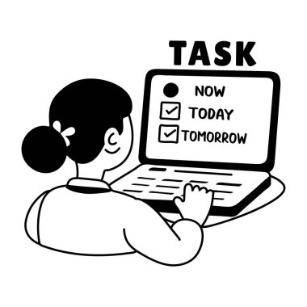
Mini Assessment / Practice Task
Task:
Design a Learning Culture Intervention Proposal for a hypothetical or real organization.
Your proposal must include:
Culture audit findings
Three strategic interventions
Learning culture KPIs
Stakeholder involvement plan
Implementation roadmap

Slide 34

Mini Assessment / Practice Task
Rubric (5 Points Each):
Strategic Alignment
Depth of Analysis
Practicality of Interventions
Measurement Strategy
Professional Quality & Clarity

Slide 35
Summary
Learning culture is the foundation of organizational innovation, agility, and performance.
Master Trainers must act as strategic influencers—not just content experts.
Culture transformation requires systems, leadership role-modeling, psychological safety, and continuous measurement.
Globally recognized L&D leaders integrate ADDIE, SAM, Kolb, and ISO standards to create sustainable learning ecosystems.
Your ability to build a learning culture positions you as a strategic partner in business growth.

Slide 36

Resources & Templates
Included in this lesson:
Learning Culture Audit Template
Stakeholder Influence Map Template
Learning Culture Intervention Blueprint
Learning Ritual Design Worksheet
Kirkpatrick L3 & L4 Measurement Guide
Master Trainer Portfolio Submission Template

Slide 37
Module 1: Strategic Leadership in Learning
Lesson 3: Leading Learning Teams and Networks
Learning Objectives
By the end of this lesson, participants will be able to:
Evaluate the effectiveness of learning teams and networks in driving organizational capability.
Design structures, processes, and governance models that strengthen L&D teams and cross-functional learning networks.
Lead and influence diverse learning teams—internal, cross-functional, and external—toward shared learning goals and strategic outcomes.
Build and sustain high-performing learning communities that enhance knowledge flow, innovation, and organizational performance.

Slide 38

Powerful Quote:
“No organization can become a learning organization unless its leaders form a learning leadership team.”
Peter Senge, The Fifth Discipline
This reminds us of a core truth:
High-impact learning organizations are built by high-impact learning leaders.

Slide 39
Why This Matters
In the global L&D landscape, Master Trainers are expected not only to deliver learning but also to lead the people who drive learning. Effective leadership of learning teams and networks:
Accelerates organizational capability and knowledge flow
Strengthens innovation, collaboration, and performance
Enables scalable learning strategies, not just individual training events
Establishes you as a strategic L&D leader, not just a facilitator
Ensures learning happens everywhere—not just in the classroom or LMS
Organizations win when their learning teams are aligned, empowered, and networked.

Slide 40

Core Concepts
Learning teams and networks consist of the individuals and communities responsible for creating, sharing, applying, and sustaining knowledge across an organization.

Slide 41
Core Concepts
1. Types of Learning Teams & Networks
L&D Teams
Learning designers, trainers, facilitators, performance coaches, analysts.
Cross-Functional Learning Networks
Representatives from operations, HR, IT, compliance, customer service.
Communities of Practice (CoPs)
Groups united by shared expertise or interest.
External Learning Ecosystems
Consultants, vendors, academic institutions, industry partners.

Slide 42

Core Concepts
2. Characteristics of High-Performing Learning Teams
Shared Purpose & Vision
Psychological Safety
Knowledge-Sharing & Open Communication
Collaboration & Cross-Functional Integration
Continuous Improvement Mindset
Clear Governance & Decision-Making Structures
Leadership Role-Modeling & Accountability

Slide 43

Core Concepts
3. Master Trainer Leadership Capabilities (Advanced-Level)
A Master Trainer must be able to:
Facilitate high-value conversations
Manage conflict constructively
Coach team members
Embed evidence-based best practices
Lead through influence, not authority
Foster inclusive learning environments
Shape strategic learning networks

Slide 44

Relevant Examples, Case Studies & Scenarios
Case Study: Adobe Learning Network Transformation
Adobe once operated in silos across regions. By establishing global learning networks made up of internal champions and subject-matter communities, they achieved:
Faster onboarding cycles
Higher adoption of new technologies
Better internal knowledge retention
Stronger alignment across markets
The key? Strong L&D leadership guiding distributed learning teams.

Slide 45

Relevant Examples, Case Studies & Scenarios
Scenario (For Master Trainer Leadership Practice)
You have been appointed to lead a regional learning team consisting of:
New trainers
SMEs with no facilitation experience
A senior manager resistant to change
A remote team across time zones
Your challenge: Build a cohesive, high-performing learning network that supports business goals.

Slide 46

Practical Tools & Leadership Frameworks
A. The Master Trainer Leadership Model for Learning Teams (MT-LT5)
Clarify – Define learning vision, roles, and expectations
Connect – Build strong relational networks internally and externally
Coordinate – Align goals, processes, workflows
Coach – Mentor team members to grow competence and confidence
Champion – Advocate for learning at all leadership levels

Slide 47

Practical Tools & Leadership Frameworks
B. Learning Network Mapping Tool
Identify key learning influencers across:
Departments
Hierarchies
Geographic regions
External partners
Map their level of influence, support needs, and role in the learning ecosystem.

Slide 48
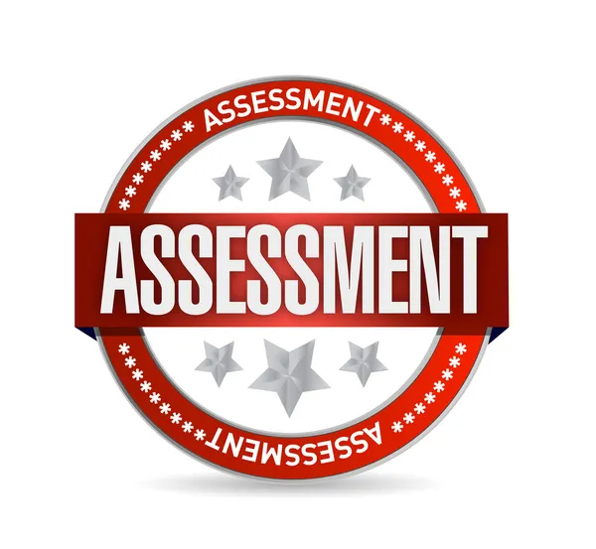
Practical Tools & Leadership Frameworks
C. Team Maturity Assessment Tool
Evaluate your learning team from Level 1 to Level 5:
Level 1: Fragmented
Level 2: Functional
Level 3: Collaborative
Level 4: Strategic
Level 5: High-Performing, Innovation-Driven

Slide 49

Practical Tools & Leadership Frameworks
D. Conflict-to-Collaboration Protocol (C2C Method)
Name the issue
Understand viewpoints
Align on shared purpose
Co-create solutions
Implement and monitor

Slide 50

Personalized Reflection Questions
What is the current maturity level of the learning team I lead or influence?
Which leadership behaviors do I exhibit consistently, and which need strengthening?
How effectively do I leverage cross-functional networks?
What barriers prevent learning collaboration in my environment?
What is one immediate leadership action I can take to strengthen the learning network?

Slide 51

Application Exercise / Activity
Activity: Build Your Learning Leadership Strategy (Self-Paced)
Conduct a quick team maturity assessment using the Level 1–5 scale.
Create a map of your current learning network.
Identify three leadership opportunities to strengthen your learning team or network.
Develop a 90-day Leadership Action Plan using the MT-LT5 Model.
Upload the plan to your Master Trainer Portfolio.

Slide 52

Mini Assessment / Practice Task
Task: Leadership Influence Case Simulation
Write a 1-page intervention plan describing how you will:
Build alignment within a diverse learning team
Increase collaboration across functions
Address one major conflict or resistance issue
Strengthen the organization’s learning network through leadership behaviors

Slide 53
Mini Assessment / Practice Task
Rubric (5 Points Each):
Clarity of Leadership Strategy
Use of Frameworks (MT-LT5, C2C, Team Maturity Levels)
Practicality and Real-World Relevance
Stakeholder Engagement
Professional Presentation and Cohesion

Slide 54

Summary
Leading learning teams requires strategic influence, not just facilitation skill.
High-performing teams demonstrate psychological safety, collaboration, aligned purpose, and continuous learning.
Master Trainers must design, lead, and sustain learning networks that extend beyond the L&D department.
Leadership frameworks (like MT-LT5) provide structure for building capacity and alignment.
You are not just a trainer—you are a learning ecosystem leader.

Slide 55

Resources & Templates
Included in this lesson:
Learning Network Mapping Template
MT-LT5 Leadership Action Plan Template
Team Maturity Assessment Tool (Levels 1–5)
90-Day Leadership Action Planner
Conflict-to-Collaboration (C2C) Worksheet
Stakeholder Engagement Grid
Master Trainer Portfolio Submission Format

Slide 56
Module 1: Strategic Leadership in Learning
Lesson 4: Aligning Learning Strategy with Business Goals
Learning Objectives
By the end of this lesson, participants will be able to:
Analyze organizational priorities, performance gaps, and strategic drivers to determine learning implications.
Design a high-level learning strategy that directly supports business goals, KPIs, and organizational transformation.
Evaluate whether learning initiatives create measurable business impact using global L&D standards.
Lead and influence stakeholders to ensure learning becomes a strategic business enabler, not an operational function.

Slide 57

Question:
“If learning does not change business performance, is it still learning—or just activity?” This question distinguishes training delivery from strategic learning leadership.
High-performing organizations know:
Learning only matters when it drives business outcomes.

Slide 58

Why This Matters
Organizations invest in learning to:
Increase revenue
Improve productivity
Reduce errors, risks, and costs
Drive innovation and operational excellence
Strengthen leadership pipelines
Enhance customer experience

Slide 59

Why This Matters
A Master Trainer must move from “delivering programs” to designing learning that solves business problems.
This is the distinguishing skill of global L&D leaders.

Slide 60
Core Concepts
A. Simple Explanation
Alignment means ensuring that every learning initiative connects directly to a business goal or performance outcome.
B. Deep Dive Components
1. Understanding Business Goals
They typically fall under categories such as:
Growth (e.g., market expansion, revenue increase)
Productivity & Efficiency
Customer Experience
Operational Excellence

Slide 61

Core Concepts
Compliance & Risk Management
Talent Development & Retention
Digital Transformation
Master Trainers must understand the organization’s strategic plan, annual goals, KPIs, and performance indicators.

Slide 62

Core Concepts
3. Performance Consulting Approach (Critical Skill at Level 3)
Before designing any learning, ask:
What is the business problem?
What does success look like?
What behaviors must change?
What skills or knowledge are required?
What systems, processes, incentives, or tools impact performance?
Is learning the right solution—or part of a wider solution?

Slide 63

Core Concepts
4. Designing a Learning Strategy That Enables Business Results
A strong learning strategy includes:
Alignment with strategic priorities
Clear performance outcomes
Learning paths, modalities, and interventions
Measurement plan (Kirkpatrick L3 & L4)
Stakeholder engagement model
Ecosystem integration (coaching, mentoring, tech, knowledge management)

Slide 64

Core Concepts
5. Kirkpatrick Alignment for Business Impact
Level 1: Reaction (Engagement)
Level 2: Learning (Knowledge/Skills Gained)
Level 3: Behavior (Application on the job)
Level 4: Results (Business impact)

Slide 65

Relevant Examples, Case Studies & Scenarios
Case Study: Coca-Cola HBC Productivity Enhancement
Business challenge: Low sales productivity in emerging markets.
L&D Response: Strategic capability programs aligned with new sales processes.
Outcome: +14% productivity within 9 months.
Why? Training directly aligned with business KPIs, not learning for learning’s sake.

Slide 66

Relevant Examples, Case Studies & Scenarios
Scenario (For Master Trainers)
You have been asked to design leadership training for mid-level managers.
But the business goal for the year is:
Improve operational efficiency by reducing process errors.
Your role?
Redirect the conversation from “training content” to “business outcomes,” using performance consulting.
Then design training that strengthens decision-making, accountability, and process adherence.

Slide 67

Practical Tools & Frameworks
A. Learning Strategy Alignment Map (LSAM)
Business Goal
Performance Gap
Critical Behaviors
Learning Need
Learning Solution
Success Measures (Kirkpatrick L3 & L4)

Slide 68

Practical Tools & Frameworks
B. Business Value Alignment Canvas (BVAC)
A one-page template that maps:
Strategic priorities
Key stakeholders
Operational drivers
Skill capability needs
Measurable outcomes
Risks & enablers

Slide 69

Practical Tools & Frameworks
C. The 5R Model for Strategic Alignment
Relevance – Does it solve a real business need?
Results – What KPI will change?
Reach – Who must be impacted?
Resources – Budget, tools, time, technology
Return – What is the business payoff? (ROI/ROE)

Slide 70

Personalized Reflection Questions
How well do I understand my organization’s business strategy?
Which stakeholders must I partner with to align learning with business impact?
What learning initiatives am I currently running that are not strategically aligned?
How can I strengthen performance consulting in my role?
What KPIs can my learning programs influence most effectively?

Slide 71
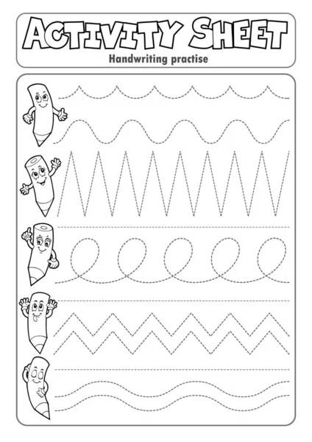
Application Exercise / Activity
Activity: Strategy-to-Learning Conversion Exercise
Select one business goal in your organization or a hypothetical case.
Complete the Learning Strategy Alignment Map (LSAM).
Identify at least three performance indicators your learning initiatives should impact.
Design a high-level learning intervention that drives those indicators.
Upload your output to your Master Trainer Portfolio.

Slide 72
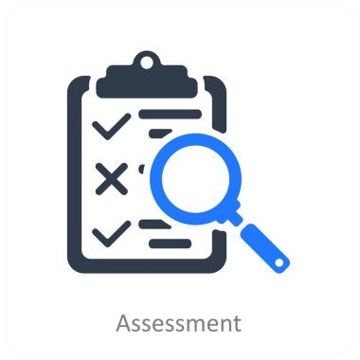
Mini Assessment / Practice Task
Task: Business Alignment Design Brief
Develop a 1–2 page strategic brief that includes:
One business goal
Identified performance gaps
Proposed learning strategy
Expected business impact
Success measures (Kirkpatrick L3–L4)
Stakeholder collaboration plan

Slide 73
Mini Assessment / Practice Task
Rubric (5 Points Each):
Strategic clarity
Business relevance
Strength of analysis
Measurement alignment
Professional presentation

Slide 74

Summary
Learning strategy must be directly tied to business strategy.
Performance consulting is essential to understand what the organization truly needs.
Learning must drive behaviors that change KPIs and results.
Master Trainers operate as strategic business partners, not training administrators.
Alignment ensures learning investments deliver measurable value and strengthen organizational performance.

Slide 75

Resources & Templates
Learning Strategy Alignment Map (LSAM)
Business Value Alignment Canvas (BVAC)
Performance Consulting Checklist
Stakeholder Alignment Ladder
Kirkpatrick Measurement Guide (L3 & L4)
Business Goal → Learning Strategy Mapping Template
Master Trainer Portfolio Submission Guide

Slide 76
Module 2: Certification and Quality Assurance
Lesson 1: Designing Trainer Certification Programs
Learning Objectives
By the end of this lesson, participants will be able to:
Evaluate organizational capability needs and determine the requirements for a sustainable trainer certification system.
Design a robust trainer certification framework that incorporates competency models, assessment standards, governance processes, and quality controls.
Integrate global L&D best practices to ensure certified trainers consistently deliver high-quality, performance-based learning experiences.
Create and implement certification pathways that align with organizational goals, adult learning principles, and measurable performance outcomes.

Slide 77

Surprising Fact:
Organizations with structured trainer certification programs experience up to 45% improvement in training quality and 40% higher learner satisfaction, according to ATD’s State of the Industry Report.
Yet, fewer than 20% of organizations have a formal certification system.This lesson equips you to become the leader who builds one.

Slide 78
Why This Matters
In today’s performance-driven learning environment:
Organizations need consistent training quality across facilitators, locations, and delivery channels.
Trainer certification ensures competence, consistency, credibility, and compliance.
Certification systems reduce risk, improve delivery standards, and strengthen learning ROI.
As a Master Trainer, you must certify trainers and ensure they meet global facilitation and instructional design standards.
Certification establishes learning as a strategic quality-controlled function, not a loosely managed activity.

Slide 79

Core Concepts
A. Simple Explanation
A Trainer Certification Program is a structured system that validates that trainers have the required knowledge, skills, and behaviors to deliver learning at an approved standard.

Slide 80

Core Concepts
1. Key Components of a Trainer Certification Program
a. Trainer Competency Framework
Includes competencies such as:
Facilitation techniques
Instructional design capability
Adult learning mastery
Coaching and feedback skills
Assessment literacy
Use of learning technologies
Classroom & virtual delivery proficiency

Slide 81

Core Concepts
b. Certification Pathway Design
Entry Requirements
Training Requirements
Observation Requirements
Assessment Requirements
Recertification Requirements
Governance & Quality Assurance

Slide 82
Core Concepts
C. Assessment Approaches
Knowledge Assessments
Skills Demonstrations (Live/Recorded Facilitation)
Portfolio Submissions
Peer Evaluations
Observation Checklists
360° Feedback
Coaching Logs

Slide 83

Core Concepts
d. Quality Assurance & Governance
Standard operating procedures (SOPs)
Rubrics & scoring guides
Moderation & calibration sessions
Continuous improvement cycles
Trainer performance dashboards
Recertification cycles (1–3 years)

Slide 84

Core Concepts
2. ADDIE & SAM Applied to Certification Design
Analysis: Capability gaps, trainer readiness, job roles, performance requirements
Design: Framework, levels, assessments, rubrics
Development: Materials, templates, evaluation tools
Implementation: Certification roll-out
Evaluation: Using Kirkpatrick L1–L4

Slide 85

Core Concepts
3. Kolb’s Experiential Learning Integrated into Certification
Trainers must demonstrate ability to:
Concrete Experience → Reflective Observation → Abstract Conceptualization → Active Experimentation
This ensures competence, not theory.

Slide 86
Examples, Case Studies, and Scenarios
Case Study: Global Telecom Trainer Certification Program
A telecom organization created a 3-level trainer certification model.
Results after 12 months:
32% improvement in customer experience training outcomes
27% reduction in training inconsistencies
Improved brand alignment across countries
Stronger managerial confidence in L&D
Key success factor: Standardized trainer assessments and reviews.

Slide 87

Examples, Case Studies, and Scenarios
Scenario for Master Trainers
You are asked to create a trainer certification program for a national organization with:
45 trainers
Inconsistent delivery quality
No formal evaluation process
High learner complaints
Multiple locations and delivery formats
Your task is to build a scalable, quality-driven system that standardizes excellence.

Slide 88
Practical Tools, Frameworks & Strategies
Three-Level Trainer Certification Framework (Global Standard)
Level 1 — Certified Trainer (CT)
Focus: Foundational facilitation skills
Assessment: Live delivery + knowledge test
Level 2 — Senior Certified Trainer (SCT)
Focus: Complex facilitation, coaching, instructional design
Assessment: Program design + observed coaching session
Level 3 — Master Trainer (MT)
Focus: Leadership, certification of others, strategic L&D alignment
Assessment: Evaluation portfolio + certification of new trainers

Slide 89

Practical Tools, Frameworks & Strategies
B. Trainer Competency Framework Template (TCF-7)
Facilitation Mastery
Instructional Design & Analysis
Learner Engagement & Inclusivity
Assessment & Feedback
Technology-Enabled Delivery
Professional Conduct & Ethics
Continuous Improvement & Reflection

Slide 90

Practical Tools, Frameworks & Strategies
C. Standardized Observation Checklist (Sample)
Evaluates:
Opening & session framing
Delivery skills
Engagement techniques
Adult learning application
Use of materials
Coaching and feedback
Closing and learning reinforcement

Slide 91

Practical Tools, Frameworks & Strategies
D. Certification Governance Guidelines
Clear certification criteria
Independent assessors
Moderation/calibration meetings
Annual quality audits
Recertification every 24–36 months
Training records & digital credentialing

Slide 92
Personalized Reflection Questions
What gaps exist in the trainer performance within my organization?
Which competencies are most critical for achieving consistent delivery excellence?
What certification pathway structure will best fit my organizational context?
What fears, resistance, or barriers might trainers have toward certification?
How can I ensure fairness, inclusivity, and transparency in the certification process?

Slide 93

Application Exercise / Activity
Activity: Build Your Trainer Certification Blueprint
Define the purpose and business case for your certification program.
Draft a three-level certification model tailored to your context.
Select the competencies required at each level.
Design assessment methods for each level.
Create a governance and quality assurance process.
Upload your blueprint to your Master Trainer Portfolio.

Slide 94
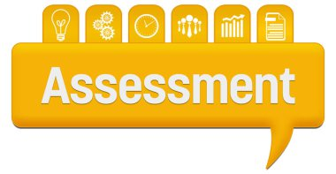
Mini Assessment / Practice Task
Task: Certification Program Design Proposal
Prepare a 2–3 page proposal that includes:
Certification purpose & business justification
Certification levels
Competencies and assessment methods
Certification workflow
Quality assurance and governance model
Measurement plan (Kirkpatrick levels used)

Slide 95

Mini Assessment / Practice Task
Rubric (5 points each):
Completeness
Alignment with global standards
Practicality & scalability
Assessment clarity
Professional structure & presentation

Slide 96

Summary
Trainer certification ensures delivery excellence, consistency, and organizational performance.
Certification relies on clear competencies, rigorous assessments, and strong governance.
Master Trainers must lead certification design using global frameworks (ADDIE, ISO 29993, Kirkpatrick, ATD).
Certification programs strengthen credibility and elevate the L&D function into a quality-assured, performance-driven discipline.
You are not just building skills—you are building a certified community of high-performing trainers.

Slide 97

Resources & Templates
Trainer Competency Framework (TCF-7)
Certification Pathway Template
Trainer Assessment Rubric
Observation Checklist (Standardized)
Certification Governance SOP
Trainer Portfolio Template
Certification Performance Dashboard Template

Slide 98
Module 2: Certification and Quality Assurance
Lesson 2: Developing Competency Frameworks
Learning Objectives
Evaluate existing competency standards and identify gaps in alignment with organizational needs.
Design a comprehensive, multi-level competency framework for trainers using global benchmarks.
Integrate behavioral, technical, and leadership competencies into a scalable and assessable structure.
Develop performance indicators and assessment criteria that ensure global-quality learning delivery.
Critically review the robustness, fairness, and inclusiveness of a competency framework and optimize it for continuous improvement.

Slide 99

Question:
If your organization were to certify trainers today, could you clearly and confidently define what “competent” looks like at every level?
Most organizations cannot—yet they expect performance excellence.

Slide 100
Why This Matters
A competency framework is the backbone of a credible certification program. When designed well, it:
Ensures consistency in trainer quality across regions and contexts.
Makes certification transparent, fair, and defensible.
Enables objective assessment of trainer readiness and mastery.
Supports career pathways, succession planning, and continuous development.
Aligns learning performance with business capability needs.
Without a competency framework, training quality becomes subjective, inconsistent, and difficult to measure.

Slide 101
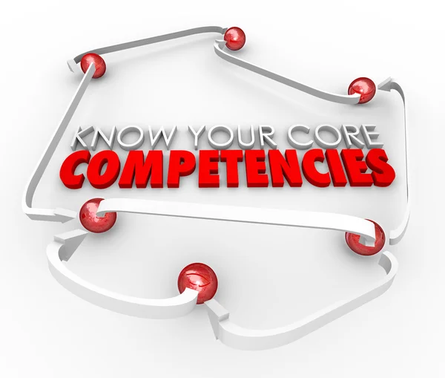
Core Concepts
1 What is a Competency Framework? (Simple Definition)
A structured system that defines the knowledge, skills, behaviors, and performance standards required to excel in a specific role.

Slide 102
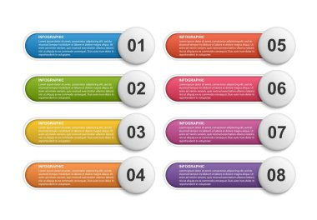
Core Concepts
2 Components of a Strong Competency Framework (Deep Dive)
Competency Categories
  Technical facilitation
  Instructional design
  Learning psychology
  Professional behavior & ethics
  Leadership and influence
  Quality assurance

Slide 103

Core Concepts
2. Levels of Proficiency
  Foundational
  Intermediate
  Advanced
  Mastery (Master Trainer)
3. Behavioral Indicators
  Observable, measurable actions that demonstrate mastery.

Slide 104

Core Concepts
4. Performance Evidence
  Video demonstrations
  Class observations
  Learner feedback
  Assessment artifacts
5. Assessment Criteria
  Rubrics
  Scoring guides
  Pass thresholds
6. Progression Pathways
Defines how trainers grow over time.

Slide 105

Relevant Examples & Case Studies
Example: ATD-Inspired Competency Clusters
Training Delivery
Instructional Design
Evaluating Learning Impact
Performance Consulting
Technology Application
Your organizational version may combine, expand, or simplify these.

Slide 106

Relevant Examples & Case Studies
Case Study: A Multinational Company Standardizes Trainer Quality
A global telecommunications company operating in 12 countries struggled with inconsistent training quality. They implemented a competency framework with:
4 levels of trainer proficiency
Standardized behavioral indicators
Assessment rubrics shared across all regions
Quarterly observation cycles

Slide 107

Relevant Examples & Case Studies
Results within 12 months:
32% improvement in learner satisfaction
21% increase in on-the-job performance scores
Reduced onboarding time for new trainers by 40%

Slide 108
Practical Tools & Frameworks
1 The 5-Step Competency Framework Development Model
Define the Purpose
Certification? Assessment? Talent development?
Identify Critical Job Tasks
Use job analysis, stakeholder interviews, and observation.
Group Tasks into Competencies
Cluster similar skills and behaviors.
Define Proficiency Levels
Create progressive, mastery-based levels.
Develop Assessment Tools
Rubrics
Observation checklists
Portfolio requirements

Slide 109

Practical Tools & Frameworks
2 The Master Trainer Competency Wheel (Template)
Six Core Domains:
Facilitation Mastery
Instructional Design Excellence
Learning Evaluation & Analytics
Coaching & Mentoring Capability
Leadership & Influence
Professionalism, Ethics & Global Standards
Each domain includes indicators across four proficiency levels.

Slide 110
Practical Tools & Frameworks
Behavioral Indicator Template
Competency | Level | Behavioral Indicator | Evidence
Facilitation | Advanced | Adapts delivery based on real-time learner cues | Observation video
Evaluation | Master | Designs multi-level evaluation strategies | Portfolio sample

Slide 111

Personalized Reflection Questions
Which competencies are absolutely essential for trainers in your context? Why?
How do you currently identify whether a trainer is competent or not?
Which global standards can your organization realistically adopt?
What risks could emerge if your competency framework is unclear or incomplete?

Slide 112

Application Exercise / Activity
Activity: Build Your First Competency Cluster
Using the template below:
Select one domain (e.g., Facilitation).
List 3–5 key competencies.
Write proficiency indicators for two levels (Intermediate and Advanced).
Identify at least two evidence sources for each competency.
Deliverable: A structured mini competency framework (submitted as PDF or worksheet).

Slide 113
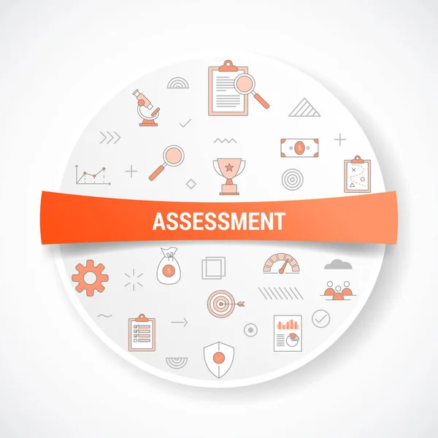
Mini Assessment / Practice Task
Task: Create a 1–2 Page Competency Framework Outline
Include:
Purpose statement
Three competency categories
Two proficiency levels
Behavioral indicators
Evidence requirements
This will form part of your Master Trainer Certification Portfolio.

Slide 114

Summary
Competency frameworks define what excellence looks like and how it is measured.
They ensure fairness, consistency, and visibility in certification programs.
Behavioral indicators make competencies observable and assessable.
Proficiency levels support trainer growth and create clear career pathways.
A well-designed framework becomes the foundation of trainer development, performance evaluation, and global-quality assurance.

Slide 115

Resources & Templates
You will receive downloadable versions of:
Competency Framework Template
Behavioral Indicators Reference Sheet
Trainer Proficiency Level Matrix
Competency Assessment Rubric (Observation + Portfolio)
Global Standards Reference Guide (ATD, ICF, CIPD, ISO 29993 aligned)

Slide 116
Module 2: Certification and Quality Assurance
Lesson 3: Assessing and Accrediting Trainers
Learning Objectives
By the end of this lesson, participants will be able to:
Critically evaluate assessment methods that ensure fairness, reliability, and global validity in trainer accreditation.
Design a multi-method trainer assessment system aligned with organizational standards.
Apply objective scoring rubrics to evaluate trainer competence across delivery, design, and professional standards.
Construct accreditation pathways that differentiate between levels of trainer expertise.
Assess and refine accreditation models to ensure continuous improvement and alignment with evolving L&D trends.

Slide 117

Surprising fact:
More than 60% of organizations rely on subjectivity—not standardized assessment—when approving trainers for delivery roles (Global L&D Benchmark 2024).
This is why accreditation often fails to guarantee quality.

Slide 118

Why This Matters
Effective trainer assessment and accreditation:
Ensures consistent learning quality across teams, regions, and delivery channels.
Protects the integrity and reputation of the training function.
Builds a scalable pipeline of competent trainers.
Strengthens trust among stakeholders, learners, and clients.
Guarantees that learning outcomes translate to improved performance (Kirkpatrick Level 3 & 4).
Without rigorous assessment, “certified” becomes meaningless—and the training function loses credibility.

Slide 119

Core Concepts
1 What is Trainer Assessment? (Simple Definition)
The systematic evaluation of a trainer’s competence using observable behaviors, artifacts, and performance evidence.
2 What is Trainer Accreditation? (Deep Definition)
A formal recognition that a trainer has demonstrated mastery of defined competencies and meets the standards required by the certifying body or organization.

Slide 120

Core Concepts
3 Principles of High-Quality Trainer Assessment
Validity – Measures what it claims to measure.
Reliability – Produces consistent results regardless of assessor.
Fairness – Free from bias and inclusive across cultures.
Transparency – Criteria are clear and accessible.
Evidential – Based on observable performance, not assumptions.
Aligned – Rooted in the competency framework and learning standards.

Slide 121

Core Concepts
4 Types of Trainer Assessment Methods
1. Direct Observation (Live or Recorded)
Measures facilitation, coaching, delivery techniques.
Levels: formative or summative.
2. Portfolio Assessment
Includes lesson plans, slide decks, evaluation reports, reflection logs.
3. Knowledge Assessments
MCQs, case-based questions, scenarios.

Slide 122

Core Concepts
4. Simulation-Based Assessments
Mock training sessions, role plays, micro-teaching.
5. Learner Impact Evidence
Feedback scores
Performance data
Engagement indicators
6. Professional Conduct Review
Ethics
Communication
Reliability
Responsiveness

Slide 123

Core Concepts
5 Accreditation Pathways
Basic Trainer Accreditation (Level 1)
Pass knowledge test
Submit basic lesson plan
Deliver a 10–15 minute micro-teach
Professional Trainer Accreditation (Level 2)
Full session observation
portfolio submission
Reflection essay
Learner feedback review

Slide 124

Core Concepts
Master Trainer Accreditation (Level 3)
Strategic project submission
Observation of multiple programs
Evidence of coaching other trainers
Demonstrated impact on business results
Panel interview with experts

Slide 125

Relevant Examples & Case Studies
Case Example: A National Public Sector Training Academy
The academy introduced a structured accreditation system:
A 3-tier certification path
Standardized rubrics
Recorded session evaluations
Results (9 months):
Trainer consistency improved by 45%
Learner satisfaction increased from 78% to 91%
Major reduction in delivery errors and content deviation

Slide 126

Practical Tools & Frameworks
1 Trainer Assessment Rubric (Sample)
Criteria (1–5 scale):
Facilitation Techniques
Content Mastery
Instructional Design Quality
Learner Engagement
Use of Adult Learning Principles
Professionalism & Ethics
Evidence of Learning Impact

Slide 127

Practical Tools & Frameworks
2 Accreditation Validation Checklist
Are all competencies linked to measurable indicators?
Are assessors trained and calibrated?
Are assessment decisions evidence-based?
Are scores documented and auditable?
Do trainers understand the accreditation criteria?

Slide 128
Practical Tools & Frameworks
3. 4-Layer Accreditation Evidence Model
Knowledge Evidence
Performance Evidence
Reflective Evidence
Impact Evidence

Slide 129

Personalized Reflection Questions
What current gaps exist in how your organization evaluates trainers?
Which evidence sources would provide the most accurate picture of trainer performance?
How can you ensure fairness and consistency across all assessors?
What accreditation levels does your organization genuinely need?

Slide 130

Application Exercise / Activity
Activity: Create a Trainer Accreditation Blueprint
Using the provided templates, participants will:
Define one accreditation level (e.g., Professional Trainer).
Identify three competencies that must be assessed.
Choose the best assessment methods for each.
Create a simple rubric with scoring descriptors.
Outline how decisions will be validated and approved.
Deliverable:
A 1-page accreditation blueprint.

Slide 131

Mini Assessment / Practice Task
Task:
Develop a two-part assessment for accrediting trainers at the Professional level.
Include:
Observation criteria
Portfolio requirements
Evidence validation method
Scoring matrix (pass/fail threshold)

Slide 132

Summary
Assessing and accrediting trainers ensures consistent, high-quality learning delivery.
Accreditation must be valid, reliable, fair, and evidence-based.
Multiple assessment methods create a holistic view of trainer competence.
Clear competency alignment is essential for credibility.
Accreditation pathways help trainers grow from basic to master-level experts.
The integrity of your entire training function depends on robust assessment and accreditation.

Slide 133

Resources & Templates
Trainer Accreditation Pathway Template
Multi-Method Assessment Checklist
Trainer Evaluation Rubric (Full Version)
Observation Guide & Scoring Sheet
Accreditation Decision Record Form
Assessors’ Calibration Toolkit
Competency-to-Evidence Mapping Worksheet

Slide 134
Module 2: Certification and Quality Assurance
Lesson 4: Ensuring Consistency and Global Standards
Learning Objectives
By the end of this lesson, participants will be able to:
Evaluate existing training and certification processes for alignment with international L&D standards.
Design global-standard quality systems that maintain consistency across delivery locations, trainers, and learning formats.
Develop monitoring and calibration mechanisms that ensure reliable assessments across cultures and contexts.
Implement continuous improvement systems that strengthen global-quality training and certification efforts.

Slide 135

"Consistency is the foundation of trust. Without it, quality becomes accidental." — Unknown
In training, inconsistency is the silent killer of credibility.

Slide 136

Why This Matters
Organizations increasingly operate across countries, cultures, and delivery channels (virtual, hybrid, face-to-face). When trainer certification and content standards vary widely:
Learners receive unequal quality.
Certification loses credibility.
Business performance becomes unpredictable.
Talent mobility and succession planning suffer.
Global clients and partners lose confidence.
Consistency and global standards protect the integrity of your learning ecosystem and enable scalability, fairness, and sustained excellence.

Slide 137

Core Concepts
1 What Are Global Standards? (Simple Definition)
Widely recognized benchmarks for quality in learning design, facilitation, and evaluation.
2 What “Consistency” Means in L&D (Deep Dive)
Consistency refers to the uniform application of standards in:
Curriculum design
Trainer evaluation
Learner experience
Assessment methods

Slide 138

Core Concepts
3 Key Global Standards for L&D
ATD (Talent Development Capability Model)
Performance improvement
Instructional design
Learning technologies
Evaluating impact
CIPD (Learning & Development Standards)
Evidence-based practice
Professional conduct
Learning ecosystems
Future-focused capability

Slide 139

Core Concepts
ICF (Coaching Standards)
Ethical guidelines
Core competencies
Professional conduct
ISO 29993 (Learning Services)
Transparency
Assessment rigor
Competence of facilitators
Consistency of delivery
Documented processes
These standards form the foundation of global-quality learning.

Slide 140

Core Concepts
4 Pillars of Consistency and Global Alignment
1. Standardized Curriculum Architecture
Structured templates
Version control
Global review cycles
2. Standardized Trainer Competency Requirements
Aligned competency framework
Multi-method assessments
Annual recertification

Slide 141

Core Concepts
3. Standardized Evaluation Framework
Kirkpatrick and ROI models
Global dashboards
Benchmarking processes
4. Assessor and Trainer Calibration
Alignment meetings
Scoring moderation
Common rubrics
5. Quality Assurance System
Internal audits
Documentation standards
Corrective action plans

Slide 142

Relevant Examples & Case Studies
Case Example: Global Retail Company Aligns Learning Across 18 Countries
Problem: Trainers delivered content inconsistently; customer service ratings varied widely by region.
Solution:
Introduced global standards
Conducted quarterly calibration
Adopted ISO 29993-aligned documentation
Standardized lesson plans and assessments

Slide 143

Relevant Examples & Case Studies
Result after 1 year:
38% improvement in training consistency
Customer satisfaction scores increased across all regions
Reduced training time for new hires by 25%

Slide 144

Practical Tools & Frameworks
1 Global Training Consistency Framework (GTCF)
Define Standards: Competencies, processes, templates
Document Expectations: SOPs, rubric guides, checklists
Train Assessors and Trainers: Calibration & certification
Monitor Performance: Dashboards, observations, feedback loops
Improve Continuously: Audits, reviews, updates

Slide 145
Practical Tools & Frameworks
2 Standardization Toolkit (What Every Master Trainer Should Use)
Global Training Delivery Checklist
Standard Lesson Plan Template
Assessment Rubric Pack
Audit and QA Monitoring Sheet
Global Evaluation Framework (Kirkpatrick aligned)
Trainer Re-accreditation Requirements

Slide 146
Practical Tools & Frameworks
3 Consistency Scorecard (Simple Version)
Score each area 1–5:
Curriculum consistency
Delivery consistency
Assessment reliability
Documentation quality
Global alignment
Trainer competence consistency

Slide 147

Personalized Reflection Questions
Which inconsistencies frequently occur in your learning environment?
What global standard(s) are currently missing from your organization’s training processes?
What would happen if your certification process were audited today?
Which quality assurance activities should you start immediately?

Slide 148

Application Exercise / Activity
Activity: Build a Global Standards Alignment Map
Participants will create a 1-page map showing:
Current organizational standards
Gaps compared to:
ATD
CIPD
ISO 29993
Internal policies
Priority actions for alignment
Deliverable: Global Standards Alignment Map (worksheet).

Slide 149

Mini Assessment / Practice Task
Task: Design a Consistency Assurance Plan
Create a 2-page plan containing:
Three standards to enforce across all trainers
Three tools you will implement to support standardization
Documentation and audit steps
Calibration schedule and method
Metrics for measuring consistency

Slide 150

Summary
Consistency builds trust, credibility, and predictable performance in learning.
Global standards (ATD, CIPD, ICF, ISO 29993) serve as benchmarks for excellence.
Standardization must cover content, facilitation, assessment, and evaluation.
Calibration ensures all trainers and assessors interpret standards the same way.
Continuous improvement keeps certification and training relevant and high-quality.
Consistency is not optional; it is the foundation of scalable, global learning excellence.

Slide 151

Resources & Templates Provided
Global Standards Alignment Map (Template)
Consistency Scorecard
ISO 29993 Implementation Checklist
Curriculum Standardization Template
Trainer Calibration Guide
Quality Assurance Audit Sheet
Global-Learning Documentation Standards

Slide 152
MODULE 3: MENTORSHIP & TALENT DEVELOPMENT
Lesson 1: Principles of Mentorship in L&D
By the end of this lesson, participants will be able to:
Analyze key mentorship principles that support trainer growth and organizational capability building.
Design structured mentorship approaches tailored to adult learners in L&D environments.
Apply coaching, feedback, and developmental strategies to accelerate trainer capability.
Evaluate the effectiveness of mentorship interactions using measurable indicators.
Develop long-term talent development plans using mentorship as a strategic lever.

Slide 153

Question:
If every trainer in your organization had a great mentor, how much faster would your learning culture mature?
Mentorship is one of the most underutilized accelerators of professional capability—yet it yields some of the highest returns on talent development.

Slide 154
Why This Matters
In L&D, mentorship is essential because:
Trainers learn best by observing, practicing, and receiving feedback.
Mentorship accelerates the development of facilitation mastery, instructional design competence, and leadership capability.
It strengthens succession pipelines and reduces dependency on external talent.
Mentored trainers show higher confidence, performance, and learner impact.
It supports psychological safety, belonging, and continuous learning—cornerstones of a strong learning culture.
Organizations that invest in mentorship experience faster skill development, higher retention, and deeper leadership strength.

Slide 155
Core Concepts
1 What Is Mentorship in L&D? A structured, supportive relationship where an experienced L&D professional guides a developing trainer to build capability, confidence, and professional identity.
2 Principles of Effective Mentorship in L&D
1. Purposeful Relationship Building
Trust, clarity, rapport, and safety.
Mentor sets an empowering tone.
2. Adult Learning Integration
Adults are self-directed.
Mentors guide, not dictate.
Learning is problem-centered and immediate.

Slide 156
Core Concepts
3. Competency-Based Development
Mentorship aligned with trainer competency frameworks.
Behavioral indicators guide growth.
4. Modeling of Best Practices
Mentors demonstrate global-standard facilitation, design, evaluation, and ethics.
5. Constructive, Timely Feedback
Feedback is specific, actionable, balanced, and future-oriented.
6. Continuous Reflection
Mentorship encourages self-awareness and personal mastery.
7. Sustainable Growth Pathways
Focus on career, professionalism, and long-term capability.

Slide 157

Practical Tools & Frameworks
1 The L&D Mentorship Blueprint (4-Stage Model)
Clarify: Set expectations, goals, competencies.
Develop: Provide guidance, modeling, resources.
Practice: Support real sessions, observe, refine.
Evaluate: Review growth, assess impact, plan next steps.

Slide 158

Practical Tools & Frameworks
2 Mentorship Session Structure Template
Warm check-in
Review previous goals
Deep-dive discussion/skill practice
Feedback and coaching
Agreement on next steps
Reflection

Slide 159
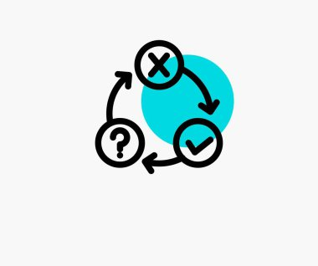
Practical Tools & Frameworks
3 Sample Mentor Feedback Framework (A.D.A.M.)
Acknowledge: Recognize strengths.
Describe: Provide objective observations.
Align: Link feedback to competencies.
Move Forward: Suggest measurable improvements.

Slide 160

Practical Tools & Frameworks
4 Mentorship Metrics (Kirkpatrick Aligned)
Level 1: Mentor and mentee satisfaction
Level 2: Improvement in knowledge/skills
Level 3: Changes in behavior and delivery quality
Level 4: Impact on learner outcomes and business KPIs

Slide 161
Personalized Reflection Questions
Who served as an informal mentor in your L&D journey—and what impact did they have?
What type of mentor do you naturally gravitate toward being (directive, supportive, strategic, reflective)?
Which L&D competencies would you most benefit from mentoring someone in—and why?
What barriers exist in your environment that prevent effective mentorship?

Slide 162

Application Exercise / Activity
Activity: Create Your Personal Mentorship Roadmap
Participants will design a 4-week mentorship plan including:
Mentee's development goals
Competency areas to focus on
Mentorship session cadence
Feedback structure
Practice opportunities
Evaluation method
Deliverable: Mentorship Roadmap (submitted as PDF or worksheet)

Slide 163

Mini Assessment / Practice Task
Task: Design a 1-page Mentorship Guide for New Mentors
Include:
Purpose and expectations
Core mentorship principles
Feedback guidelines
Recommended session flow
Tools and documentation requirements
This will be added to your Master Trainer Certification Portfolio

Slide 164
Summary
Mentorship is a powerful catalyst for developing trainer capability and leadership strength.
It is relationship-based, competency-driven, and aligned with adult learning principles.
Effective mentorship incorporates modeling, feedback, reflection, and practice.
Organizations with strong mentorship systems build more consistent, confident, and high-performing trainers.
Mentorship supports long-term talent development and strengthens learning culture maturity.

Slide 165

Resources & Templates Provided
Mentorship Blueprint (4-Stage Model)
Mentorship Session Template
Mentor Feedback Framework (A.D.A.M.)
Mentorship Roadmap Worksheet
Competency-to-Mentorship Focus Map
Mentee Development Plan Template
Mentorship Progress Tracker

Slide 166
MODULE 3: MENTORSHIP & TALENT DEVELOPMENT
LESSON 2: Identifying and Nurturing Training Talent
By the end of this lesson, participants will be able to:
Evaluate potential training talent using behavioral, instructional, and leadership indicators aligned with global L&D standards.
Design a structured talent identification pipeline tailored to their organization’s learning goals.
Develop individualized growth plans for emerging trainers based on competency and performance gaps.
Execute talent-nurturing interventions that accelerate trainer readiness and long-term capability.
Assess the impact of talent development initiatives using quantifiable metrics aligned with Kirkpatrick and ISO 29993.

Slide 167
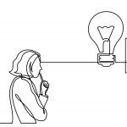
Question:
What if the greatest training talent in your organization is someone who has never facilitated a session?
Research shows that 70% of high-potential talent remains undiscovered because organizations rely on “visibility” instead of “capability indicators.”

Slide 168

Why This Matters
Strong training functions do not emerge from strong trainers — they emerge from systems that continually identify, develop, and elevate talent.
Organizations that intentionally nurture trainer pipelines experience:
3× higher internal leadership readiness
40% faster program scalability
Improved consistency in learning quality
Master Trainers must be able to spot potential early, cultivate capability intentionally, and accelerate readiness.

Slide 169

Core Concepts
A. What Training Talent Really Means
Training talent goes beyond "good presentation skills."
It includes:
Cognitive agility
Interpersonal intelligence
Instructional reasoning
Learning empathy
Facilitation adaptability
Evaluation mindset

Slide 170
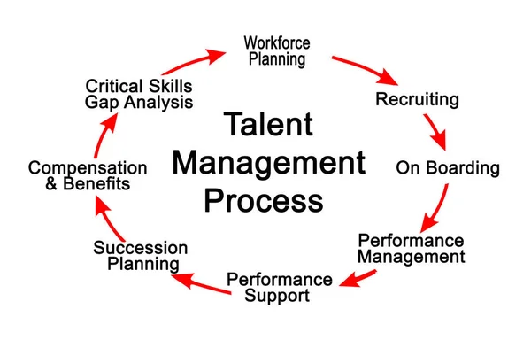
Core Concepts
B. The Talent Identification Continuum
Interest Indicators – Enthusiasm, willingness to learn, curiosity
Aptitude Indicators – Communication, analysis, empathy
Skill Indicators – Micro-teaching, feedback integration
Performance Indicators – Session outcomes, learner sentiment
Potential Indicators – Leadership, initiative, consistency

Slide 171

Core Concepts
C. Talent Nurturing Framework
Exposure – Give opportunities to observe
Practice – Provide micro-teaching and co-facilitation
Coaching – 1:1 reinforcement from Master Trainers
Stretch Assignments – Give challenges slightly above current skills
Certification Pathway – Validate competence and accelerate growth
Performance Support – Tools and templates to sustain success

Slide 172

Relevant Examples / Case Study
Case Study: Hidden Talent in Customer Support
A bank discovered a high-potential future trainer when a customer support staff member consistently produced the highest quality internal knowledge-sharing videos.
Indicators observed:
Clear communication
Ability to simplify complex processes
High peer engagement
Consistent initiative

Slide 173

Relevant Examples / Case Study
With structured mentoring and co-facilitation, she became a Lead Trainer within a year and later developed their Digital Service Skills Curriculum.
Insight: Talent often reveals itself in informal learning behaviors.

Slide 174

Practical Tools & Frameworks
Tool 1: Talent Identification Scorecard (TIS)
Rated 1–5
Communication clarity
Empathy & learner awareness
Facilitation readiness
Analytical thinking
Initiative & ownership
Adaptability
Learning orientation
Team collaboration

Slide 175

Practical Tools & Frameworks
Tool 2: The 4-Stage Talent Development Pipeline (4-TDP)
Spotting Talent
– Use scorecards, peer nominations, behavior indicators
Screening Talent
– Micro-teaching, scenario simulations
Shaping Talent
– Mentorship, coaching, applied learning
Scaling Talent
– Certification, leadership tracks, deployment into projects

Slide 176

Practical Tools & Frameworks
Tool 3: IDP for Emerging Trainers (Individual Development Plan)
Includes:
Competency baseline
Training goals
Learning activities
Coaching schedule
Practice assignments
Evaluation criteria

Slide 177
Personalized Reflection Questions
Who in your team has demonstrated informal learning behaviors that could indicate training potential?
What unconscious biases may influence your perception of “high potential”?
What systems (not individuals) determine how talent is found in your organization today?
What capability gaps exist in your current trainer pipeline?

Slide 178
Application Exercise / Activity
Activity: Talent Spotting Simulation
You will be given profiles of five fictional employees with varied strengths and weaknesses.
Your task:
Rate each person using the Talent Identification Scorecard.
Select the top two high-potential training candidates.
Develop a 30-day IDP for each candidate outlining:
  What they need to learn
  How they will learn it
  Evidence of progress

Slide 179
Mini Assessment / Practice Task
Task:
Record a three-minute talent justification pitch where you:
Select one emerging trainer
Justify why they are high potential
Identify their developmental needs
Outline the next three steps you will take to nurture them

Slide 180
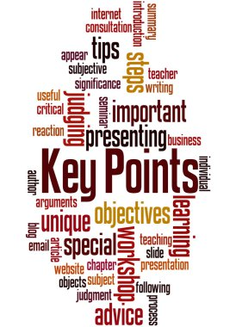
Summary
Training talent is discovered through behavior patterns, not job titles.
Talent development is a system — not an event.
Identifying and nurturing talent creates organizational continuity, stronger learning ecosystems, and future Master Trainers.
Use structured frameworks (TIS, 4-TDP, IDP) to ensure fairness, consistency, and global standards.
Master Trainers carry the responsibility of building the next generation of trainers.

Slide 181
Resources & Templates
Template 1: Talent Identification Scorecard (TIS)
Indicator | Definition | Score 1–5 | Notes
Communication | Clarity, structure, audience awareness
Learning empathy | Ability to sense learner needs
Facilitation potential | Presence, pacing, adaptability
Analytical reasoning | Ability to break down concepts
Initiative | Proactivity, creativity

Slide 182
Resources & Templates
Collaboration | Works well with teams
Growth mindset | Learns, unlearns, relearns
Reliability | Delivers consistently
Template 2: 30-Day Emerging Trainer IDP
Goal:
Strengths baseline:
Gaps identified:
Coaching sessions:
Practice tasks:
Metrics / evidence:

Slide 183

Resources & Templates
Template 3: 4-Stage Talent Development Pipeline Map
Stage 1: Spotting
Stage 2: Screening
Stage 3: Shaping
Stage 4: Scaling

Slide 184
MODULE 3: MENTORSHIP & TALENT DEVELOPMENT
LESSON 3: Creating Sustainable Learning Communities
By the end of this lesson, participants will be able to:
Evaluate the components of sustainable learning communities in diverse organizational and cultural contexts.
Design a scalable learning community ecosystem that drives continuous learning and professional development.
Integrate mentorship, collaboration, and knowledge-sharing structures into community design.
Lead community engagement using evidence-based strategies that enhance participation and long-term sustainability.
Measure community effectiveness using qualitative and quantitative metrics aligned with global L&D evaluation standards.

Slide 185

Surprising Fact:
Communities with strong learning cultures are five times more likely to retain top talent and twice as likely to innovate successfully compared to traditional training-dependent teams.
Thought-Provoking Question:
If your learning initiatives stopped today, would learning still happen in your organization — or would everything collapse without you?

Slide 186

Why This Matters
Master Trainers do not just teach — they ignite ecosystems where learning grows organically.
Sustainable learning communities create:
Continuous knowledge exchange
Strong mentorship pipelines
Enhanced problem-solving culture
Reduced reliance on formal training
Increased engagement and innovation
Organizations that build learning communities become self-renewing, ensuring that capability remains strong even during transitions or disruptions.

Slide 187

Core Concepts
A. What Is a Learning Community?
A structured, collaborative ecosystem where individuals:
Share knowledge
Solve problems together
Mentor each other
Build collective capability
It is people-driven, purpose-driven, and process-supported.

Slide 188

Core Concepts
B. Key Elements of a Sustainable Learning Community
Shared Purpose
– Collective understanding of why the community exists.
Collaborative Structures
– Peer learning, group discussions, knowledge-sharing circles.
3. Leadership & Facilitation
– Community champions, mentors, coordinators.

Slide 189

Core Concepts
4.Content Ecosystem
– Curated knowledge assets, open resources, user-generated content.
5. Engagement Loops
– Activities that keep members returning and contributing.
6. Recognition & Incentives
– Celebrating contributions, showcasing expertise.
7. Measurement & Feedback Mechanisms
– To evaluate effectiveness, experience, and impact.

Slide 190

Core Concepts
C. The 5-Pillar Sustainable Learning Community Framework (SLCF)
Used globally to build thriving, long-term learning ecosystems:
P1 – Purpose Alignment
Define the mission, goals, and value proposition.
P2 – People Engagement
Identify roles, communities of practice, champions, and peer supports.
P3 – Platforms & Processes
Select tools, platforms, rituals, and workflows that sustain learning.

Slide 191
Core Concepts
4. P4 – Participation & Practice
– Create structured opportunities for interaction, sharing, and co-creation.
5. P5 – Performance Measurement
– Use data to evaluate contribution, growth, and overall community health.
This framework aligns with ISO 29993 expectations for structured, learner-centered ecosystems.

Slide 192

Relevant Examples and Case Studies
Case Study: Global FMCG Learning Circle Network
A multinational company struggling with inconsistent capability development launched internal “Learning Circles” across 14 countries.
Within one year:
Productivity increased by 18%
Onboarding time decreased by 30%
Employee-led micro-learning grew by 200%
Communities became the primary channel for problem-solving
Insight: People learn best from people facing similar challenges — communities turn learning into a shared journey

Slide 193

Practical Tools & Frameworks
Tool 1: Community Design Blueprint Canvas (CDBC)
Sections include:
Community Vision
Target Participants
Value Proposition
Engagement Activities
Roles & Responsibilities
Tools & Platforms
Governance Structure
Success Indicators

Slide 194

Practical Tools & Frameworks
Tool 2: Engagement Loop System (ELS)
Trigger – A need or challenge
Action – Participate, share, discuss
Reward – Recognition, progress, resolution
Investment – Contribution, content creation
Return Loop – Members keep returning

Slide 195

Practical Tools & Frameworks
Tool 3: 90-Day Community Launch Plan
Month 1: Setup, recruitment, content seeding
Month 2: Community rituals, mentorship mapping
Month 3: Engagement acceleration, measurement, optimization

Slide 196

Personalized Reflection Questions
What problem in your organization could a learning community solve more effectively than traditional training?
Which groups naturally exchange knowledge — and could evolve into a formal community?
What barriers currently prevent people from engaging in shared learning?
As a Master Trainer, what role will you play in enabling the community to thrive without depending on you?

Slide 197
Application Exercise / Activity
Activity: Design Your Learning Community Prototype
Using the Community Design Blueprint Canvas, participants will:
Select a target group (e.g., new trainers, sales team, supervisors).
Define a clear purpose for their community.
Identify 3–5 key engagement rituals (e.g., weekly huddles, Q&A hours, knowledge drops).
Map the roles required.
Outline the first 30 days of community launch activities.
Participants will upload their canvas for feedback and refinement.

Slide 198
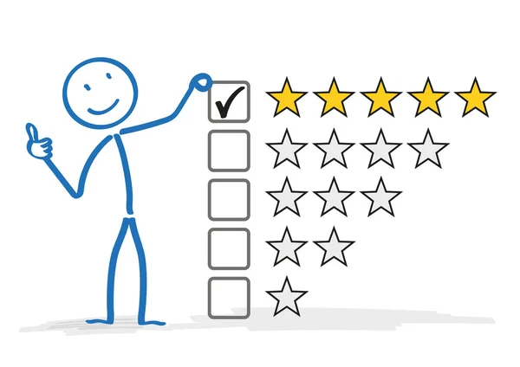
Mini Assessment / Practice Task
Task:
Create a 3-slide pitch deck to present your proposed learning community to leadership.
Your slides must include:
The problem your community will solve
The purpose and value proposition
The engagement and sustainability plan

Slide 199

Summary
Sustainable learning communities turn learning into a living, continuous ecosystem, not a one-time intervention.
Successful communities require clear purpose, engagement structures, leadership roles, and consistent rituals.
The SLCF provides a structured approach to design, launch, and sustain professional learning networks.
Communities thrive when members feel ownership, value, and connection.
Master Trainers are architects of capability — and learning communities are their most powerful long-term legacy.

Slide 200

Resources & Templates
Template 1: Community Design Blueprint Canvas (CDBC)
Community Name
Purpose Statement
Target Members
Core Activities
Roles & Responsibilities
Platforms
Governance Model
Success Metrics

Slide 201

Resources & Templates
Template 2: Engagement Ritual Checklist
Weekly knowledge share
Peer coaching session
Monthly challenge
Learning circle
Spotlight expert session
Resource drop
Member recognition

Slide 202
Resources & Templates
Template 3: 90-Day Community Launch Plan Template
Month 1 – Setup
Identify members
Launch communication
Seed core content
Month 2 – Engagement
Establish rituals
Begin peer learning cycles

Slide 203
Resources & Templates
Month 3 – Sustainability
Introduce champions
Implement measurement tools
Gather and apply feedback

Slide 204
MODULE 3: MENTORSHIP & TALENT DEVELOPMENT
LESSON 4: Empowering Trainers as Change Agents
By the end of this lesson, participants will be able to:
Analyze the role of trainers as organizational change agents and catalysts for transformation.
Design strategies to position trainers as influencers who drive behavioral, cultural, and performance change.
Develop mechanisms that build trainer confidence, authority, and credibility in change initiatives.
Implement coaching and mentorship interventions that equip trainers to lead change sustainably.
Evaluate the impact of trainers in organizational transformation using qualitative and quantitative metrics.

Slide 205
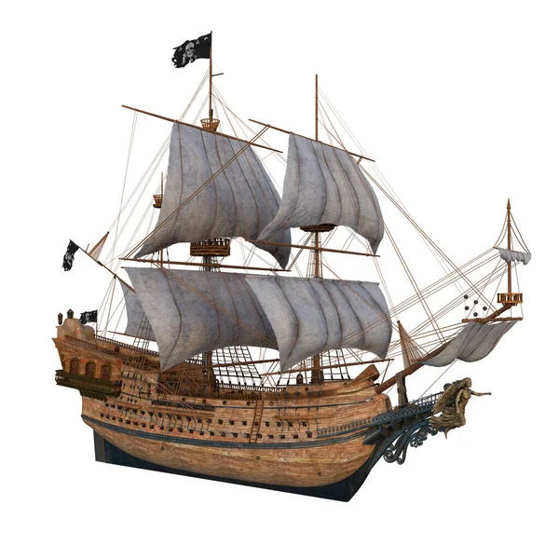
Quote:
"If you want to build a ship, don’t drum up people to collect wood; teach them to long for the vast and endless sea." — Antoine de Saint-Exupéry
Thought-Provoking Question:
How often do your trainers inspire people to desire change — rather than simply comply with it?

Slide 206
Why This Matters
Organizations today are in constant transformation — digitalization, restructuring, new market demands, AI adoption, innovation pressures.
Trainers are no longer “content deliverers”; they are the frontline influencers who:
Shape mindsets
Simplify transitions
Build confidence
Reinforce new behaviors
Reduce resistance
Accelerate adoption of new systems and processes
When nurtured effectively, trainers become the most powerful internal change agents, bridging strategy and execution.

Slide 207

Core Concepts
A. Who Is a Change Agent Trainer?
A trainer who:
Influences behavior
Improves systems adoption
Reinforces new mindsets
Bridges leadership vision and frontline reality
Models the desired ways of working
They guide people from what is familiar to what is necessary.

Slide 208

Core Concepts
B. The 4 Roles of Trainers as Change Agents
Sense-Maker
– Helps employees understand why change is happening.
Skill-Builder
– Equips people to perform new tasks confidently.
Motivator
– Reduces fear, resistance, and uncertainty.
Reinforcement Partner
– Encourages and supports new behaviors until they stick.

Slide 209

Core Concepts
C. The Change Influence Framework (CIF)
A global, behavior-centered model for empowering trainer influence:
Clarity – Communicate the purpose, vision, and benefits
Confidence – Create competence through practice and coaching
Consistency – Reinforce behaviors regularly
Culture – Shape peer learning and collective adoption
Credibility – Build trust through expertise, authenticity, and reliability

Slide 210

Core Concepts
D. The Trainer Change Readiness Model (TCRM)
Trainers must be developed across four levels:
Awareness – Understand change dynamics
Alignment – Adopt change personally
Ability – Equip others effectively
Advocacy – Lead and propel change across the organization

Slide 211

Case Study / Scenario
Case Study: Digital Transformation Rollout
A global logistics company introduced a new digital operations system. Adoption was slow and resistance was high until the internal trainers were repositioned as change agents.
What changed?
Trainers led small group Q&A sessions
Shared micro-success stories
Provided one-on-one coaching
Used the CIF framework to reinforce behaviors
Led feedback loops to leadership

Slide 212
Case Study / Scenario
Outcome:
System adoption improved by 47% in 60 days.
Employee confidence increased by 30%.
Insight: When trainers become influencers, change becomes sustainable.

Slide 213
Practical Tools & Frameworks
Tool 1: Trainer Change Agent Profile Assessment
Rate 1–5 on:
Communication clarity
Empathy
Change storytelling
Problem-solving
Facilitation adaptability
Coaching presence
Credibility
Resilience

Slide 214

Practical Tools & Frameworks
Tool 2: The Change Storytelling Template
Current Reality
B. Reason for Change
C. Vision for the Future
D. What It Means for You
E. Success Stories / Wins
F. Next Steps
Tool 3: Change Reinforcement Plan
Weekly check-ins
Micro-learning nudges
Peer learning circles
Quick wins tracking
Behavioral reinforcement scripts

Slide 215

Practical Tools & Frameworks
Tool 4: Change Coaching Questions
What concerns you the most about this change?
What strengths can you use to adapt successfully?
What early wins can you aim for?
What support do you need from me as your trainer?

Slide 216

Personalized Reflection Questions
How have you personally reacted to organizational change in the past?
Which of the four change agent roles do you naturally excel in?
What barriers prevent your trainers from becoming credible change agents?
How can you build a culture where trainers influence — not instruct?

Slide 217
Application Exercise / Activity
Activity: Change Influence Scenario Design
Participants will:
Select a real or hypothetical upcoming change in their organization.
Map out how trainers will act as change agents using the CIF framework.
Create one 2–3 minute “change story” script that trainers can use.
Develop a 14-day reinforcement plan for the change.

Slide 218
Mini Assessment / Practice Task
Task:
Record a short (2–3 minute) video where you:
Describe a change initiative
Explain how trainers will lead it
Demonstrate one change storytelling technique
Outline the next step you will take to enable adoption

Slide 219

Summary
Trainers are influencers and catalysts, not content deliverers.
Change leadership requires clarity, confidence-building, and reinforcement.
Empowered trainers accelerate transformation by shaping culture and behaviors.
Sustainable change depends on community, collaboration, and credible role models.
Master Trainers must design processes that allow trainers to lead change with competence and confidence.

Slide 220

Resources & Templates
Template 1: Trainer Change Agent Profile Assessment
Competency | Definition | Score 1–5 | Notes
Template 2: Change Story Script Template
The current situation
Why change is needed
What the future looks like
What people need to do
What success will look like

Slide 221
Resources & Templates
Template 3: 14-Day Reinforcement Plan
Day 1: Kick-off story
Day 3: Quick win showcase
Day 5: FAQ session
Day 7: Peer circle
Day 10: Skill challenge
Day 14: Celebration + evaluation

Slide 222

MODULE 4: CAPSTONE & PROFESSIONAL BRANDING
LESSON 1: Capstone Project — Design and Deliver a Train-the-Trainer Program
Learning Objectives:
By the end of this Capstone lesson, Train-the-Trainer (TTT) program.
Design a complete, end-to-end TTT intervention using globally accepted instructional design methodologies.
Develop facilitator resources, assessments, tools, and materials demonstrating advanced training leadership.

Slide 223
Learning Objectives
4. Deliver a professional-level TTT session demonstrating facilitation mastery, engagement strategies, and learner experience expertise.
3. Evaluate the TTT program using Kirkpatrick Level 1–4 metrics and propose continuous improvement recommendations.
5. Present a robust TTT portfolio that reinforces their professional brand as a globally competent Master Trainer.

Slide 224
Quote:
"The best leaders create more leaders, not followers." — Ralph Nader
Thought-Provoking Question:
If someone replicated your training style tomorrow, would they produce excellence — or simply copy techniques without mastery?
This Capstone ensures you produce trainers who train with your level of excellence.

Slide 225

Why This Matters
Organizations need internal trainers who are:
Competent
Confident
Consistent
Aligned with business expectations
Able to scale organizational learning rapidly

Slide 226

Why This Matters
Designing a Train-the-Trainer program is the ultimate test of Master Trainer capability.
It proves you can:
Lead learning
Develop others
Build systems
Drive capability maturity
Multiply organizational impact
This Capstone project becomes your signature professional artifact, strengthening your global brand.

Slide 227

Core Concepts
A. What Makes a World-Class TTT Program?
A high-performing TTT program includes:
Role clarity — What trainers must be, do, and deliver
Robust content — Methods, models, facilitation, adult learning
Practice-based learning — Rehearsals, simulations, micro-teaching
Standards & certification criteria
Coaching and assessment
Tools trainers will use daily in the job
Sustainability mechanisms — Communities, mentoring, competency tracking

Slide 228

Core Concepts
B. Minimum Components of a Complete TTT Program (ISO 29993 Compliant)
Program Overview and Rationale
Trainer Competency Framework
Curriculum Mapping (Modules, Lessons, Outcomes)
Learning Experience Architecture
Facilitator Guide
Learner Workbook
Assessment Framework
Certification Rubric
Delivery Plan (Virtual / Hybrid / In-person)
Post-Training Reinforcement Plan

Slide 229
Core Concepts
C. ADDIE & SAM Integration for the Capstone
Analysis
– Identify the target trainer audience
– Understand performance gaps
Design
– Create curriculum map, objectives, assessment strategy
Develop
– Build facilitator guides, slides, job aids, templates

Slide 230

Core Concepts
Implement
– Deliver a pilot micro-session
Evaluate
– Use Kirkpatrick Levels 1–4
Using SAM, participants iterate quickly:
Prototype the idea
Test with peers
Refine

Slide 231
Core Concepts
D. Kolb’s Experiential Learning in TTT Programs
Each module should follow:
Experience
Reflection
Conceptualization
Application

Slide 232
Examples & Case Studies
Example 1: Corporate TTT for Manufacturing Company
Problem: inconsistent on-the-job training
Solution: competency-based TTT
Outcome: 22% reduction in onboarding defects, 18% safety improvement
Example 2: Government Agency TTT
Problem: outdated training delivery practices
Solution: digital TTT + coaching
Outcome: 64% efficiency improvement, faster training cycles

Slide 233
Examples & Case Studies
Example 3: NGO Community TTT
Problem: volunteers lacked facilitation skills
Solution: interactive TTT with micro-teaching
Outcome: 40 new trainers deployed across 3 regions

Slide 234

Practical Tools & Frameworks
Tool 1: TTT Curriculum Mapping Template
Sections:
Module Title
Learning Objectives
Evidence of Learning (Assessment)
Methods & Modalities
Required Materials
Duration

Slide 235

Practical Tools & Frameworks
Tool 2: Trainer Competency Rubric
Measures:
Facilitation
Instructional Design
Engagement Strategy
Coaching Ability
Assessment Capability
Professionalism and Presence

Slide 236

Practical Tools & Frameworks
Tool 3: Micro-Teaching Planning Sheet
Topic
Objectives
Delivery strategy
Time allocation
Engagement technique
Evaluation mechanism

Slide 237

Practical Tools & Frameworks
Tool 4: TTT Delivery Toolkit
Icebreakers
Adult learning techniques
Discussion frameworks
Role-play templates
Feedback cards
Session observation form

Slide 238

Personalized Reflection Questions
What type of trainer do you want your participants to become after your TTT?
What signature element of your own training style must be embedded into your program?
What gaps or challenges are common among trainers in your industry?
How will you ensure your TTT results in long-term behavior change?

Slide 239

Application Exercise / Activity
Part 2: Develop (Upload Required)
Build slides for one module
Prepare two tools/job aids
Develop a micro-teaching script
Part 3: Deliver (Recorded Video)
Deliver a 10-minute micro-teaching session to demonstrate mastery.
Part 4: Evaluate
Use Kirkpatrick Levels 1–4 to evaluate your own performance.

Slide 240
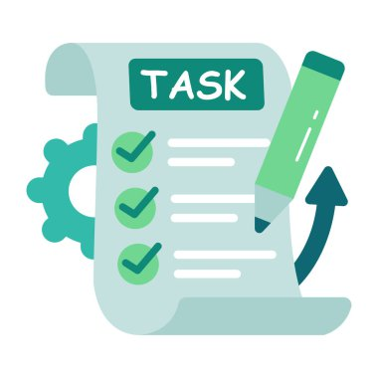
Mini Assessment / Practice Task
Task:
Upload a 3–5 page TTT Program Overview Document that includes:
Program purpose
Audience profile
Three learning outcomes
Curriculum overview
Assessment strategy
Certification requirements
This forms the foundation of your final Capstone submission.

Slide 241

Summary
Designing and delivering a TTT program is the highest demonstration of Master Trainer capability.
A world-class TTT requires alignment with ADDIE, adult learning principles, and competency-based standards.
Trainers must be given tools, practice opportunities, coaching, and clear standards for success.
This Capstone project builds your global professional brand, demonstrating your expertise as a training architect, strategist, and facilitator.
Your completed TTT program becomes a powerful portfolio asset for global career positioning.

Slide 242

Resources & Templates
Template 1: TTT Curriculum Mapping Sheet
Template 2: Trainer Competency Rubric
Template 3: Micro-Teaching Planning Sheet
Template 4: TTT Assessment & Certification Framework
Template 5: TTT Deliverables Checklist
Template 6: Peer Review Feedback Form

Slide 243

MODULE 4: CAPSTONE & PROFESSIONAL BRANDING
Lesson 2: Peer Review and Masterclass Demonstration
Learning Objectives
By the end of this lesson, participants will be able to:
Evaluate training deliveries using global-standard peer review and accreditation criteria.
Synthesize feedback from peers, mentors, and self-assessments to improve instructional mastery.
Demonstrate advanced facilitation, coaching, and audience engagement competencies in a live or recorded Masterclass.

Slide 244
Learning Objectives
4. Critique learning sessions using evidence-based quality frameworks aligned with ATD, CIPD, ICF coaching competencies, and ISO 29993 standards.
5. Construct a continuous performance improvement plan based on peer review insights and observed delivery strengths and gaps.

Slide 245

Question:
“If the world were to evaluate your training delivery today, what invisible habits would be revealed—excellence, or blind spots you didn’t know existed?”
This lesson helps you uncover those blind spots before the world does.

Slide 246
Why This Matters
Leading trainers must be able not only to teach but to evaluate, certify, and elevate others.
Peer review and masterclass demonstration are global standards for Master Trainer accreditation because they:
Build credibility as a globally competent facilitator.
Strengthen self-awareness and reflective capability.
Ensure quality assurance in L&D ecosystems.
Enhance your ability to guide and certify future trainers.
Demonstrate professional maturity, confidence, and leadership presence.
Master Trainers who excel in peer review processes become trusted evaluators, mentors, and program directors.

Slide 247

Core Concepts
A. Peer Review in L&D
A structured, evidence-based evaluation of a trainer’s performance by other qualified trainers.
Key Dimensions:
Instructional effectiveness
Facilitation mastery
Coaching and learner support
Engagement techniques
Content alignment and design quality
Assessment and evaluation practice
Professional presence

Slide 248

Core Concepts
B. Masterclass Demonstration
A masterclass is a high-level, polished demonstration of training expertise showcasing:
Command of content
Adult learning integration
Adaptability
Coaching and facilitation excellence
Real-world relevance
Learning impact
This is the “public evidence” of your readiness to hold the Master Trainer title.

Slide 249

Core Concepts
C. Evidence-Based Evaluation Frameworks
Kirkpatrick Levels
  Reaction → Learning → Behavior → Results
  Used to assess training impact and improvement potential.
ISO 29993
  Quality of learning delivery
  Learner satisfaction
  Learning outcomes and relevance
  Transparency of evaluation

Slide 250
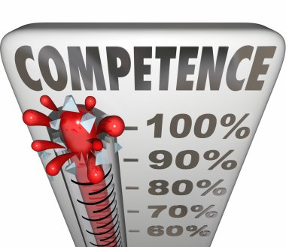
Core Concepts
3. ICF Coaching Competencies
  Active listening
  Powerful questioning
  Presence and emotional intelligence
  Partnership creation
4. Competency Anchors for Trainer Excellence
  Content mastery
  Facilitation agility
  Engagement expertise
  Assessment literacy
  Learner empathy
  Ethical practice
  Strategic alignment

Slide 251

Examples and Case Scenarios
Example 1: Strong Masterclass Delivery
A trainer opens with a story that captures attention, uses visual aids effectively, incorporates learner-driven discussions, checks for understanding, and ends with a practical framework learners can apply immediately.

Slide 252
Examples and Case Scenarios
Example 2: Weak Masterclass Delivery
A trainer spends 80% of the session lecturing, uses difficult jargon, does not verify learning, and rushes through the final content without practical tools.
Scenario: Peer Review Challenge
A peer delivers excellent content but fails in time management and ends late.
Your task: Provide constructive feedback using global standards.

Slide 253

Practical Tools & Frameworks
A. Peer Review Rubric (Global Standards – Excerpt)
Criteria rated 1–5
Learning Need Alignment
Clarity of Outcomes
Facilitation Mastery
Engagement Techniques
Assessment Effectiveness
Coaching/Feedback Skills
Learning Transfer Strategy
Professionalism & Presence
Inclusion & Accessibility
Evidence of Impact

Slide 254
Practical Tools & Frameworks
B. The 4R Feedback Framework
Recognize – Acknowledge strengths
Reflect – Highlight observed patterns
Recommend – Provide actionable strategies
Reaffirm – Restate potential and capability

Slide 255
Practical Tools & Frameworks
C. Masterclass Structure Template
Powerful opening
Clear objectives
Experiential activity
Concept explanation
Tools/framework
Application exercise
Knowledge check
Closing impact message

Slide 256
Practical Tools & Frameworks
D. Self-Review Checklist
Did I create engagement?
Did I demonstrate mastery of adult learning?
Was the learning outcome achieved?
Did participants leave empowered?

Slide 257

Personalized Reflection Questions
What part of your delivery style consistently earns praise?
What feedback patterns tend to repeat across different reviewers?
Which facilitation competencies do you want to be known for globally?
How comfortable are you giving and receiving evidence-based feedback?
What will your signature Masterclass topic be? Why?

Slide 258

Application Exercise / Activity
Activity: Conduct and Evaluate a Micro-Masterclass
Record a 15–20 minute Masterclass on a topic of your expertise.
Submit it to two peers and one mentor.
Evaluate their sessions using the global peer review rubric.
Compare your feedback with theirs.
Identify at least three improvement actions.

Slide 259
Application Exercise / Activity
Deliverables:
Masterclass video
Peer Review reports
Self-reflection summary

Slide 260

Mini Assessment / Practice Task
Task: Create a Peer Review Feedback Report
Using the 4R Framework, produce a one-page feedback report for a peer based on their training video.
Must include:
Evidence-based observations
Constructive recommendations
Alignment to learning outcomes
Next-step improvement plan

Slide 261

Summary
Peer review is a cornerstone of global Master Trainer excellence.
Masterclass demonstration validates your professional capability to train, coach, and inspire.
Evidence-based evaluation frameworks ensure quality, consistency, and credibility.
Feedback is a growth accelerant when it is structured, objective, and actionable.
Continuous improvement is a required mindset for certified Master Trainers.

Slide 262

Resources & Templates
Included Templates:
Masterclass Structure Template
Global Trainer Peer Review Rubric (ISO-Aligned)
4R Feedback Template
Master Trainer Self-Review Checklist
Peer Review Summary Sheet
Masterclass Preparation Guide
Trainer Competency Observation Sheet

Slide 263

MODULE 4: CAPSTONE & PROFESSIONAL BRANDING
Lesson 3: Building Your Global Trainer Brand
Learning Objectives
By the end of this lesson, participants will be able to:
Evaluate their current professional identity against global training and facilitation standards.
Design a compelling global trainer brand that communicates expertise, credibility, and unique value.
Synthesize elements of thought leadership, credibility assets, and digital presence to position themselves internationally.

Slide 264

Learning Objectives
4. Construct a globally relevant portfolio showcasing facilitation mastery, L&D leadership, and measurable learning impact.
5. Develop a long-term strategic branding plan that aligns with their Master Trainer goals and market opportunities.

Slide 265

Quote:
“Your brand is what people say about you when you’re not in the room.” — Jeff Bezos
As a Master Trainer, your brand is not your logo or job title.
It is your influence, your impact, and your promise to the world.

Slide 266

Why This Matters
Top-tier Master Trainers are recognized globally not only for what they know but for the brand they project.
A strong global trainer brand:
Opens doors to international speaking engagements.
Positions you as a thought leader in L&D.
Attracts partnerships, consulting opportunities, and corporate contracts.

Slide 267

Why This Matters
Builds trust and credibility with senior stakeholders.
Enables you to influence industries, not just classrooms.
Without a strong brand, even the most skilled trainers remain invisible.
With the right brand, your expertise becomes magnetic.

Slide 268

Core Concepts
A. What Is a Global Trainer Brand?
Your professional identity expressed through:
Your values
Your expertise
Your story
Your credibility assets
Your learner impact
The experience you deliver
Your digital visibility and thought leadership

Slide 269

Core Concepts
B. The 7 Pillars of a Global Trainer Brand
1. Signature Expertise
The unique area you are known for globally (e.g., leadership development, change management, facilitation mastery).
2. Credibility Assets
Certifications (ATD, CIPD, ICF), awards, testimonials, results, case studies.
3. Thought Leadership
Articles, videos, podcasts, short insights, frameworks, models

Slide 270
Core Concepts
4. Digital Visibility
LinkedIn, website, content strategy, professional photos, optimized bio.
5. Professional Portfolio
Your evidence base: sample courses, facilitation videos, curriculum designs, results.
6. Global Network & Community
Your collaboration footprint: conferences, associations, masterminds, networks.
7. Consistency & Presence
Your tone, communication style, reliability, integrity, and professionalism.

Slide 271

Core Concepts
C. Brand Positioning for Master Trainers
Positioning answers:
Who you serve
The problem you solve
The transformation you create
Why your approach is unique
Your global value proposition

Slide 272

Core Concepts
D. ISO 29993 and Global Brand Alignment
ISO emphasizes:
Transparency
Evidence of learning impact
Professional competence
Learner-centered value
Your global brand must reflect these elements.

Slide 273

Examples, Case Studies & Scenarios
Example 1: Strong Global Trainer Brand
A trainer consistently publishes actionable insights, features testimonials from multinational clients, maintains a professional LinkedIn presence, and has a clear signature program recognized across industries.
Example 2: Weak Global Trainer Brand
A trainer relies only on word-of-mouth, lacks a digital footprint, has inconsistent messaging, and cannot articulate their specialty.

Slide 274

Examples, Case Studies & Scenarios
Scenario: Brand Positioning Challenge
A trainer with diverse skills cannot decide on their core niche.
Solution: Analyze strengths, passion, market relevance, and measurable results to craft a narrow but powerful niche.

Slide 275

Practical Tools & Frameworks
A. The Global Trainer Branding Canvas
Vision Statement
Signature Expertise
Target Audience
Transformation Promise
Signature Framework
Proof of Competence
Thought Leadership Strategy
Digital Platforms Plan
Global Network Strategy
Long-Term Brand Roadmap

Slide 276

Practical Tools & Frameworks
B. Signature Statement Formula
“I help [audience] achieve [transformation] through [method/expertise] so they can [ultimate value].”
C. Content Strategy Model: The 3E System
Educate – share tools, frameworks, insights
Engage – ask questions, build conversations
Establish Authority – share results, testimonials, case studies

Slide 277

Practical Tools & Frameworks
D. Portfolio Structure Template
Bio and Professional Profile
Certifications & Qualifications
Signature Programs
Facilitation Videos
Curriculum Samples
Testimonials & Impact Stories
Case Studies
Contact & Booking Information

Slide 278

Personalized Reflection Questions
What do I want to be known for globally?
What makes my approach distinct, memorable, or superior?
Which audiences energize me the most?
What do my best clients consistently praise about me?
What evidence of impact do I currently have?
What are the gaps between where I am and where I want my brand to be?

Slide 279

Application Exercise / Activity
Activity: Build Your Global Trainer Brand Blueprint
Create a one-page strategy document that includes:
Your signature expertise
Your global value proposition
Your transformation promise
Three credibility proof points
Your thought leadership content themes
Your top two digital platforms
One global networking goal
One brand asset you will create this month (bio, website, signature video, etc.)

Slide 280

Mini Assessment / Practice Task
Task: Develop a Signature Trainer Brand Statement
Using the signature statement formula, craft a concise, globally relevant brand identity message.
Example:
“I help organizations build high-performance learning cultures through evidence-based training systems so they can accelerate capability, innovation, and results.”
Your submission must include:
Signature expertise
Transformation promise
Unique method or approach

Slide 281

Summary
A global trainer brand is your identity, influence, and professional promise.
Thought leadership, credibility assets, and digital visibility are essential for global recognition.
A strong brand communicates clarity, authority, and measurable impact.
Consistency builds trust; trust builds opportunity.
As a Master Trainer, your brand is both your legacy and your leverage.

Slide 282

Resources & Templates
Included Templates:
Global Trainer Branding Canvas
Signature Value Proposition Template
3E Content Strategy Sheet
Trainer Portfolio Outline
Signature Expertise Identification Worksheet
Global Brand Roadmap Template
Thought Leadership Topic Generator

Slide 283

MODULE 4: CAPSTONE & PROFESSIONAL BRANDING
LESSON 4: Continuing Professional Development (CPD) and Lifelong Learning
Learning Objectives
By the end of this lesson, participants will be able to:
Evaluate personal and professional growth gaps using global CPD frameworks.
Design a structured CPD plan aligned with current and emerging L&D industry competencies.
Integrate lifelong learning practices that enhance relevance, agility, and global competitiveness.

Slide 284

Learning Objectives
4. Critically reflect on learning experiences to identify patterns, strengths, and future development pathways.
5. Construct a sustainable learning ecosystem that supports ongoing mastery as a global L&D leader.

Slide 285

Question:
“If your knowledge today expired in five years, what would you begin learning now to stay globally relevant?”
The L&D profession evolves faster than most imagine. Lifelong learning is not optional—it is the Master Trainer’s currency.

Slide 286

Why This Matters
Master Trainers who remain relevant and in-demand commit to deliberate, structured, evidence-based professional development.
CPD is essential because it:
Protects your credibility as a trainer and facilitator.
Ensures compliance with global standards (ATD, CIPD, ICF, ISO 29993).
Enables you to lead L&D transformation with current knowledge.

Slide 287

Why This Matters
Strengthens employability, global mobility, and consulting value.
Enhances innovation, creativity, and instructional excellence.
Models lifelong learning for the trainers you mentor.
A Master Trainer who stops learning becomes obsolete.
A Master Trainer who commits to CPD becomes irreplaceable.

Slide 288

Core Concepts
A. What Is CPD?
A structured approach to maintaining, enhancing, and validating professional competence.
Types of CPD:
Formal (courses, certifications)
Informal (peer learning, coaching, research)
Experiential (projects, facilitation, conferences)
Self-directed (reading, reflection, practice)

Slide 289

Core Concepts
B .CPD Requirements for Global Trainers
Most global bodies expect:
Evidence of continuous learning
Reflection on impact
Application to professional practice
Documentation and tracking
Alignment with competency frameworks

Slide 290
Core Concepts
C. The Lifelong Learning Mindset
A lifelong learner is:
Curious
Adaptive
Self-directed
Evidence-informed
Reflective
Open to innovation
For Master Trainers, this mindset is a leadership requirement.

Slide 291

Core Concepts
D. 5 Dimensions of Professional Growth for Master Trainers
Knowledge Development (L&D trends, methodologies)
Skill Mastery (facilitation, coaching, design)
Industry Awareness (technology, business strategy)
Global Engagement (conferences, networks, collaborations)
Personal Effectiveness (emotional intelligence, communication, wellbeing)

Slide 292

Core Concepts
CPD Alignment With ISO 29993
ISO mandates clarity, transparency, and evidence of improvement.
Therefore, your CPD must be:
Planned
Documented
Measurable
Applied
Reviewed

Slide 293

Examples, Case Studies & Scenarios
Example 1: High-Impact CPD Practice
A trainer attends an ATD conference, documents key insights, applies two new facilitation strategies to a client workshop, and reports observable improvements in learner engagement.
Example 2: Low-Impact CPD Practice
A trainer collects certificates but never applies new knowledge to practice.

Slide 294

Examples, Case Studies & Scenarios
Scenario: Industry Disruption
An organization shifts from classroom to virtual delivery.
A Master Trainer with strong CPD practices adapts effortlessly.
A trainer without CPD struggles, loses relevance, and falls behind.

Slide 295

Practical Tools and Frameworks
A. Annual CPD Planning Framework
Identify competency gaps
Set professional development goals
Choose CPD activities
Allocate time and budget
Apply learning
Record evidence
Reflect and evaluate
Re-adjust and continue

Slide 296

Practical Tools and Frameworks
B. CPD Evidence Categories
Evidence may include:
Course certificates
Reflective journals
Project reports
Peer feedback
Coaching logs
Articles written
Frameworks developed
Impact stories

Slide 297
Practical Tools and Frameworks
C. Master Trainer CPD Matrix (Sample)
Area | Activities | Evidence | Impact
Facilitation | Masterclass training | Video + Feedback | Improved learner engagement
Design Skills | ID certification | Portfolio updates | Higher-quality courses
Thought Leadership | Published articles | Online presence metrics | Expanded influence

Slide 298

Practical Tools and Frameworks
D. The Continuous Growth Cycle (Kolb Integration)
Experience – Learn something new
Reflect – What did it mean?
Conceptualize – How does this connect to my role?
Apply – Implement in real-world practice

Slide 299
Personalized Reflection Questions
What areas of my expertise are strongest—and which are outdated?
What global trends in L&D excite me the most?
What do I want my professional relevance to look like in 5 years?
How consistently do I document my learning?
Which mentors, communities, or networks will accelerate my growth?

Slide 300

Application Exercise / Activity
Activity: Build Your 12-Month CPD Roadmap
Create a structured CPD plan with:
Three professional development goals
Competencies you aim to enhance
Planned CPD activities (courses, books, networks, coaching)
Expected impact
Evidence you will collect
Timeline and budget
Review points (quarterly)
Deliverable: 12-Month CPD Roadmap Document

Slide 301

Mini Assessment / Practice Task
Task: Create an Evidence-Based CPD Report (One Page)
Your report must include:
A CPD activity completed in the last 30 days
Key insights gained
Evidence attached (or described)
How it improved your facilitation or design practice
One action you will take next

Slide 302

Summary
CPD and lifelong learning define the career longevity of Master Trainers.
Sustainable professional growth requires intentional planning, documentation, and application.
Global relevance comes from continuously expanding competence and industry awareness.
Lifelong learning is not an event; it is your identity as a Master Trainer.
Your growth fuels the growth of every trainer you mentor or certify.

Slide 303

Resources & Templates
Included Templates:
Annual CPD Planning Framework
CPD Tracking Sheet
CPD Evidence Log Template
Master Trainer Competency Gap Analysis Tool
Continuous Growth Cycle Worksheet
CPD Reflection Journal Template
Lifelong Learning Action Plan

Slide 304
THANK YOU

