Slide 1


MASTER TRAINER CERTIFICATION COURSE
Become a Globally Recognized Master Trainer
Dr. Toyin Sam-Emehelu
(FPMC, FIMC, FPACA, CPLP)
www.drtoyinsamemehelu@gmail.com

Slide 2
Course Overview
The Master Trainer Certification Program is a world-class, multi-level professional development journey designed to elevate trainers, facilitators, educators, coaches, and L&D practitioners into globally recognized Master Trainers.
This transformative program blends evidence-based instructional design, adult learning science, and real-world training mastery to equip you with the skills, tools, and credibility to design, deliver, coach, certify, and lead training at an expert level.
Through a personalized self-paced learning experience, you will progress from foundational training principles to advanced Master Trainer competencies, developing the ability to multiply impact by elevating other trainers and shaping learning cultures across industries.

Slide 3
Course Overview
The course is structured into three progressive levels—Beginner, Intermediate, and Advanced—each containing four comprehensive modules with micro-lessons, practice activities, templates, and assessments designed around internationally recognized standards (ATD, CIPD, ICF, Kirkpatrick, ADDIE, ISO 29993).
By the end of this program, you will not only be a highly skilled trainer—you will be a leader and influencer in the global Learning and Development landscape, capable of building training ecosystems, certifying trainers, and driving organizational learning transformation.

Slide 4

Course Introduction
Welcome to your Master Trainer journey.
This course is more than a training program—
it is a professional transformation designed to unlock your highest potential as a training leader.
You will learn not only how to train, but why great training works, and how to replicate excellence across teams, organizations, and communities.

Slide 5
Course Introduction
Welcome to your Master Trainer journey.
You will discover how to:
Design training that inspires real behavior change
Deliver sessions with confidence, clarity, and presence
Coach trainers to reach their full potential
Build certification systems and quality standards
Lead and influence learning at a strategic level
Throughout the course, you will apply each concept to your own context, building a personalized toolkit you can use immediately in real-world training environments.
This program follows a “known → unknown → mastery” learning pathway—honoring your existing experience, expanding your capabilities, and guiding you toward advanced trainer leadership.

Slide 6

What Makes This Program World-Class?
Aligned with Global Standards
Every module aligns with global L&D frameworks, including:
ATD Talent Development Framework
CIPD Professional Standards
ICF Coaching Competencies
Kirkpatrick Evaluation
ADDIE/SAM Instructional Design Models
ISO 29993 Learning Service Requirements

Slide 7

What Makes This Program World-Class?
Competency-Based, Practice-Focused
You will practice real skills through:
Micro-teaching
Design projects
Trainer coaching
Evaluation exercises
Capstone delivery
Personalized & Self-Paced
Adaptive reflection, downloadable templates, and real-world scenarios allow you to learn at your own speed while building a portfolio that reflects your unique style as a trainer.

Slide 8

Who This Course Is For?
This course is designed for:
Trainers & facilitators
Teachers & educators
Learning & Development professionals
Corporate training managers
Coaches and consultants
Anyone seeking global Master Trainer status
Whether you are just beginning or already facilitating programs, this certification meets you where you are and elevates you to mastery.

Slide 9

Your Learning Journey at a Glance
Level 1 – Beginner: Foundations of Training Excellence
Learn the fundamentals of adult learning, instructional design, facilitation, and training evaluation.
Level 2 – Intermediate: Trainer Development & Performance Excellence
Strengthen advanced design, delivery, coaching, and evaluation capabilities.
Level 3 – Advanced: Master Trainer Leadership & Certification
Build strategic influence, design certification systems, mentor trainers, and complete your capstone.

Slide 10

Your Transformation
By the end of this program, you will:
Be a Certified Master Trainer equipped with global-level competencies
Able to train, evaluate, mentor, and certify other trainers
Confident in leading learning strategies within organizations
Recognized as a thought leader in the L&D profession
Possess a full professional portfolio showcasing your mastery

Slide 11
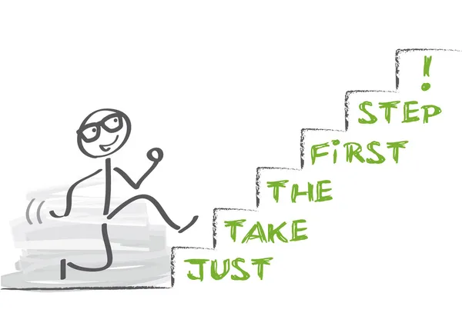
Welcome to the Journey of Mastery
You are about to join a global community of training professionals committed to excellence, transformation, and lifelong learning.
Prepare to:
Learn deeply. Practice boldly. Lead confidently.
Your journey to becoming a Global Master Trainer starts now

Slide 12
Master Trainer Certification Course
Course Structure:
Levels: 3 (Beginner → Intermediate → Advanced)
Modules per Level: 4
Lessons per Module: 4
Delivery: Blended (Live Virtual Sessions, and Self-paced)
Assessment: Practical demonstrations, peer evaluation, and final capstone project

Slide 13

LEVEL 1: Beginner – Foundations of Training Mastery
Goal: Build a strong foundation in training design, delivery, and facilitation essentials.

Slide 14

Module 1: Understanding the Training Profession
The Role of a Trainer vs. Master Trainer
The Learning & Development Ecosystem
Core Ethics and Professional Standards
The Learning Cycle and How Adults Learn

Slide 15
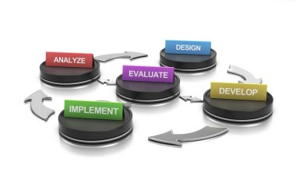
Module 2: Foundations of Instructional Design
Introduction to ADDIE & SAM Models
Conducting Training Needs Analysis (TNA)
Setting SMART Learning Objectives
Structuring Effective Lesson Plans

Slide 16

Module 3: Training Delivery Essentials
Facilitation vs. Presentation Skills
Engaging Adult Learners
Managing Group Dynamics
Handling Questions & Difficult Participants

Slide 17

Module 4: Assessment & Evaluation Basics
Kirkpatrick’s Four Levels of Evaluation
Designing Simple Learning Assessments
Gathering Feedback for Improvement
Using Reflection for Trainer Growth

Slide 18
LEVEL 2: Intermediate – Trainer Development & Performance Excellence
Goal: Equip trainers to design impactful programs and coach others effectively.

Slide 19

Module 1: Advanced Instructional Design
Storyboarding and Sequencing Content
Designing for Blended & E-Learning Environments
Using Case Studies, Role-Plays & Simulations
Applying Learning Science & Behavioral Models

Slide 20

Module 2: Coaching and Developing Trainers
The Trainer-Coach Mindset
Observing and Assessing Training Sessions
Delivering Constructive Feedback
Building Trainer Confidence and Competence

Slide 21

Module 3: Communication & Facilitation Mastery
Advanced Facilitation Techniques
Storytelling and Experiential Learning
Managing Emotions and Energy in the Room
Cross-Cultural Communication Skills

Slide 22

Module 4: Measuring Training Impact
Designing Evaluation Tools and Metrics
ROI of Learning & Performance Outcomes
Linking Training to Business Results
Data-Driven Decision-Making in L&D

Slide 23

LEVEL 3: Advanced – Master Trainer Leadership & Certification
Goal: Empower participants to lead L&D initiatives, certify trainers, and maintain global standards.

Slide 24

Module 1: Strategic Leadership in Learning
The Evolving Role of a Master Trainer
Building a Learning Culture in Organizations
Leading Learning Teams and Networks
Aligning Learning Strategy with Business Goals

Slide 25

Module 2: Certification and Quality Assurance
Designing Trainer Certification Programs
Developing Competency Frameworks
Assessing and Accrediting Trainers
Ensuring Consistency and Global Standards

Slide 26

Module 3: Mentorship and Talent Development
Principles of Mentorship in L&D
Identifying and Nurturing Training Talent
Creating Sustainable Learning Communities
Empowering Trainers as Change Agents

Slide 27
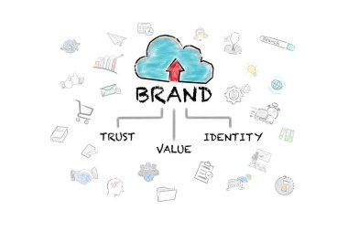
Module 4: Capstone & Professional Branding
Capstone Project: Design and Deliver a Train-the-Trainer Program
Peer Review and Masterclass Demonstration
Building Your Global Trainer Brand
Continuing Professional Development (CPD) and Lifelong Learning

Slide 28
Program Outcomes
By completing all three levels, participants will:
Earn a Master Trainer Certification recognized by international L&D standards.
Be able to design, deliver, and evaluate training at an expert level.
Be qualified to train, certify, and mentor other trainers.
Lead strategic learning initiatives in any organization or training ecosystem.

Slide 29
MODULE 1: UNDERSTANDING THE TRAINING PROFESSION
Lesson 1: The Role of a Trainer vs. Master Trainer
🎯 Learning Objectives
By the end of this lesson, participants will be able to:
Differentiate clearly between the role, responsibilities, and competencies of a Trainer and a Master Trainer.
Analyze real training scenarios to determine the level of expertise required.
Evaluate personal strengths and growth areas against global Master Trainer standards.
Synthesize insights to begin shaping their professional identity as a future Master Trainer

Slide 30

Introduction
“If every trainer can teach, what makes only a few trainers capable of transforming people who then transform others?”
Pause and reflect: This single question separates a Trainer from a Master Trainer.

Slide 31
Why This Matters
In today’s global learning environment, organizations don’t just need trainers who deliver content—they need Master Trainers who multiply impact. These are professionals who:
Train trainers
Maintain learning quality
Influence organizational capability
Build sustainable L&D ecosystems
Create standards, frameworks, and learning strategies
Understanding the distinction is the first step to positioning yourself as a globally recognized Master Trainer with the power to shape learning cultures—not just classrooms.

Slide 32

Who Is a Trainer?
A Trainer delivers learning experiences that help participants acquire specific skills, knowledge, and behaviors.
Trainer Core Functions:
Content delivery
Facilitation
Guiding discussions
Demonstrating skills
Ensuring learning outcomes
Basic evaluation

Slide 33

Who Is a Master Trainer?
A Master Trainer goes beyond delivering training. They develop trainers, ensure quality, design systems, and lead learning strategy.

Slide 34

Deep Dive: Key Distinctions
A. Scope of Influence
Trainer: Impacts individuals
Master Trainer: Impacts trainers, teams, and organizational systems
B. Competencies
Trainer: Facilitation, communication, content knowledge
Master Trainer: Instructional design, coaching, mentoring, evaluation, strategic L&D leadership

Slide 35

Deep Dive: Key Distinctions
C. Quality Assurance
Trainer: Follows standards
Master Trainer: Creates, maintains, and enforces standards
D. Capability Multiplication
Trainer: Transfers knowledge
Master Trainer: Builds knowledge ecosystems

Slide 36

Deep Dive: Key Distinctions
E. Professional Identity
Trainer: “I teach.”
Master Trainer: “I develop people who teach.”
A company rolls out a new technology. Trainers are required to teach employees how to use it.
Trainer role: Deliver workshops, answer questions, demonstrate skills.
Master Trainer role: Prepare trainers with a complete teacher’s guide, run TTT sessions, observe their practice, provide feedback, and ensure training consistency across teams.

Slide 37

Scenario 2: Quality Issues
Learners report inconsistent experiences across different trainers.
Trainer role: Improve their individual delivery.
Master Trainer role: Evaluate all trainers, redesign the program, build a quality framework, and implement standards.

Slide 38

Scenario 3: Organizational Expansion
A company wants to scale training across five countries.
Trainer: Delivers sessions.
Master Trainer: Builds certification pathways, trains regional trainers, and ensures global alignment.

Slide 39
Practical Tools & Frameworks
1. The “Trainer → Master Trainer Growth Ladder”
Level | Focus | Skill Type
Trainer | Delivery | Facilitation, content
Senior Trainer | Performance | Coaching, evaluation
Lead Trainer | Design | Curriculum development
Master Trainer | Capacity Building | Certification, mentoring, strategy

Slide 40

Practical Tools & Frameworks
2. The Master Trainer Capability Matrix
Evaluate yourself on these dimensions:
Facilitation Mastery
Instructional Design
Coaching & Feedback
Observation & Evaluation
Certification Development
Learning Strategy
L&D Leadership

Slide 41
Personalized Reflection Questions
Based on what you’ve learned, how would you describe your current position on the Trainer → Master Trainer ladder?
Which Master Trainer competency excites you the most?
What challenges do you anticipate as you move toward Master Trainer capabilities?
What is one immediate action you can take this week to move toward mastery?

Slide 42

Application Exercise / Activity
Activity: Personal Role Mapping
Create two columns labeled Trainer Responsibilities and Master Trainer Responsibilities.
List all tasks you currently perform in your training role.
Compare your list to the distinctions above.
Mark tasks you must develop to reach Master Trainer status.
Upload your completed mapping to your learning journal.

Slide 43

Assessment / Practice Task
Task: Master Trainer Gap Analysis
Download the Capability Matrix Template (provided below).
Rate yourself (1–5) in each competency category.
Write a 150-word action plan on how you will strengthen one of your lowest-rated competencies.

Slide 44

Summary
Trainers teach, Master Trainers multiply teaching capacity.
Trainers focus on delivery, Master Trainers focus on development, quality, and strategy.
Master Trainers influence learning at a systemic level, shaping trainers, programs, and organizational capability.
Understanding this distinction is the foundation of your journey toward global Master Trainer recognition.

Slide 45

Resources & Templates
Trainer vs. Master Trainer Comparison Chart
Master Trainer Capability Matrix
Role Mapping Worksheet
Self-Assessment Checklist for Mastery Readiness
Reflection Journal Page (PDF)

Slide 46


MODULE 1: UNDERSTANDING THE TRAINING PROFESSION
Lesson 2: The Learning & Development (L&D) Ecosystem
All components follow ADDIE, SAM, Kolb’s Experiential Cycle, Kirkpatrick, and ISO 29993 standards.
Format: Explanation → Example → Activity → Reflection → Assessment → Mastery

Slide 47
Introduction
“What if your effectiveness as a trainer had less to do with what you teach—and more to do with where you fit inside the learning ecosystem?”
This question helps participants shift from a narrow “trainer” mindset to a holistic “L&D professional” mindset.

Slide 48

Learning Objectives
By the end of this lesson, learners will be able to:
Analyze the structure and interconnected roles within the global Learning & Development ecosystem.
Evaluate how L&D functions influence organizational performance, culture, and capability building.
Differentiate key roles and responsibilities across the L&D value chain.
Integrate the trainer role into broader talent development systems for strategic impact.
Map their personal pathway toward becoming a Master Trainer within the ecosystem.

Slide 49

Why This Matters (Real-World Importance)
The L&D ecosystem is more complex than delivering a class or designing slides. It shapes:
Workforce capability
Culture transformation
Organizational performance
Talent pipelines
Innovation and long-term competitiveness

Slide 50
Why This Matters (Real-World Importance)
Understanding this ecosystem helps trainers:
Work more strategically
Collaborate with HR, leadership, and SMEs
Position themselves as business partners, not just facilitators
Grow into Master Trainers who influence systems—not sessions
A Master Trainer must know how learning works across the entire organization.

Slide 51

Core Concepts
1. What Is the Learning & Development Ecosystem?
The L&D ecosystem is the complete network of people, processes, technologies, and strategies that create, deliver, and support learning in an organization.
Components of the ecosystem:
People
  Trainers
  Master Trainers
  Instructional Designers
  L&D Managers
  HRBPs
  SMEs
  Coaches & Mentors
  Learners

Slide 52

Core Concepts
2. Processes
  Needs analysis
  Design and development
  Delivery
  Evaluation (Kirkpatrick)
  Continuous improvement
3. Content
  Curriculum
  Courses
  Microlearning
  Assessments
  Resources

Slide 53

Core Concepts
4. Technology
  LMS/LXP
  Authoring tools
  AI learning tools
  Analytics dashboards
  Virtual facilitation platforms
5. Culture & Strategy
  Learning culture
  Organizational goals
  Leadership buy-in and L&D governance

Slide 54

Deep Dive: The L&D Value Chain
The L&D Value Chain (ISO-Aligned)
Strategic Alignment
Needs Assessment
Program Design (ADDIE/SAM)
Delivery (F2F/Virtual/Blended)
Evaluation (Kirkpatrick Levels 1–4)
Continuous Improvement
A Master Trainer operates at every stage, not just delivery.

Slide 55

Real Examples & Scenarios
Scenario 1: Poor Ecosystem Awareness
A trainer designs great slides but fails to align with business goals. The program receives good feedback but no performance improvement.
Diagnosis:
Misalignment with strategy → Weak ecosystem integration.

Slide 56

Real Examples & Scenarios
Scenario 2: Strategic Master Trainer
A master trainer conducts needs analysis with stakeholders, collaborates with SMEs, supports other trainers, and measures impact.
Outcome:
Increased performance
Better learning adoption
Higher organizational credibility
Sustainable trainer pipeline
This is ecosystem thinking in action.

Slide 57

Practical Tools & Frameworks
Tool 1: The L&D Ecosystem Map
A simplified model showing where a trainer fits within:
Strategy
Design
Delivery
Evaluation
Talent development
Tool 2: The Strategic Trainer Checklist
Checklist to confirm strategic alignment before training.

Slide 58

Practical Tools & Frameworks
Tool 3: The Learning Impact Flow
NEED ➝ LEARNING ➝ APPLICATION ➝ RESULTS
(Kirkpatrick-aligned)
Tool 4: Ecosystem Role Cards
Clear definitions of roles and how they interconnect.

Slide 59

Personalized Reflection Questions
Which part of the L&D ecosystem have I been operating in most?
Which ecosystem roles do I need to understand better?
Where do I see myself in the next 2–5 years?
How can I shift from operational tasks to strategic influence?

Slide 60

Application Exercise / Activity
Activity: Create Your Personal L&D Ecosystem Map
Step-by-step task:
Draw a circle labeled “Me as a Trainer” in the center.
Surround it with the six ecosystem components:
  People
  Process
  Content
  Technology
  Culture
  Strategy
Fill in what you currently do under each section.
Add a second layer: What a Master Trainer would do.
Compare and circle 3 growth areas.
This bridges known → unknown.

Slide 61

Mini Assessment / Practice Task
Task:
Write a one-page analysis describing:
Your current role in the L&D ecosystem
How your role overlaps with others
Opportunities to expand into a Master Trainer pathway
One action you will take within 7 days

Slide 62
Mini Assessment / Practice Task
Rubric (ISO-aligned):
Criterion | Excellent (4) | Good (3) | Basic (2) | Needs Work (1)
Clarity | Insightful, clear, concise | Clear | Some clarity issues | Unclear
Ecosystem Understanding | Deep, strategic | Moderate | Basic | Minimal
Application | Strong relevance | Some relevance | Limited relevance | Missing
Action Plan | Practical, measurable | Mostly practical | Vague | None

Slide 63

Summary
The L&D ecosystem is a dynamic network that shapes organizational capability.
Trainers operate within a broader system of people, processes, content, technology, and strategy.
Master Trainers influence the system—not just sessions.
Understanding your ecosystem position unlocks growth opportunities and strategic value.

Slide 64

Resources & Templates Provided
L&D Ecosystem Map Template
Strategic Trainer Checklist
Learning Impact Flow Diagram
Ecosystem Role Cards
Personal Ecosystem Mapping Worksheet

Slide 65
Module 1: Understanding the Training Profession
Lesson 3: Core Ethics and Professional Standards
.
“Integrity is doing the right thing, even when no one is watching.” C.S. Lewis
Ethics is the foundation of trust, and trust is the currency of every trainer, facilitator, and educator.
Without trust, learning collapses.

Slide 66
Lesson 3: Core Ethics and Professional Standards
Learning Objectives
By the end of this lesson, learners will be able to:
Analyze ethical expectations and professional standards required in global L&D practice.
Evaluate ethical dilemmas and make sound professional decisions using structured frameworks.
Differentiate ethical practices from misconduct in training and facilitation.
Develop a personalized Trainer Ethics Code aligned with global L&D standards.
Apply ethical reasoning to real-world training scenarios and stakeholder interactions

Slide 67
Why This Matters
Training is a trust-driven profession.
Learners trust you with their time, vulnerability, data, performance, emotions, and development.
Organizations trust you to represent standards, uphold culture, protect information, and guide behavior.
Master Trainers must:
Model professional integrity
Handle confidential information carefully
Maintain objectivity and fairness
Prevent bias and discrimination
Ensure psychological safety
Respect cultural differences
Set the ethical tone for other trainers
Ethics is not “extra”—it is the core competency that differentiates trainers from Master Trainers.

Slide 68

Core Concepts
1. What Are Professional Ethics?
The guiding principles that shape behavior, decisions, relationships, and conduct in all training and L&D activities.
Ethics answer the question:
“What is the right thing to do?”

Slide 69
Key Ethical Principles in the L&D Profession
1. Integrity
Honest communication
Transparency in process and expectations
No manipulation or hidden agendas
2. Competence
Operate within your level of professional ability
Seek help where needed
Commit to continuous learning
3. Confidentiality
Protect learner data
Do not share stories or assessments without consent
4. Equity & Fairness
Treat all learners equally
Avoid favoritism
Remove bias in delivery and evaluation

Slide 70

Key Ethical Principles in the L&D Profession
5. Respect for Learners
Honor diversity
Provide psychological safety
Avoid shaming or harmful practices
6. Professional Boundaries
Avoid dual relationships (trainer vs. friend/boss/confidant)
Maintain professionalism at all times
7. Responsibility to the Organization
Align with strategic goals
Uphold organizational values
Deliver accurate, ethical reporting

Slide 71

Common Ethical Challenges in the Training Field
Challenge 1: Misrepresenting Competence
→ Delivering topics you are not qualified for.
Challenge 2: Breach of Confidentiality
→ Sharing learner performance with others without permission.
Challenge 3: Bias in Facilitation
→ Favoring certain participants, cultures, or learning styles.

Slide 72

Common Ethical Challenges in the Training Field
Challenge 4: Manipulative Facilitation
→ Forcing participation or “calling out” learners publicly.
Challenge 5: Data & Evaluation Misuse
→ Altering evaluation scores to look “successful.”
Challenge 6: Cultural Insensitivity
→ Using examples or jokes that marginalize groups.
Master Trainers must recognize and navigate these with clarity and composure.

Slide 73
Cases & Scenarios
Scenario 1: The Confidentiality Trap
A learner privately reveals struggles with workload.
Later, a manager asks you what people said about team morale.
Ethical Response:
Protect confidentiality → Share themes, not identities.
Scenario 2: The Competence Dilemma
Your manager asks you to deliver a technical topic you’ve never trained before.
Ethical Response:
Acknowledge limits → Recommend SME collaboration or co-delivery.
Scenario 3: Favoritism in Facilitation
An energetic participant gets all your attention while quieter learners are overshadowed.
Ethical Response:
Apply inclusive facilitation → Balance engagement methods.

Slide 74
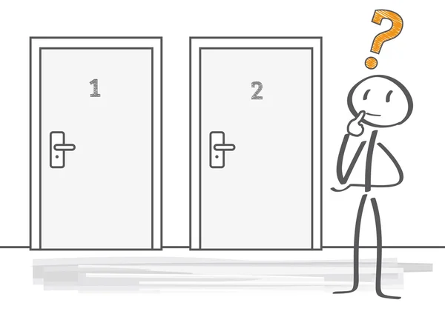
Practical Tools & Frameworks
Tool 1: The Ethical Decision-Making Framework (EDMF)
Define the dilemma
Identify stakeholders
Examine values and risks
Consult ethical principles
Evaluate options
Decide
Reflect and document

Slide 75

Practical Tools & Frameworks
Tool 2: The Trainer Code of Conduct Template
Includes:
Integrity commitments
Respect & inclusivity statements
Facilitation ethics
Data protection rules
Boundary guidelines
Anti-bias declarations

Slide 76

Practical Tools & Frameworks
Tool 3: Ethical Red Flags Checklist
Is anything being hidden?
Does this harm trust?
Would I do this if my mentor were observing?
Is this decision fair and inclusive?
Does this align with professional codes?

Slide 77
Personalized Reflection Questions
What ethical values guide my work as a trainer?
Which ethical dilemmas have I already encountered?
How do I respond when pressured by leaders or stakeholders?
Which ethical principles do I want to strengthen?
How can I role-model ethical excellence for future trainers?

Slide 78

Application Exercise/ Activity
Activity: Ethical Scenario Mapping
Use the EDMF framework.
Choose one ethical dilemma you've experienced.
Describe the situation.
Identify all stakeholders.
List possible decisions.
Evaluate each decision using ethical standards.
Choose the most ethical action.
Write a 150–300 word reflection.

Slide 79
ASSESSMENT
Write your Personal Trainer Ethics Code (200–400 words):
Your values
Commitments to learners
Professional boundaries
Handling confidentiality
Ensuring fairness
Maintaining competence
Your pledge as a future Master Trainer

Slide 80
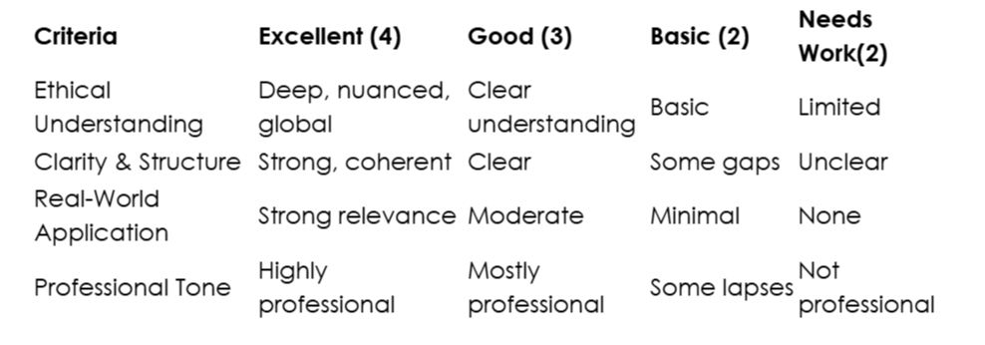
Assessment Rubrics

Slide 81

Summary
Ethics is the backbone of trust and credibility in the L&D profession.
Master Trainers model ethical excellence and guide others.
Ethical decision-making requires structure, reflection, and courage.
Global professional standards help ensure fairness, inclusivity, and safety.
Creating your personal code of ethics is a foundational step toward Mastery.

Slide 82

Resources
Trainer Code of Ethics Template
Ethical Decision-Making Framework Worksheet
Ethical Red Flags Checklist
Confidentiality & Boundaries Guide
Ethical Scenario Reflection Sheet

Slide 83

Module 1: Understanding the Training Profession
Lesson 4: The Learning Cycle and How Adults Learn
Designed using ADDIE, SAM, Kolb’s Experiential Learning Cycle, Adult Learning Theory, Kirkpatrick, and ISO 29993 global standards.

Slide 84

Lesson 4: The Learning Cycle and How Adults Learn
Learning Objectives
By the end of this lesson, learners will be able to:
Analyze how adult learning principles influence training design and facilitation.
Evaluate real training scenarios using Kolb’s Learning Cycle and other adult learning frameworks.
Design learner-centered strategies that align with diverse adult learning preferences.

Slide 85

Lesson 4: The Learning Cycle and How Adults Learn
Apply experiential learning principles to create engaging, high-impact learning experiences.
Adapt training methods to optimize retention, transfer, and long-term behavior change.
“Adults don’t learn from experience… they learn from reflecting on experience.” — John Dewey

Slide 86

Introduction
If your learners only remember 20–40% of what you teach, which part of your session is causing the loss—the experience or the reflection?
This lesson reveals why the answer to that question determines whether you remain a trainer…
or evolve into a Master Trainer.

Slide 87
Why This Matters
As a Master Trainer, your success depends on your ability to create learning that sticks, transforms behavior, and drives real-world performance.
Understanding how adults learn allows you to:
Increase learner engagement and ownership
Adapt training to different learning needs
Strengthen retention and transfer
Build psychologically safe learning spaces
Ensure your training creates measurable business impact (Kirkpatrick Levels 1–4)
A Master Trainer does not just deliver content—they engineer learning experiences.

Slide 88

Core Concepts
What Makes Adult Learners Different? (Andragogy – Malcolm Knowles)
Adults learn best when:
A. They see immediate relevance
They must know why the learning matters.
B. They feel autonomous
They want control over pace, style, and application.
C. They bring prior experience
Training must connect to what they already know.

Slide 89

Core Concepts
What Makes Adult Learners Different? (Andragogy – Malcolm Knowles)
D. They are problem-solvers
Adults prefer scenarios, challenges, and real-world applications.
E. Learning is practical and actionable
Concepts must translate to job tasks.
F. They need respect and psychological safety
They must feel valued and heard.

Slide 90
Core Concepts
2. Kolb’s Experiential Learning Cycle (The Master Trainer’s Blueprint)
Kolb says all adults learn through a 4-stage cycle:
Concrete Experience (CE) — Doing / experiencing
Reflective Observation (RO) — Reviewing / noticing
Abstract Conceptualization (AC) — Understanding / theorizing
Active Experimentation (AE) — Applying / testing

Slide 91
Core Concepts
What this means for training design:
Every effective session must include:
Kolb Stage | Trainer Method | Purpose
Experience | activities, demos, simulations | ignite curiosity
Reflection | discussion, journaling, debrief | deepen understanding
Concepts | models, frameworks | provide structure
Application | practice, scenarios, role-play | build competence

Slide 92

Core Concepts
3. Diverse Learning Preferences (VARK & Beyond)
While modern research shows people learn through multiple modes, variety increases engagement.
Offer multiple learning modalities:
Visual (diagrams, maps)
Auditory (discussion, storytelling)
Reading/Writing (guides, self-paced notes)
Kinesthetic (activities, case simulations)
Master Trainers design for whole-brain learning

Slide 93
Examples, Case Studies & Scenarios
Scenario Example: Poor Training
A technical trainer lectures for 90 minutes with slides full of text. Learners leave disengaged, forget content, and do not apply skills.
What the Master Trainer does differently using Kolb:
Provide a hands-on demonstration (Experience)
Facilitate a debrief on challenges (Reflection)
Offer a simple troubleshooting framework (Concepts)
Let learners practice on real equipment (Application)
This cycle transforms recall → into retention → into performance.

Slide 94
Practical Tools & Frameworks
1. Adult Learning Alignment Grid (ALAG)
A planning tool:
Training Goal | Adult Learning Principle | Learning Method | Evidence of Learning
Skill-based | Experiential | Simulation | Observable behaviour
Attitude shift | Autonomy & relevance | Case discussions | Reflections
Knowledge | Structure & meaning | Microlearning | Quiz results

Slide 95

Practical Tools & Frameworks
2. Kolb Integration Checklist
Before delivering a session, ask:
Did I create an experience for learners?
Did I provide time for reflection?
Did I explain the concepts clearly?
Did learners get to practice or test it?
Did I check for transfer?
How will I measure impact at Kirkpatrick Levels 1–3?

Slide 96

Personalized Reflection Questions
Which parts of the learning cycle do I naturally use?
Which parts do I tend to skip—and why?
What assumptions do I make about adult learners that may be limiting?
How can I create more autonomy and choice in my sessions?
What learning experiences do I remember most—and what made them powerful

Slide 97

Application Exercise/Activity
Activity: Re-Design a Training Segment Using Kolb
Choose a training topic you already teach.
Redesign it using the 4-stage cycle:
Experience: What activity or scenario will open the lesson?
Reflection: What debrief questions will deepen understanding?
Concepts: What model or explanation will structure learning?
Application: What practice activity will reinforce mastery?
Upload your redesigned segment to your program workspace.

Slide 98

Assessment & Practice Task
Practice Task:
Analyze one of your past training sessions.
Identify which principles you missed.
List three improvements based on this lesson.

Slide 99

Summary
Adults learn best when learning is relevant, experiential, and respectful.
Kolb’s cycle is essential for designing effective learning.
A Master Trainer blends experience + reflection + concepts + application.
Variety boosts engagement and retention.
Learning becomes transformation when learners make meaning through reflection and practice.

Slide 100

Resources & Templates
Kolb Learning Cycle Training Planner
Adult Learning Principles Checklist
Learning Method Selection Matrix
Reflection & Debrief Question Bank
Experience → Reflection → Concept → Application Design Sheet

Slide 101

Module 2: Foundations of Instructional Design
Lesson 1: Introduction to ADDIE & SAM Models
Aligned with ADDIE, SAM, Adult Learning Principles, Kolb’s Cycle, Kirkpatrick, and ISO 29993.
Structured using explanation → example → activity → reflection → assessment → mastery.

Slide 102
Lesson 1: Introduction to ADDIE & SAM Models
⭐ Learning Objectives
By the end of this lesson, participants will be able to:
Analyze the strengths and limitations of ADDIE and SAM in modern instructional design.
Compare and contrast both models to determine when each approach is most effective.
Apply ADDIE and SAM steps to real-world training needs.
Evaluate a training project and identify which model best supports the desired outcomes.
Design a simple training plan using the appropriate model for their context.
“A poorly designed training program will always fail—no matter how excellent the facilitator is.”

Slide 103

Thought-provoking question
If you had to bet your reputation on one model to ensure your training succeeds, which would you choose—and why?
This lesson gives you the tools to design with precision, speed, and mastery.

Slide 104

Why This Matters (Real-World Importance)
Master Trainers must do more than deliver content—they must design learning that:
Meets business goals
Solves real performance gaps
Is efficient, scalable, and relevant
Provides measurable results (Kirkpatrick Levels 1–4)

Slide 105

Thought-provoking question
ADDIE and SAM remain the global gold standards for instructional design because they provide:
Structure
Consistency
Predictability
Flexibility
Repeatable processes
Without a strong design foundation, training becomes guesswork.
With design mastery, training becomes a strategic business solution.

Slide 106
Core Concepts
1. Understanding ADDIE (The Classic, Systematic Approach)
ADDIE stands for:
A – Analysis
Identify needs, gaps, learner profiles, business goals.
D – Design
Develop learning objectives, structure, activities, assessments.
D – Development
Create materials, tools, guides, templates, content.
I – Implementation
Deliver the training in any format (virtual, hybrid, self-paced).
E – Evaluation
Measure results (Levels 1–4), analyze improvements.

Slide 107
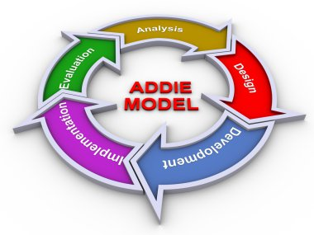
Core Concepts
Why ADDIE Works
Thorough and structured
Minimizes risk
Ensures alignment from needs → outcomes
Works for large organizations, compliance, long-term programs
Limitations
Can be slower
Requires more documentation
Not ideal for fast-paced or rapidly evolving content

Slide 108
Core Concepts
2. Understanding SAM (Successive Approximation Model)
SAM is based on rapid, iterative design (SAM1 – Basic)
Three phases:
Preparation Phase
Collect info → outline goals.
Iterative Design Phase
Draft → review → revise → repeat.
Iterative Development Phase
Build → test → refine → finalize.
SAM2 – Advanced
Uses multiple small iterations ("savvy start") with real users.

Slide 109

Core Concepts
Why SAM Works
Fast
Flexible
Collaborative
Reduces waste
Ideal for digital learning, agile teams, rapidly changing content
Limitations
Requires strong collaboration
May miss depth if poorly managed
Not ideal for highly regulated environments

Slide 110

Examples, Case Studies & Scenarios
Scenario 1: Compliance Training
A banking institution must train 10,000 employees globally. The training requires accuracy, documentation, and alignment with regulations.
Best fit: ADDIE
Why: Requires precision, documentation, validation.
Scenario 2: New Product Launch
A company must train sales teams in three weeks on new features. Content keeps changing.
Best fit: SAM
Why: Fast iterations, flexibility, co-design with SMEs.

Slide 111

Examples, Case Studies & Scenarios
Scenario 3: Leadership Development Program
A 9-month blended program with coaching and workshops.
Best fit: ADDIE + SAM hybrid
Why: Need structure, but also rapid prototyping.

Slide 112
Practical Tools & Frameworks
1. ADDIE vs SAM Quick-Select Decision Guide
If you need… | Choose… | Because…
Accuracy, compliance, detailed evaluation | ADDIE | Thorough, structured
Speed, agility, collaboration | SAM | Iterations reduce time
E-learning modules | SAM | Rapid prototyping
Enterprise-wide program | ADDIE | Predictability
Design in uncertainty | SAM | Flexible
Hybrid complex projects | Both | Balanced approach

Slide 113

Practical Tools & Frameworks
2. The Master Trainer Design Blueprint
A simplified flow blending both models: Clarify the performance problem (Analysis) Draft a concept prototype (SAM iteration) Validate with SMEs (SAM) Refine design details (Design) Develop final materials (Development) Pilot test (Implementation + SAM iteration) Measure and optimize (Evaluation

Slide 114
Practical Tools & Frameworks
Shows how both models overlap naturally:
ADDIE | SAM Equivalent
Analysis | Preparation phase
Design | Savvy start + iterative design
Development | Iterative development
Implementation | Final integration cycle
Evaluation | Continuous reviews + testing

Slide 115

Personalized Reflection Questions
Which model feels more natural to the way I design training?
What assumptions do I hold about design that may limit innovation?
Which past training failures could have been avoided with a structured model?
Where in my current projects would SAM save time?
Where would ADDIE bring needed clarity and rigor?

Slide 116

Application Exercise / Activity
Activity: Choose Your Model
Identify a current or upcoming training project.
Then complete:
What is the purpose?
What constraints exist (time, budget, accuracy)?
Which model better fits—and why?
How will the chosen model improve outcomes?
Upload your decision and justification.

Slide 117
Assessment & Practice Task
Practice Task: Build a Mini-Design Plan
Choose one of your training topics and outline:
ADDIE version (5 steps)
SAM version (3 phases)
Compare the process and select which one you’ll use moving forward.

Slide 118

Summary
ADDIE = structured, thorough, reliable
SAM = rapid, iterative, adaptive
Both models are essential tools for Master Trainers
Choosing the right model increases efficiency and effectiveness
Design is the foundation of impactful learning—delivery alone is never enough

Slide 119

Resources & Templates
ADDIE Phase Planning Sheet
SAM Rapid Iteration Template
ADDIE vs SAM Comparison Grid
Training Project Selection Tool
Design Decision Justification Worksheet

Slide 120

Module 2: FOUNDATIONS OF INSTRUCTIONAL DESIGN
Lesson 2: Conducting Training Needs Analysis (TNA)
Thought-Provoking Question:
“What if the real problem isn’t a lack of skills—but a lack of clarity?”
Most training fails not because it was poorly delivered, but because it should never have been delivered in the first place.
A Master Trainer knows how to discover the real performance gap before designing any learning solution.

Slide 121
🎯 Learning Objectives
By the end of this lesson, participants will be able to:
Analyze organizational performance gaps using a structured TNA methodology.
Evaluate whether training is the right solution using data and evidence-based decision-making.
Design a comprehensive Training Needs Analysis using stakeholder insights, performance metrics, and business goals.
Synthesize findings to recommend strategic, high-impact training interventions.
Apply TNA tools (interview guides, surveys, gap analysis templates, and root-cause diagnostics) to real-world scenarios.

Slide 122
Why This Matters
In global Learning & Development ecosystems, TNA is the strategic foundation of impactful training.
Without TNA:
Training becomes guesswork
ROI becomes impossible
Learners feel disengaged
Organizations waste time and money
Trainers lose credibility
Master Trainers are not order-takers—they are strategic partners who diagnose before prescribing.
TNA is what elevates a trainer into an L&D consultant and organizational performance catalyst.
.

Slide 123

Core Concepts
1. What is Training Needs Analysis?
A systematic process of identifying:
Performance gaps
Skill needs
Knowledge requirements
Behavioral expectations
Environmental or systemic obstacles

Slide 124

Core Concepts
2. The Three Levels of TNA (Global Best Practice)
Organizational Needs
Aligns with strategy, culture, KPIs, and future workforce trends.
Task/Job Needs
Identifies required skills & competencies for each role.
Individual Needs
Measures current competencies vs. desired performance.

Slide 125
Core Concepts
3. Root-Cause Analysis in TNA
Most performance issues are not training problems.
A Master Trainer must distinguish:
Issue Category | Example | Training Required?
Knowledge gap | Employee doesn’t know how to use CRM | YES
Skill gap | Facilitator can’t manage group dynamics | YES
Motivation gap | Low engagement | NO
System/process issue | Outdated software | NO
Leadership/clarity issue | No role expectations | NO

Slide 126

Core Concepts
4. TNA Data Collection Methods
Stakeholder interviews
Competency mapping
Surveys & questionnaires
Focus groups
Observation
Performance reviews
KPI analysis
Learning analytics
Job task analysis

Slide 127

Core Concepts
5. The TNA Flow (Master Trainer Version)
Trigger → Data Collection → Gap Analysis → Root Cause → Recommendations → Training Plan
.

Slide 128

Relevant Example / Case Scenario
Case: “Sales Team Underperforming”
Sales team isn’t meeting quarterly targets.
Leadership requests “Sales Motivation Training”.
But a Master Trainer conducts TNA and discovers:
Product knowledge gaps
CRM misuse
Poor lead qualification
Unclear targets
Root cause: Skill and process gaps—not motivation.
Right solution: Role-based skills training + CRM competency development + process alignment.
This is how Master Trainers protect organizational resources & credibility.

Slide 129
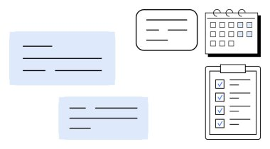
Practical Tools & Frameworks
1. The 5D TNA Framework (Master Trainer Version)
Define the Problem
Determine Performance Standards
Diagnose Root Causes
Data Collection & Analysis
Design Recommendations

Slide 130
Practical Tools & Frameworks
2. Gap Analysis Template
Desired Performance → Actual Performance → Gap → Cause → Solution
3. Performance vs. Training Matrix
A quick tool to validate if training is the right response.
4. TNA Stakeholder Interview Script
Includes:
Performance questions
Environment questions
Tools/process questions
Motivation/leadership questions
5. Recommendation Mapping
| Solution | Level | Expected Impact | Priority |

Slide 131

Personalized Reflection Questions
What assumptions do I typically make before analyzing performance gaps?
How comfortable am I challenging stakeholders respectfully?
Which data collection methods match my natural strengths?
What performance issues in my past projects were misdiagnosed?
How can I improve my ability to ask diagnostic, high-value questions?

Slide 132
Application Exercise / Activity
Activity: “Diagnose Before You Prescribe”
You are given a performance problem:
Customer service satisfaction dropped from 90% to 72% in three months.
Your task:
Identify potential causes (training vs. non-training).
List five questions you would ask stakeholders.
Identify the level(s) of TNA required.
Recommend the top three data collection methods.
Draft a one-paragraph preliminary TNA statement.

Slide 133

Assessment / Mini Practice Task
Complete a full Gap Analysis:
Step 1: Define Desired Performance
Step 2: Capture Actual Performance
Step 3: Identify the Gap
Step 4: Diagnose the Cause
Step 5: Recommend a solution
Rubric includes:
Accuracy of diagnosis
Evidence-based logic
Balanced use of qualitative & quantitative data
Clarity & feasibility of recommendations

Slide 134

Summary
TNA is the strategic heart of instructional design.
Master Trainers always diagnose before designing solutions.
Not every performance issue requires training.
Accurate TNA ensures high ROI, learner relevance & organizational impact.
Conducting TNA elevates you from trainer → consultant → trusted advisor.

Slide 135

Resources & Templates
TNA Data Collection Checklist
Gap Analysis Template
Stakeholder Interview Guide
Training vs. Non-Training Problem Matrix
TNA Report Outline
Recommendation Mapping Tool
TNA Planning Worksheet

Slide 136

MODULE 2: FOUNDATIONS OF INSTRUCTIONAL DESIGN
LESSON 3: Setting SMART Learning Objectives
“If you don’t know where you’re going, any road will take you there.” — Lewis Carroll
Most training fails before it even begins—not during delivery, not in the design phase, but right here…
at the moment objectives are defined.
A Master Trainer is a master of clarity.
Learning objectives are not statements.
They are commitments.
They determine the purpose, direction, and success criteria of learning.

Slide 137

🎯 Learning Objectives
By the end of this lesson, participants will be able to:
Analyze the relationship between business goals, learning needs, and instructional objectives.
Evaluate learning objectives for clarity, alignment, and measurable outcomes.
Design SMART learning objectives using Bloom’s Taxonomy and performance-based verbs.
Differentiate between training goals, learning objectives, and performance outcomes.
Apply SMART models to real L&D scenarios and produce high-quality objectives that guide curriculum development.

Slide 138

Why This Matters
SMART learning objectives are the blueprint of instructional design.
Without them:
Training loses focus.
Developers don’t know what to build.
Facilitators don’t know what to emphasize.
Learners don’t know what success looks like.
Evaluation becomes impossible.

Slide 139

Why This Matters
Master Trainers use clear objectives to:
ensure alignment
guide content creation
design assessments
prove training ROI
drive behavioral and performance outcomes
SMART objectives are essential to ADDIE (Analysis → Design) and serve as the foundation of Kirkpatrick Level 2 & 3 evaluation.

Slide 140

Core Concepts
1. What Are Learning Objectives?
Learning objectives describe what learners will be able to do after completing a training session.
They focus on:
Observable behavior
Demonstrable skills
Meaningful performance
Objectives are NOT:
Topics
Agenda items
Trainer activities
Vague promises like “understand” or “learn”

Slide 141

Core Concepts
2. SMART Framework for Learning Objectives
A powerful global standard used across L&D, education, coaching, and organizational development.
S — Specific
Clear, focused, unambiguous.
M — Measurable
Observable, demonstrable, and trackable.
A — Achievable
Realistic based on level, and learner capability.

Slide 142

Core Concepts
2. SMART Framework for Learning Objectives
R — Relevant
Connected to business goals and job performance.
T — Time-Bound
Defined timeframe or learning event boundary.

Slide 143
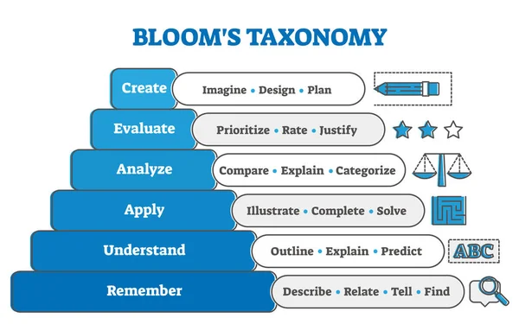
Core Concepts
3. Integrating Bloom’s Taxonomy
Bloom’s verbs help make learning measurable.
Avoid vague verbs:
know
understand
appreciate
learn

Slide 144

Core Concepts
3. Integrating Bloom’s Taxonomy
Use measurable verbs based on levels:
Remember → define, list, recall
Understand → explain, summarize, classify
Apply → demonstrate, use, perform
Analyze → compare, differentiate, examine
Evaluate → justify, critique, assess
Create → design, develop, construct
Master Trainers choose verbs that fit the desired performance level and intended learning outcome.

Slide 145
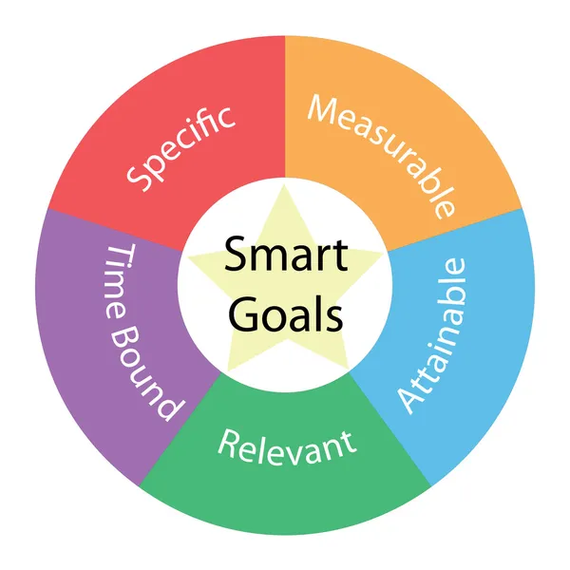
Core Concepts
4. SMART Objective Formula
[Learner] + [Action Verb] + [Skill/Knowledge] + [Condition] + [Criteria]
Example:
“By the end of this lesson, learners will be able to design a SMART learning objective using the SMART framework with 100% accuracy using the template provided.”

Slide 146

Real-World Scenario / Case Example
Scenario: New Customer Service Training
Business goal: Increase customer satisfaction from 75% to 88%.
A bad learning objective:
“Learners will understand customer service principles.”
A SMART learning objective:
“By the end of the session, agents will be able to apply the 5-Step Customer Recovery Method to resolve customer issues with at least 90% accuracy in role-play simulations.”

Slide 147

Real-World Scenario / Case Example
This leads to:
Clear content
Targeted practice
Effective evaluation
Real performance change

Slide 148

Practical Tools & Frameworks
1. SMART Objective Builder Template
Fill in:
Action verb
Specific behavior
Conditions
Performance criteria
Alignment with business goal
2. Bloom’s Verb Selector
A categorized verb list aligned with cognitive complexity.

Slide 149
Practical Tools & Frameworks
3. Objective Alignment Matrix
| Business Goal | Performance Requirement | Learning Objective | Assessment Method |
4. The “3 Golden Tests” for Objectives
Ask:
Can you observe it?
Can you measure it?
Can you evaluate competence from it?
If no → rewrite.

Slide 150

Personalized Reflection Questions
When creating objectives, do I naturally focus more on content or outcomes?
Which Bloom’s levels do I tend to use most—and why?
Do I challenge myself to write objectives that push learners toward application or analysis?
How do SMART objectives help me justify training?
Which part of SMART is hardest for me: measurable, relevant, or time-bound?

Slide 151

Application Exercise / Activity
Activity: Rewriting Weak Objectives
Rewrite these into SMART objectives:
“Learners will understand workplace safety.”
“Participants will know how to manage conflict.”
“Trainers will learn how to create engaging presentations.”
Then:
Use the SMART Builder Template to create one new objective related to your workplace.

Slide 152
Assessment & Practice Task
Mini-Assessment:
Write three SMART objectives for a training program of your choice.
Your objectives will be evaluated using the rubric:

Slide 153
Assessment & Practice Task
Criteria | Excellent | Good | Needs Improvement
Specific | Crystal clear; no ambiguity | Mostly clear | Vague
Measurable | Fully measurable with criteria | Some measurement | No measurement
Achievable | Realistic, scoped well | Reasonable | Unattainable
Relevant | Strong alignment | Moderate alignment | Weak alignment
Time-Bound | Clear timeframe | Some time reference | Missing

Slide 154
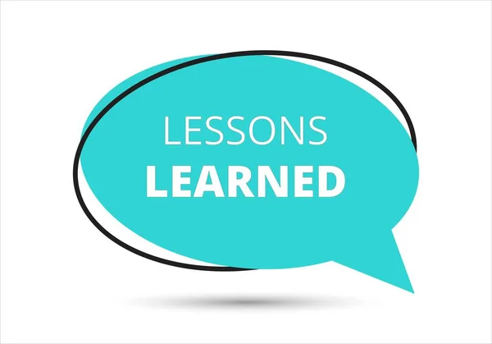
Summary
SMART objectives define the direction of learning.
Clarity determines instructional success.
Objectives must be measurable, aligned, and performance-based.
Bloom’s Taxonomy strengthens verb selection.
Master Trainers use objectives to connect training to business impact.

Slide 155
Resources & Templates
SMART Objective Builder
Bloom’s Verb Bank
Objective Alignment Matrix
SMART Quality Rubric
Objective Writing Worksheet

Slide 156

MODULE 2: FOUNDATIONS OF INSTRUCTIONAL DESIGN
LESSON 4: Structuring Effective Lesson Plans
Thought-provoking question:
“Why do some trainers seem naturally fluid, confident, and impactful—while others struggle even when they know the content?”

Slide 157

MODULE 2: FOUNDATIONS OF INSTRUCTIONAL DESIGN
Answer:
It’s not talent.
It’s structure.
Behind every powerful learning experience is a strategic lesson plan engineered for clarity, flow, and learner engagement.
Master Trainers don’t “wing it.”
They design lessons that create transformation.

Slide 158
Learning Objectives
By the end of this lesson, participants will be able to:
Evaluate lesson plans for structure, alignment, and instructional effectiveness.
Design comprehensive lesson plans that incorporate adult learning principles and experiential learning.
Apply ADDIE, SAM, and Kolb’s Learning Cycle to create engaging, outcome-driven lessons.
Synthesize multiple instructional elements (objectives, content, activities, assessments) into a cohesive learning sequence.
Create a lesson plan blueprint that ensures consistent quality across training delivery.

Slide 159
Why This Matters
Lesson plans ensure:
Consistency
Alignment
Trainer confidence
Better pacing
Higher engagement
Effective evaluation
Repeatable excellence
A well-structured lesson plan is the backbone of scalable training.
In global organizations, lesson plans are quality-control tools that protect brand reputation and learning impact.

Slide 160

Why This Matters
Master Trainers use lesson plans to:
Align with business goals
Manage diverse groups
Facilitate with confidence
Deliver consistent, measurable learning outcomes

Slide 161

Core Concepts
1. What Is a Lesson Plan?
A lesson plan is a roadmap that outlines:
What will be taught
How it will be taught
Why it matters
How learning will be measured
It ensures learners move from known → unknown, simple → complex, theory → practice → mastery.

Slide 162

Core Concepts
2. The Anatomy of an Effective Lesson Plan
A world-class lesson plan includes:
a. Learning Objectives
(Performance-based, SMART, Bloom’s aligned)
b. Opening / Hook
Captures attention and establishes relevance.
c. Core Content
Key concepts, frameworks, and explanations.
d. Examples / Scenarios
Bridges theory with real-world practice.

Slide 163

Core Concepts
e. Learning Activities
Individual, group, or experiential exercises aligned with Kolb’s cycle.
f. Reflection Questions
Strengthen internalization.
g. Assessment / Knowledge Check
Low-stakes or formal assessment.
h. Application Task
Immediate real-world transfer.

Slide 164

Core Concepts
I. Materials & Resources
Tools needed for delivery
j. Timing Breakdown
Ensures pacing and flow.
k. Facilitation Notes
Tips, questions to ask, checkpoints

Slide 165
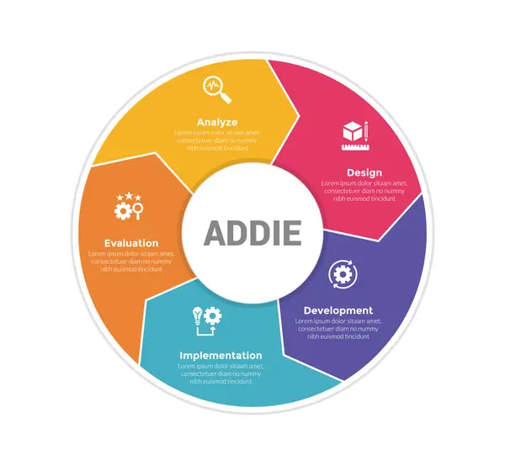
Core Concepts
3. The 4 Models Behind Effective Lesson Plan Structure
1. ADDIE
A (Analyze) → who are the learners?
D (Design) → what should be taught?
D (Develop) → how should we teach it?
I (Implement) → deliver the lesson
E (Evaluate) → test effectiveness
2. SAM (Successive Approximation Model)
Iterative design → pilot → refine.

Slide 166

Core Concepts
3. Kolb’s Experiential Model
Concrete Experience
Reflective Observation
Abstract Conceptualization
Active Experimentation
Lesson plans should incorporate all four.

Slide 167
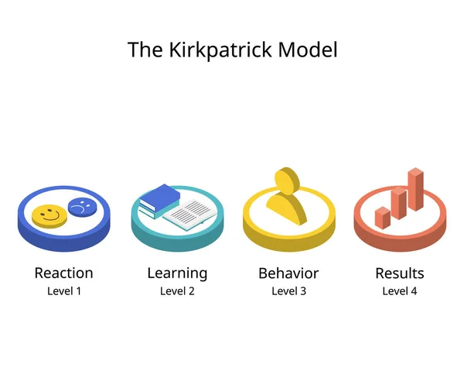
Core Concepts
4. Kirkpatrick
Lesson plans should support:
Level 1: Reaction/ Engagement
Level 2: Learning
Level 3: Behavior
Level 4: Results

Slide 168

Case Example
Scenario: Designing a Lesson on Conflict Management
A poor lesson plan:
Tells stories
Shares tips
Shows slides
Hopes for learning

Slide 169

Case Example
A world-class lesson plan:
Has SMART objectives (e.g., “Demonstrate… apply…”)
Incorporates scenarios
Includes structured role-play
Measures skill adoption
Connects to workplace KPIs
Guides the trainer through timing, flow, and checkpoints
This is the difference between teaching and transforming.

Slide 170

Practical Tools & Frameworks
1. The Master Trainer Lesson Plan Template
Sections:
Title
Duration
Audience
Objectives
Methods
Materials
Step-by-step breakdown
Engagement strategies
Assessment plan
Notes & risks

Slide 171

Practical Tools & Frameworks
2. The “Golden 10-Step Lesson Structure”
Welcome
Hook
Learning objectives
Agenda
Core concept
Example
Activity
Reflection
Assessment
Application commitment

Slide 172

Practical Tools & Frameworks
3. Flow & Pacing Grid
| Activity | Method | Time | Materials | Expected Outcome |
4. 3E Engagement Model
Explain
Explore
Experience
5. Trainer Confidence Checklist
Ensures readiness before delivery.

Slide 173

Personalized Reflection Questions
What lesson plan structure do I currently use, and why?
Which components of lesson planning do I naturally excel at?
Where do I tend to under-plan or over-plan?
How does structure affect my confidence in training delivery?
What would my lesson plan look like if I planned like a global Master Trainer?

Slide 174

Application Exercise / Activity
Activity: Build Your Own Lesson Plan (Mini Build)
Choose a topic you teach.
Fill in:
Title
Learning objectives
Hook
Key concepts
Example

Slide 175
Application Exercise / Activity
6. Activity
7. Reflection
8. Assessment
9. Real-world application
10. Materials list

Slide 176
Assessment
Create a complete 1-hour lesson plan using the Master Trainer Template.
Evaluation Rubric:
Alignment with learning objectives
Clarity and flow
Adult learning integration
Instructional design principles applied
Feasibility and pacing
Quality of activities
Assessment alignment

Slide 177

Summary
Lesson plans are essential for consistency, clarity, and impact.
Master Trainers design structured lessons that guide learning from awareness → action → mastery.
Lesson plans must incorporate objectives, content, activities, reflection, and evaluation.
Strong lesson planning differentiates a trainer from a Master Trainer.

Slide 178

Resources & Templates Available
Master Trainer Lesson Plan Template
Flow & Pacing Grid
10-Step Lesson Builder
Trainer Confidence Checklist
Lesson Plan Rubric

Slide 179
MODULE 3: TRAINING DELIVERY ESSENTIALS
LESSON 1: Facilitation vs. Presentation Skills
Question:
“Are you teaching… or are you transforming?”
Many trainers can deliver a presentation.
Few can facilitate learning.
Master Trainers must know the difference—and apply it strategically.

Slide 180
Learning Objectives
By the end of this lesson, participants will be able to:
Differentiate between facilitation and presentation using observable behavioral indicators.
Evaluate real or simulated training sessions for facilitation effectiveness.
Design training sessions that balance presenting information and facilitating learning.
Apply facilitation strategies that promote engagement, ownership, and learner-driven insights.
Adapt delivery approach based on learner needs, context, and desired performance outcomes.

Slide 181
Why This Matters
In today’s workplace, information is abundant—but transformation is rare.
Organizations no longer need presenters who dump information; they need facilitators who ignite insight, build capability, and support behavior change.
This distinction affects:
Learner engagement
Learning retention
Classroom dynamics
Business impact
Trainer credibility
Master Trainers know when to present and when to facilitate—and how to shift seamlessly between both.

Slide 182

Core Concepts
1. What Is Presentation?
Presentation is the act of delivering information to an audience.
Presentation prioritizes:
Clarity
Structure
Professionalism
Visual aids
Strong speaking skills
A presenter’s focus is on:
Message → Audience receives

Slide 183

Core Concepts
When Presentation is Most Useful:
Explaining new concepts
Delivering technical or factual information
Reporting data
Introducing a topic
Giving instructions

Slide 184

Core Concepts
2. What Is Facilitation?
Facilitation is the act of guiding a learning process, not delivering information.
Facilitation prioritizes:
Engagement
Dialogue
Discovery
Collaboration
Problem-solving
Learner autonomy

Slide 185

Core Concepts
The facilitator’s focus is:
Learner → Learning process → Outcomes
When Facilitation is Most Useful:
Skill building
Behavior change
Team learning
Problem solving
Group reflection
Coaching-style learning

Slide 186
Core Concepts Explained Simply → Deep Dive
3. Key Differences at a Glance
Aspect | Presentation | Facilitation
Purpose | Inform | Transform
Flow | Trainer-driven | Learner-driven
Interaction | Low | High
Role Style | Expert | Guide
Tools | Slides, data | Activities, discussion
Outcomes | Awareness | Mastery & application

Slide 187

Core Concepts Explained Simply → Deep Dive
4. The Master Trainer Delivery Spectrum
Great facilitators are not anti-presenting—they blend both.
The Delivery Spectrum:
📢 Presentation ←—————→ Facilitation 🤝
Mastery is knowing:
When to talk
When to ask
When to step back
When to go deep

Slide 188

Real-World Scenario
Scenario:
You’re training new managers on Performance Feedback Skills.
A presenter would:
Explain the feedback model
Show slides
Give examples

Slide 189

Real-World Scenario
A facilitator would:
Ask managers to discuss challenges
Run role-play activities
Guide debriefing
Ask probing questions
Encourage reflection
The impact?
Presentation helps learners know.
Facilitation helps learners do.

Slide 190

Practical Tools & Frameworks
1. The 3P Facilitation Method (Master Trainer Tool)
Prompt
Ask a powerful question.
Probe
Dig deeper: “Tell me more…” “Why does that matter?”
Pivot
Move the group toward meaning: “Let’s connect this to…”

Slide 191

Practical Tools & Frameworks
2. The 70/30 Engagement Rule
Learners speak 70%
Trainer speaks 30%
3. Facilitation Behaviors Checklist
Asks open questions
Encourages participation
Redirects discussions
Summarizes insights
Manages energy
Handles difficult participants
Maintains psychological safety

Slide 192

Practical Tools & Frameworks
4. Presentation Excellence Framework
Clear messaging
Strong visuals
Confident voice
Intentional body language
Clear explanations
Structured flow

Slide 193

Practical Tools & Frameworks
5. When to Shift From Presenting to Facilitating
Shift when:
Learner energy dips
You see confusion
A new example is needed
A concept needs practice
learners are ready for application

Slide 194

Personalized Reflection Questions
Do I naturally lean toward presenting or facilitating? Why?
Which environments make me rely heavily on presentation?
What facilitation behaviors do I want to strengthen?
How comfortable am I with learner-driven sessions?
What would make me a more balanced, confident facilitator?

Slide 195

Application Exercise / Activity
Activity: Re-Design a Segment
Choose a training segment you have delivered.
Step 1: Write how you usually present the content.
Step 2: Rewrite it as a facilitated activity using:
Open questions
Pair/group discussion
Reflection prompts
Application tasks
Compare the differences in learner engagement.

Slide 196

Assessment
Mini Assessment: Identify the Approach
For each scenario, identify whether a trainer should present or facilitate—and why.
Example:
“Introducing a new compliance policy.” → Present
“Exploring causes of team communication challenges.” → Facilitate

Slide 197

Assessment
Mastery Task (Scored With Rubric):
Design a 15-minute micro-learning plan containing:
5 minutes of presentation
10 minutes of facilitation
Rubric evaluates:
Balance
Flow
Question quality
Engagement strategy
Relevance
Application

Slide 198

Summary
Presentation delivers information.
Facilitation drives transformation.
Master Trainers blend both with intention.
Facilitation builds ownership, engagement, and long-term behavior change.
The goal: Less telling. More discovering. More doing.

Slide 199

Resources
Facilitation vs. Presentation Comparison Chart
Facilitation Behavior Checklist
70/30 Engagement Planning Sheet
Micro-Learning Delivery Plan Template
Facilitation Skills Self-Assessment

Slide 200

MODULE 3: TRAINING DELIVERY ESSENTIALS
LESSON 2: Engaging Adult Learners
“Adults don’t learn because we teach.
They learn because they care, relate, and apply—so how do you ignite that spark?”

Slide 201
Learning Objectives
By the end of this lesson, participants will be able to:
Analyze how adult learning principles influence training design and delivery.
Evaluate training sessions for alignment with adult learner motivation and engagement needs.
Apply evidence-based adult learning strategies to create high-engagement learning experiences.
Design interactive learning opportunities that support autonomy, relevance, and immediate application.
Adapt facilitation approaches to different learner profiles, motivations, and workplace contexts.

Slide 202

Why This Matters (Real-World Importance)
Great content is not enough.
Engagement is the engine of adult learning.
When adults disengage:
retention drops
participation decreases
behavior change doesn’t happen
training fails to meet business outcomes

Slide 203

Why This Matters (Real-World Importance)
Master Trainers must understand:
why adults learn
how adults learn
what motivates engagement
how to create learning environments where adults feel respected, capable, and invested
Engagement is not entertainment—
it is a strategic, intentional process that drives transformation.

Slide 204
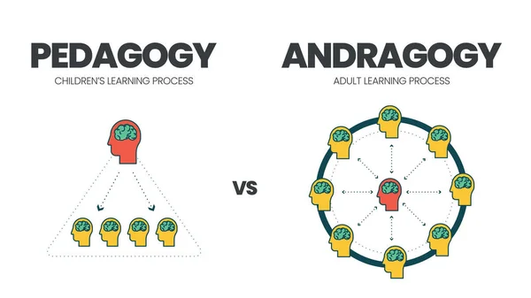
Core Concepts Explained Simply → Deep Dive
1. What Makes Adult Learners Different? (Andragogy)
Adults bring:
Experience
Biases
Motivations
Learning preferences
Emotional states
Competing priorities

Slide 205

Core Concepts
Adults learn best when:
The learning is relevant
They can contribute
They feel psychologically safe
They can apply learning immediately
They are treated as equal partners

Slide 206
Core Concepts
2. Six Adult Learning Principles (Malcolm Knowles)
Need to Know – Adults want to know why something matters.
Self-Concept – They want autonomy, not control.
Experience – They learn by connecting new ideas to prior knowledge.
Readiness to Learn – They learn when they feel the need.
Orientation to Learning – They prefer problem-centered learning.
Motivation – Internal motivation is far stronger than external rewards.

Slide 207

Core Concepts
3. Engagement Through Kolb’s Experiential Learning Cycle
A Master Trainer ensures every lesson includes:
Experience – Doing, testing, exploring
Reflection – Thinking, noticing, analyzing
Conceptualization – Understanding frameworks, models
Application – Practicing and experimenting
This is the backbone of engaging adults.

Slide 208
Core Concepts
4. The 4 Dimensions of Adult Engagement
Dimension | Description | Example
Cognitive | Mental stimulation | Case studies, problem-solving
Emotional | Connection, relevance | Stories, real challenges
Behavioral | Doing, participating | Role plays, simulations
Social | Learning with others | Group activities, discussions

Slide 209

Core Concepts
5. Engagement Does Not Equal Entertainment
Entertainment makes learners feel good.
Engagement makes learners change.
Master Trainers use:
challenging questions
facilitator probes
reflection activities
breakout discussions
real-world tasks
scenario-based learning
These strategies awaken curiosity and ownership—not passive consumption.

Slide 210
Real-World Scenario
You’re conducting a workshop on “Leadership Conversations.”
A disengaged group forces you to adapt.
What would a novice trainer do?
→ Continue the plan, lecture harder, add more slides.
What would a Master Trainer do?
→ Adjust on the fly:
Facilitate a quick peer discussion
Ask learners to share real challenges
Replace lecture with role-play simulation
Connect learning to current workplace needs
The Master Trainer uses the room as the curriculum.

Slide 211

Practical Tools & Frameworks
The RED Model for Adult Engagement
A simple system for Master Trainers:
R — Relevance
“Why does this matter to me?”
Tools:
WIIFM statements
Scenario hooks
Real work examples

Slide 212

Practical Tools & Frameworks
E — Experience
“Let me connect this to what I already know.”
Tools:
Story sharing
Peer discussions
Pre-session surveys

Slide 213
Practical Tools & Frameworks
D — Doing
“Let me try it.”
Tools:
Practical
Group tasks
Rapid prototyping
Skills labs

Slide 214
Practical Tools & Frameworks
2. 10 Evidence-Based Engagement Techniques
Start with a challenge question
Use problem-solving activities
Incorporate real workplace examples
Enable peer-to-peer learning
Polls and live feedback
Role plays with debrief
Gamified micro-challenges
Case study rotations
Learning sprints
Reflection pauses

Slide 215
Practical Tools & Frameworks
3. The 3 Levels of Engagement Mastery
Level | Trainer Style | Learner Experience
Basic | Presenter | Listening
Intermediate | Facilitator | Participating
Master | Learning Architect | Discovering, applying, transforming

Slide 216

Personalized Reflection Questions
When do I lose adult learners—and why?
What assumptions do I make about adult motivation?
Which engagement style do I naturally use: cognitive, emotional, behavioral, or social?
How can I better honor adults’ need for autonomy?
What engagement techniques do I want to master next?

Slide 217

Application Exercise / Activity
Activity: Re-Engineer a Boring Topic
Pick a topic you often teach that usually feels dry.
Step 1: Write your typical delivery approach.
Step 2: Apply the RED Model (Relevance–Experience–Doing).
Step 3: Re-design the segment into an engaging, adult-centered mini lesson.
Step 4: Share version A and version B side by side.

Slide 218

Assessment
Part A: Quick Assessment
Match each statement with the correct adult learning principle:
Autonomy
Relevance
Problem orientation
Experience
(Provide answer key upon request.)

Slide 219

Assessment
Part B: Mastery Task (With Rubric)
Design a 20-minute session that includes:
One engagement technique for EACH dimension (cognitive, emotional, behavioral, social)
One experiential activity aligned with Kolb
A strategy to increase intrinsic motivation

Slide 220

Assessment
Rubric evaluates:
Relevance to adults
Learner autonomy
Quality of engagement strategy
Alignment with learning outcomes
Depth of experiential design
Real-world application

Slide 221
Summary
Adults learn when something matters, feels relevant, and connects to their world.
Engagement must be intentional, not accidental.
The best trainers create space for adults to think, feel, and act.
Engagement is a science—and Master Trainers practice it deliberately.

Slide 222

Resources
Adult Engagement Planning Sheet
RED Model Lesson Planner
Adult Learning Needs Diagnostic Form
Engagement Techniques Cheat Sheet
Learning Experience Design Rubric

Slide 223

MODULE 3: TRAINING DELIVERY ESSENTIALS
LESSON 3: Managing Group Dynamics
“Groups aren’t just learners in a room—they are a living system.
If you don’t manage the system, the system will manage you.”

Slide 224

Learning Objectives
By the end of this lesson, participants will be able to:
Analyze group behaviors and identify patterns that influence learning engagement.
Diagnose potential disruptions and barriers within group learning environments.
Apply facilitation tactics to manage difficult behaviors and create productive learning climates.
Design sessions that intentionally shape positive group dynamics.
Evaluate training interactions to improve psychological safety, collaboration, and learner interaction

Slide 225

Why This Matters
Even the best curriculum fails if group dynamics are unmanaged.
Master Trainers must guide:
diverse personalities
power dynamics
cultural differences
communication styles
conflicts
emotional climates
participation levels

Slide 226

Why This Matters
Effective group dynamics management leads to:
✔ higher engagement
✔ psychological safety
✔ deeper discussions
✔ better learning transfer
✔ a smoother training experience
A Master Trainer doesn’t just teach content—they orchestrate the room.

Slide 227

Core Concepts
1. What Are Group Dynamics?
Group dynamics refer to the invisible yet powerful forces that influence how people communicate, participate, behave, and collaborate during learning.
Key components:
Roles
Norms
Interactions
Energy levels
Emotions
Motivation
Group maturity

Slide 228

Core Concepts
2. Tuckman’s Model of Group Formation
Groups typically evolve through four predictable stages:
Forming → polite, unsure
Storming → tension, differences, dominance
Norming → alignment and harmony
Performing → collaboration, high engagement
A Master Trainer adjusts facilitation strategies based on the stage.

Slide 229

Core Concepts
3. 10 Common Difficult Learner Types
The Dominator
The Silent Observer
The Distractor
The Side-Talker
The Challenger

Slide 230
Core Concepts
6. The Know-It-All
7. The Lost or Confused
8. The Negative Critic
9. The Resistant Participant
10. The Over-Participator
Master Trainers address the behavior, not the person.

Slide 231
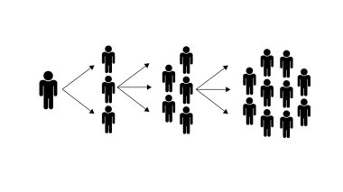
Core Concepts
4. The Psychology of Group Behavior
Adult learners often react based on:
emotional safety
perceived value
prior experiences
group energy
facilitator confidence

Slide 232

Core Concepts Explained Simply → Deep Dive
Engagement rises when learners feel:
respected
heard
involved
included
capable

Slide 233

Real-World Scenario
Scenario: Conflict in the Room
You’re facilitating a leadership session.
Two participants begin debating aggressively.
The room becomes tense.
A novice trainer freezes or ignores it.
A Master Trainer:
Acknowledges without judgment
Reframes into a learning opportunity
Facilitates structured dialogue
Ensures psychological safety
Redirects focus
Group dynamics become the curriculum.

Slide 234

Practical Tools & Frameworks
1. The SAFE Framework for Managing Group Dynamics
A simple Master Trainer tool:
S — See It Early
Read micro-signals:
silence
side conversations
hesitation
eye contact patterns
emotional spikes

Slide 235

Practical Tools & Frameworks
A — Acknowledge It
Name what’s happening neutrally:
“I’m noticing some strong viewpoints—this means we care about the topic.”
F — Facilitate the Process
Use tools:
structured dialogue
timed turns
breakout reframing
question funnels

Slide 236

Practical Tools & Frameworks
2. The Three Levels of Intervention (Trainer Skill)
Light touch – nonverbal cues, proximity, pausing
Moderate – naming behavior, redirecting
High – resetting norms, private side conversations
Mastery lies in choosing the right level at the right time.

Slide 237

Practical Tools & Frameworks
3. 10 Evidence-Based Strategies for Positive Group Dynamics
Set norms early
Use inclusive facilitation techniques
Maintain psychological safety
Distribute participation intentionally
Ask high-quality questions
Balance energy levels
Reframe conflict into learning
Validate diverse perspectives
Use group tasks for collective success
Debrief group behavior (meta-learning)

Slide 238
Personalized Reflection Questions
What types of group behavior challenge me most and why?
How comfortable am I addressing disruptions directly?
What signals do I tend to overlook in a group?
Which facilitation behaviors create psychological safety in my sessions?
How can I better prevent group issues before they arise?

Slide 239

Application Exercise / Activity
Activity: Managing Real Behaviors
Choose three difficult learner types you’ve encountered recently.
For each:
Describe what happened
Identify what group stage the group was in
Apply the SAFE Framework
Redesign the moment using a facilitation strategy
This builds confidence and readiness.

Slide 240

Assessment & Mastery Practice
Quick Assessment
Match each difficult behavior with the BEST trainer response:
Dominator
Silent participant
Side-talker
Resistant learner

Slide 241

Assessment & Mastery Practice
Mastery Task (With Rubric)
Design a 10-minute intervention plan for a scenario involving group tension, specifying:
What signals you noticed
Which intervention level you choose (light/moderate/high)
The engagement strategy you will apply
How you ensure psychological safety
Expected learner outcomes

Slide 242

Assessment & Mastery Practice
Rubric evaluates:
Situational awareness
Appropriateness of intervention
Facilitation skill
Safety creation
Insightfulness of analysis

Slide 243

Summary
Group dynamics determine the success of learning.
Master Trainers must read the room, steer the energy, and shape the climate.
Difficult behaviors are predictable—and manageable.
Psychological safety, facilitation skill, and structured interventions create thriving groups.
Master Trainers do not react—they respond strategically.

Slide 244

Resources & Templates Available
Group Dynamics Diagnostic Checklist
Difficult Learner Response Matrix
SAFE Framework Quick Guide
Intervention Strategy Planner
Group Norms Agreement Template
Psychological Safety Assessment Sheet

Slide 245

MODULE 3: TRAINING DELIVERY ESSENTIALS
LESSON 4: Handling Questions & Difficult Participants
Powerful Quote:
“Questions open the door to discovery.
Difficult people open the door to mastery.”
A Master Trainer knows how to handle both with skill, empathy, and authority.

Slide 246
Learning Objectives
By the end of this lesson, learners will be able to:
Evaluate the types of learner questions and determine the most effective facilitation response.
Analyze difficult participant behaviors to understand root causes rather than symptoms.
Apply structured techniques to handle challenging questions with confidence and clarity.
Design intervention strategies that maintain psychological safety while addressing disruptive behavior.
Adapt facilitation style to ensure learning continuity and group cohesion.

Slide 247

Why This Matters
Questions are powerful learning moments—and difficult participants can derail or deepen learning depending on how they are handled.
A Master Trainer must be able to:
✔ respond to any question with clarity
✔ redirect unproductive questions
✔ manage dominant or resistant participants
✔ protect psychological safety
✔ maintain flow without losing control
These skills build credibility, command respect, and elevate the learning experience.

Slide 248

Core Concepts
1. Types of Participant Questions
Not all questions are equal. Most fall into four categories:
A. Clarification Questions
“Can you explain that again?”
→ Indicates confusion or cognitive overload.
B. Application Questions
“How do I use this in my context?”
→ Indicates engagement and readiness.

Slide 249

Core Concepts
C. Challenge Questions
“Are you sure that’s correct?”
→ May indicate expertise, skepticism, or ego.
D. Curveball Questions
Tangential, irrelevant, overly complex.
→ Usually attempts to display knowledge or redirect attention.
A Master Trainer identifies the intent behind the question, not just the question itself.

Slide 250

Core Concepts
2. The Q.C.R. Model for Handling Questions
A simple, powerful model:
Q — Question
Listen fully. Do not interrupt. Clarify if needed.
C — Context
Ask: Why is this question being asked?
Motivation
Emotion
Group impact
Relevance

Slide 251
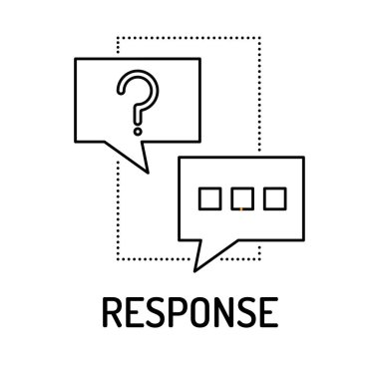
Core Concepts
R — Response
Choose the appropriate strategy:
Answer directly
Redirect to group
Park it
Defer
Reframe
This model prevents overreacting and helps you respond strategically.

Slide 252

Core Concepts
3. Understanding Difficult Participants
Most “difficult” behavior is a symptom of an unmet need.
Common Difficult Types
The Dominator
The Challenger
The Distractor
The Side-Talker
The Know-It-All

Slide 253

Core Concepts
6. The Silent/Withdrawn
7. The Negative/Resistant
8. The Overly Emotional
9. The Question Machine
10. The Time-Stealer
Master Trainers diagnose the need, not the label.

Slide 254

Core Concepts
4. Root Causes Behind Difficult Behavior
Need for recognition
Fear of failure
Boredom or lack of relevance
Fatigue
Unclear expectations
Emotional triggers

Slide 255

Core Concepts
Low psychological safety
Desire to control
Mismatched learning style
External stress
When we understand the cause, we can choose the right intervention.

Slide 256
Core Concepts
5. The Triple-A Method for Difficult Participants
A — Acknowledge
Validate without endorsing.
“I see your point.” “That’s an interesting perspective.”
A — Address
Respond to the behavior or question.
Redirect, refocus, clarify, or coach.
A — Advance
Move the group forward.
“This is important, and we’ll return to it later. For now, let’s continue with…”

Slide 257
Real-World Case Study
Case:
A participant keeps interrupting with long stories unrelated to the lesson.
The group is losing focus.
Trainer Response (Novice):
Lets the participant talk out of politeness.
The group disengages.

Slide 258

Real-World Case Study
Trainer Response (Master Trainer):
Acknowledges: “Thank you for sharing.”
Redirects: “Let’s capture that in the parking lot.”
Advances: “Let’s get back to the technique we’re practicing.”
The session stays on track.

Slide 259

Practical Tools & Frameworks
1. The “Parking Lot” Strategy
A structured way to maintain flow by capturing:
Off-topic questions
Non-urgent issues
Deep-dive topics
Emotional triggers
This increases trust and helps you manage time.

Slide 260

Practical Tools & Frameworks
2. The 5-Second Pause Rule
Silence is a facilitation tool.
A brief pause:
increases question clarity
reduces emotional reactions
encourages other learners to contribute
gives you authority

Slide 261

Practical Tools & Frameworks
3. Redirecting Techniques
Use these strategically:
✔ “What do others think?”
✔ “Let’s hear another perspective.”
✔ “How would you apply this?”
✔ “Let’s explore this after the break.”

Slide 262

Practical Tools & Frameworks
4. The Safety–Respect–Flow Triangle
Every intervention must protect:
Safety (emotional space)
Respect (for the person)
Flow (for the group)
If one breaks, learning breaks.

Slide 263

Personalized Reflection Questions
Which types of questions challenge me the most and why?
How do I usually feel when difficult participants show up?
What behaviors from past sessions triggered nervousness or frustration?
How can I use acknowledgment without enabling disruptive behavior?
What can I do to protect psychological safety while remaining firm?

Slide 264

Application Exercise / Activity
Activity: Hot Seat Simulations
Choose three of the following scenarios:
A participant aggressively challenges your expertise.
Someone keeps interrupting and dominating discussions.
A learner keeps asking unrelated technical questions.
Someone is visibly disengaged and refusing to participate.
A participant corrects you publicly in front of the group.

Slide 265

Application Exercise / Activity
For each scenario:
Identify root cause
Apply Q.C.R. Model
Apply Triple-A Method
Plan your intervention dialogue

Slide 266
Assessment & Mastery Practice
Mastery Task (with Rubric)
Design a 5-minute micro-intervention plan based on a difficult participant you’ve handled before.
Include:
Behavior observed
Root cause analysis
Strategy selection
Sample facilitator dialogue
How you protected safety, respect, and flow

Slide 267

Assessment & Mastery Practice
Rubric evaluates:
Diagnostic accuracy
Appropriateness of response
Emotional intelligence
Facilitation skill
Group impact awareness

Slide 268

Summary
Questions are learning opportunities, not interruptions.
Difficult behavior is usually a signal, not a threat.
Master Trainers use frameworks—not emotions—to respond.
The goal is to maintain safety, respect, and flow at all times.
With the right tools, any difficult moment can become a powerful learning moment.

Slide 269

Resources & Templates Available
Q.C.R. Question-Handling Guide
Difficult Participant Intervention Planner
Parking Lot Template
Question Categorization Cheat Sheet
Triple-A Method Response Cards
Safety–Respect–Flow Diagnostic Checklist
Difficult Behavior Root-Cause Analysis Worksheet

Slide 270
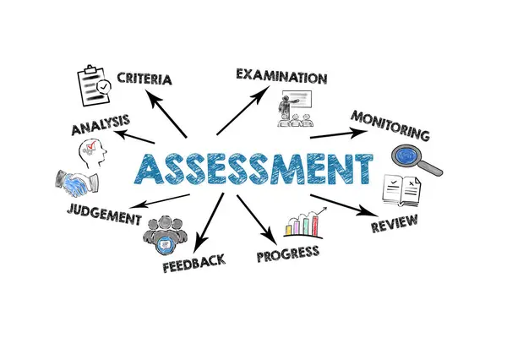
MODULE 4: ASSESSMENT & EVALUATION BASICS
LESSON 1: Kirkpatrick’s Four Levels of Evaluation
"Global studies show that nearly 70% of training programs are never evaluated beyond Level 1, meaning organizations have no evidence that the training actually worked."
A Master Trainer does not conduct training—
they prove training makes an impact.

Slide 271
Learning Objectives
By the end of this lesson, participants will be able to:
Evaluate the effectiveness of training programs using Kirkpatrick’s Four Levels.
Analyze various data types to understand learner reactions, learning acquisition, behavior change, and organizational results.
Design measurable evaluation strategies aligned with learning objectives and organizational goals.
Develop practical tools, surveys, and assessments for each evaluation level.
Apply data insights to refine training for continuous improvement.

Slide 272

Why This Matters
Training without evaluation is guesswork.
Organizations want proof, not assumptions.
They want evidence of:
performance improvement
behavior change
ROI or business value
skill application

Slide 273

Why This Matters
Master Trainers must show leadership teams:
“This training didn’t just happen—it worked.”
Kirkpatrick’s model is the global gold standard for demonstrating training impact.

Slide 274

Core Concepts
1. Overview of Kirkpatrick’s Four Levels
The model evaluates training effectiveness from four perspectives:
🟦 Level 1: Reaction — “Did they like it?”
Measures learner satisfaction, engagement, and perceived value.
Tools:
Feedback forms
Smile sheets
Engagement ratings
Session evaluations

Slide 275
Core Concepts
Level 2: Learning — “Did they learn something?”
Measures knowledge, skills, attitude, or confidence gained.
Tools:
Pre/Post tests
Quizzes
Demonstrations
Assignments
Skills assessments

Slide 276

Core Concepts
Level 3: Behavior — “Are they applying it?”
Measures transfer of learning to the workplace.
Tools:
Observation checklists
Supervisor interviews
Self-report behavior logs
30/60/90 day follow-ups

Slide 277

Core Concepts
Level 4: Results — “Did it impact the business?”
Measures organizational impact.
Possible metrics:
Increased sales
Reduced errors
Improved customer satisfaction
Faster onboarding
Fewer incidents
Higher productivity
This level proves ROI.

Slide 278

Core Concepts
2.The Pyramid: Why Most Organizations Stop at Level 1
Because Levels 3 and 4 require:
planning
collaboration with managers
data collection
follow-up
Master Trainers know how to build an evaluation system from day one.

Slide 279
Core Concepts
3. Evaluation Planning Should Start at Design (ADDIE Principle)
Ask early:
“What evidence would prove this training worked?”
Then align:
objectives
assessments
delivery strategies
workplace assignments
business KPIs
Planning backward ensures training has measurable value.

Slide 280

Real-World Case Study
Case:
A customer service organization invests in a 2-day communication workshop.
Scenario A:
They only measure Level 1.
Learners say: “Great session!”
But complaints remain unchanged.

Slide 281

Real-World Case Study
Scenario B (Master Trainer Approach):
Level 2: Skills improved 30% in role plays
Level 3: 80% applied the techniques within 60 days
Level 4: Customer complaints dropped 18%
ROI calculated: +260%
This is the difference between training activity and training impact.

Slide 282

Practical Tools & Frameworks
1. The Kirkpatrick Evaluation Blueprint
A Master Trainer uses a simple planning sheet:
Learning Objectives → What must change?
Evidence Needed → What proves success?
Data Sources → Learners? Managers? Systems?
Tools Required → Surveys? Tests? Observations?
Timeline → During training? After 30/60/90 days?
Stakeholders → Who collects what?
KPIs → What metrics matter to the business?

Slide 283

Practical Tools & Frameworks
2. The C.I.A. Method for Level 3 Behavior Change
C — Capability
Do they know how?
I — Incentives
Do they want to?
A — Accountability
Is someone checking?
Most training fails at Level 3 due to missing incentives or accountability.

Slide 284
Practical Tools & Frameworks
3. Evidence-Based Tools for Each Level
Level | Tools
1 | Reaction surveys, engagement polls, smile sheets
2 | Pre/post tests, skill demos, micro-assessments
3 | Observation forms, manager feedback, learning transfer logs
4 | Performance dashboards, KPI comparison, ROI calculations

Slide 285

Personalized Reflection Questions
Which evaluation levels do I naturally focus on?
Where have I struggled to prove training impact?
How can I shift from “training delivery” to “performance improvement”?
What business results matter most to my organization or clients?
How will I integrate evaluation planning into future training design?

Slide 286

Application Exercise / Activity
Activity: Build an Evaluation Plan
Choose a course you currently deliver.
Design an evaluation strategy including:
Level 1: 3 feedback questions
Level 2: 2 assessment methods
Level 3: 1 workplace behavior tracking tool
Level 4: 2 possible business results
This becomes part of your Master Trainer portfolio.

Slide 287

Assessment
Part B: Mastery Task (With Rubric)
Create a Kirkpatrick-aligned evaluation plan for a 1-day workshop.
Your plan must include:
Level 1 survey items
Level 2 test or assessment
Level 3 transfer method
Level 4 business KPIs
How data will be collected
Timeline for follow-up

Slide 288

Assessment
Rubric evaluates:
Alignment with objectives
Quality of metrics
Relevance to organization
Feasibility of data collection
Insightfulness

Slide 289

Summary
Kirkpatrick is the global framework for proving training effectiveness.
Evaluation is not an afterthought—it begins during design.
Real success is demonstrated at Levels 3 and 4.
Master Trainers measure what matters: learning, transfer, and business impact.
Evaluation builds credibility with leaders and elevates training from cost to investment.

Slide 290

Resources
Kirkpatrick Evaluation Blueprint Template
Level 1 Reaction Survey
Level 2 Pre/Post Test Template
Level 3 Behavior Transfer Checklist
Level 4 Results & KPI Dashboard
Evaluation Data Collection Plan
Training ROI Calculator Worksheet

Slide 291

MODULE 4: Assessment & Evaluation Basics
LESSON 2: Designing Simple Learning Assessments
Thought-Provoking Question:
“If your learners took your training but you weren’t allowed to ask them a single exam question, how would you prove they actually learned something?”
This question separates a Trainer from a Master Trainer.

Slide 292

Learning Objectives
By the end of this lesson, participants will be able to:
Differentiate assessment types and select the most effective method for the learning outcome.
Design valid and reliable assessment items aligned with Bloom’s Taxonomy.
Evaluate assessments to ensure fairness, clarity, and accuracy.
Create simple but meaningful assessments that measure knowledge, skills, attitudes, and confidence.
Apply assessment strategies in lesson plans for stronger learning transfer.

Slide 293
Why This Matters
Organizations care about learning that sticks—not “nice sessions” or “fun activities.”
Assessments are the proof that learners actually acquired new knowledge or skills.

Slide 294

Why This Matters
Without assessments:
you cannot measure learning (Kirkpatrick Level 2)
you cannot improve the training
you cannot ensure learner competence
you cannot justify investment
Master Trainers use simple, intentional assessments—not complicated exams—to validate learning.

Slide 295
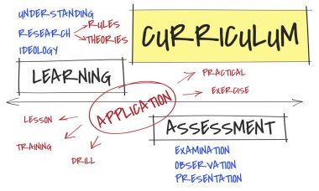
Core Concepts
1. What Is a Learning Assessment?
A structured way to determine whether learners achieved the learning objectives.
Assessment’s measure:
Knowledge (what they know)
Skills (what they can do)
Attitudes (what they believe or value)
Confidence (their readiness to apply)

Slide 296

Core Concepts
2. Types of Learning Assessments
A. Diagnostic Assessments – “Where are they now?”
Pre-tests
Self-rating checklists
Skill scans
Interviews

Slide 297

Core Concepts
B. Formative Assessments – “Are they learning during the course?”
Short quizzes
Micro-activities
Polls or check-ins
Practice tasks
Role-play feedback

Slide 298

Core Concepts
C. Summative Assessments – “Did they learn at the end?”
Final quizzes
Presentations
Practical demonstrations
Capstone tasks
Written assignments

Slide 299

Core Concepts
3. The Principle of Alignment (ADDIE + ISO 29993)
Assessment must be aligned to:
Learning objectives
Content
Instructional methods
Real-world application
If the objective is apply, don’t use a remember-level question.

Slide 300
Core Concepts
4. Bloom’s Taxonomy in Assessment Design
Bloom Level | Example Assessment
Remember | Multiple-choice questions
Understand | Short explanation questions
Apply | Scenarios, case-based tasks
Analyze | Comparing or diagnosing situations
Evaluate | Justifying decisions
Create | Designing a plan, solution, or product
Aim for higher-order thinking to build Master Trainers.

Slide 301

Core Concepts
5. Qualities of a Good Assessment (Validity, Reliability, Fairness)
Validity – Does it measure what it is supposed to measure?
Reliability – Would different assessors score it similarly?
Fairness – Is it unbiased, accessible, and inclusive?
Master Trainers always check:
clarity
relevance
cognitive level
cultural neutrality
alignment

Slide 302
Example Scenarios & Application
Example 1: Soft Skills Training
Objective: Apply the 4-step conflict resolution model.
Weak assessment: “Define conflict resolution.”
Strong assessment: “Analyze this scenario and apply the 4-step model.”
Example 2: Product Knowledge
Objective: Explain product features to a customer.
Weak: True/false questions.
Strong: Short role-play or recorded audio demonstration.

Slide 303

Example Scenarios & Application
Example 3: Leadership Workshop
Objective: Create a 30-day leadership plan.
Assessment: Learners design their own action plan.

Slide 304

Practical Tools & Frameworks
1. Assessment Design Checklist
Does the assessment align with the objective?
Is it practical for self-paced learning?
Is scoring clear?
Does it measure the right cognitive level?
Is it culturally inclusive?
Is feedback included?

Slide 305

Practical Tools & Frameworks
2. The “Triple-A” Assessment Framework
Use this to design simple, effective assessments:
A — Ask
“What evidence proves they achieved the objective?”
A — Assess
Choose the simplest assessment that provides that evidence.
A — Adjust
Revise based on clarity, fairness, and alignment.

Slide 306

PRACTICAL TOOLS
3. The A.S.A. Method for Designing Assessments
A simple method for trainers:
A — Align
Match the assessment to the objective.
S — Simplify
Choose the simplest method that still validly measures the objective.
A — Apply
Assess real-world application whenever possible.

Slide 307

Practical Tools & Frameworks
4. Templates for Simple Assessments
Quiz template (MCQs + short answer)
Observation/skill demo checklist
Case-study assessment
Performance task rubric
Self-reflection assessment form

Slide 308

PRACTICAL TOOLS
5. The “Five Questions” Test for Strong Assessments
What objective does this measure?
Is this the best method for this objective?
Is it clear what learners must do?
Can someone else grade it consistently?
Will the results provide actionable feedback?

Slide 309

PRACTICAL TOOLS
7. Rubrics (A Master Trainer’s Secret Weapon)
Rubrics show:
criteria
expectations
levels of mastery
They increase reliability and transparency.

Slide 310

PRACTICAL TOOLS
Sample rubric criteria:
accuracy
completeness
clarity
application
professionalism

Slide 311

Personalized Reflection Questions
Which assessment types do I usually rely on? Why?
How can I make my assessments more practical and application-focused?
What is one assessment I can redesign this week?
Which Bloom level do I want my learners to reach?
How can I ensure fairness and accessibility in my assessments?

Slide 312

PERSONALIZED REFLECTION QUESTIONS
What assessment methods do I tend to rely on most? Why?
Do my assessments genuinely measure real-world performance?
Where do I need to strengthen validity or alignment?
How can I integrate more performance-based assessments into my programs?
What type of assessment do my learners respond to best?
0

Slide 313

Application Exercise
Activity: Design One Simple Assessment
Choose one learning objective from any of your courses.
Then create:
One formative assessment
One summative assessment
One rubric or scoring guideline
This becomes part of your Master Trainer Certification Portfolio.

Slide 314

Assessment
Rubric Measures:
Alignment
Appropriateness
Clarity
Cognitive level
Transfer potential

Slide 315

APPLICATION EXERCISE
Design a Simple Formative and Summative Assessment
Choose one learning objective from a course you teach.
Create:
One formative assessment
One summative assessment
A rubric for the summative assessment
Upload or document your design in your Master Trainer Portfolio.

Slide 316

Summary
Simple assessments are powerful when aligned with objectives.
Assessments measure learning, not attendance.
A good assessment is valid, reliable, and fair.
Bloom’s Taxonomy helps design higher-level assessments.
Master Trainers design practical assessments that show real skill development.

Slide 317

SUMMARY
Assessments are the proof of learning.
Formative = progress; Summative = achievement.
The method must match the learning objective.
Strong assessments measure real-world performance, not just recall.
Rubrics increase fairness, reliability, and learner confidence.
Master Trainers design assessments that drive behavioral change and business impact.

Slide 318

Resources
Assessment Design Checklist
Formative Assessment Ideas List
Summative Assessment Template
Rubric Template
Case-Based Assessment Template
Diagnostic Pre-Assessment Worksheet

Slide 319

RESOURCES
Assessment Planning Template
Formative Assessment Ideas List
Summative Assessment Design Template
Performance Task Rubric
Alignment Triangle Worksheet
Question Quality Checklist
Assessment Validity Checklist

Slide 320
MODULE 4: ASSESSMENT & EVALUATION BASICS
LESSON 3: Gathering Feedback for Improvement
Introduction
“Feedback is a gift—but are you asking the right questions to truly receive it?”
Master Trainers don’t just teach—they listen to improve continuously.

Slide 321

Learning Objectives
By the end of this lesson, participants will be able to:
Explain the role of feedback in continuous learning and training improvement.
Design effective feedback mechanisms tailored to adult learners and organizational goals.
Analyze feedback data to identify trends, gaps, and opportunities for improvement.
Apply strategies to act on feedback while maintaining learner trust and psychological safety.
Integrate feedback into course redesign and personal development as a Master Trainer.

Slide 322

Why This Matters
Without feedback, even excellent training can stagnate.
Learners’ insights show what works and what doesn’t.
Feedback drives continuous improvement and learner satisfaction.
Organizations rely on data-driven insights to measure ROI and training impact (Kirkpatrick Levels 1–3).
Master Trainers treat feedback as a strategic tool, not a formality.

Slide 323

Core Concepts
1. What Is Feedback for Learning Improvement?
Feedback is structured information from learners, peers, or stakeholders about training effectiveness, usability, and impact.
Types:
Immediate feedback – collected during or right after a session
Delayed feedback – collected days/weeks later for reflection
360-degree feedback – from learners, peers, managers, and stakeholders

Slide 324

Core Concepts
2. Feedback Principles for Master Trainers
Actionable – provides information you can use
Specific – avoids general statements like “good” or “boring”
Constructive – focuses on improvement, not blame
Timely – collected soon enough to act on it
Safe & Anonymous – encourages honesty

Slide 325
Core Concepts
3. Common Feedback Mechanisms
Method | Purpose | Example
Surveys / Questionnaires | Quantitative & qualitative data | Likert scales, open-ended questions
Polls | Immediate engagement | “Which activity helped you most?”
Focus Groups | Deep qualitative insight | Small-group discussions post-training
Observation | Trainer or peer assessment | Checklists, session ratings
Self-Reflection | Learner insight on personal growth | Journals, guided questions
Digital Tools | Real-time analytics | Learning management system analytics

Slide 326

Core Concepts
4. Designing Effective Feedback Questions
Key Tips:
Align questions with learning objectives
Include open-ended and scaled questions
Ask about:
  Content relevance
  Engagement and facilitation
  Clarity and pacing
  Application potential
  Suggestions for improvement

Slide 327

Core Concepts
Example Open-Ended Questions:
“Which activity helped you apply the learning most?”
“What could make this session more practical?”
“What is one behavior you plan to implement after this training?”

Slide 328

Real-World Scenario
Scenario:
After a leadership workshop, only 3 participants filled in the feedback form.
Novice Trainer Response:
Assumes the training was fine and makes no changes.

Slide 329

Real-World Scenario
Master Trainer Response:
Analyzes low response rates
Introduces shorter, anonymous digital surveys
Adds guided reflection prompts during the session
Holds a brief post-session focus discussion
Applies insights to next workshop
Outcome: Feedback quality improves and course effectiveness increases.

Slide 330
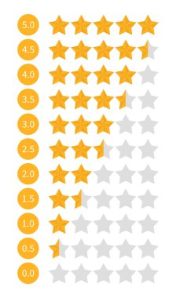
Practical Tools
1. Feedback Loop Framework
Cycle of Continuous Improvement:
Collect → Surveys, polls, observation
Analyze → Identify trends, gaps, successes
Act → Make adjustments to content, delivery, or materials
Communicate → Share changes with learners and stakeholders
Evaluate → Monitor impact in next session

Slide 331

Practical Tools
2. The 3-Step Feedback Processing Method
Sort → Organize feedback by theme
Prioritize → Focus on high-impact or recurring issues
Implement → Make changes, test, and monitor outcomes

Slide 332

Practical Tools
3. Feedback Data Visualization
Charts, graphs, and dashboards help track trends over time
Example: Rating of engagement vs. learning outcome per module

Slide 333

Personalized Reflection Questions
How do I currently collect feedback? Is it enough?
What barriers prevent learners from giving honest feedback?
How do I handle feedback that challenges my training style?
Which feedback mechanisms could improve my course design?
How will I close the feedback loop and demonstrate improvements?

Slide 334
Application Exercise
Activity: Create a Feedback Plan
Select a course you deliver.
Design a feedback strategy including:
  Two quantitative questions
  Two open-ended questions
  At least one post-session qualitative method (focus group, observation, reflection journal)
Plan how feedback will be analyzed and applied.

Slide 335

Assessment
Mastery Task
Design a feedback implementation plan for a 60-minute session, including:
Collection methods
Timeline
Analysis approach
Application strategy

Slide 336

Assessment
Rubric evaluates:
Alignment with learning objectives
Variety and relevance of feedback methods
Actionable insights planned
Feasibility and clarity
Alignment with Master Trainer standards

Slide 337

Summary
Feedback is essential for continuous improvement.
Master Trainers design feedback strategically and act on it.
Feedback must be actionable, specific, and safe.
Using multiple feedback methods increases reliability and depth.
Closing the feedback loop enhances credibility, learner trust, and session impact.

Slide 338

Resources
Feedback Plan Template
Session Feedback Questionnaire
Reflection Journal Prompts for Learners
Focus Group Discussion Guide
Feedback Analysis & Action Plan Template
Feedback Loop Tracker
Master Trainer Feedback Checklist

Slide 339

MODULE 4: ASSESSMENT & EVALUATION BASICS
LESSON 4: Using Reflection for Trainer Growth
Thought-Provoking Question:
“Are you teaching the same way you were trained—or the way your learners need to learn?”
Master Trainers use reflection not only to evaluate their sessions but to transform their own practice continuously.

Slide 340

Learning Objectives
By the end of this lesson, participants will be able to:
Explain the role of reflection in continuous trainer development.
Identify personal strengths, gaps, and biases in facilitation practice.
Apply structured reflection methods to enhance teaching effectiveness.
Develop a personal growth plan based on reflective insights.
Integrate reflection as a habitual process for ongoing Master Trainer growth.

Slide 341

Why This Matters
Even experienced trainers plateau without reflection.
Benefits of structured reflection include:
Improved facilitation skills
Better handling of difficult learners
Higher engagement and learning transfer
Self-awareness and emotional intelligence
Evidence-based professional growth
Master Trainers see every session as a learning opportunity for themselves, not just for learners.

Slide 342

Core Concepts
1. What Is Reflection for Trainers?
Reflection is a deliberate thinking process to analyze:
What went well
What could be improved
How learner needs were met
Alignment with objectives
Personal facilitation style
It is more than journaling—it is actionable insight for growth.

Slide 343

Core Concepts
2. Kolb’s Experiential Learning Cycle Applied to Trainers
Reflection is central to experiential learning:
Concrete Experience – The training session itself
Reflective Observation – Analyzing what happened
Abstract Conceptualization – Identifying patterns, principles, improvements
Active Experimentation – Applying insights to the next session
Master Trainers continuously iterate this cycle.

Slide 344

Core Concepts
3. Structured Reflection Techniques
A. Self-Reflection
Journal prompts after each session
Rating your own delivery on clarity, engagement, and impact
B. Peer Observation
Invite colleagues to observe and provide feedback
Focus on objective behaviors, not personal critique

Slide 345

Core Concepts
C. Learner Feedback Integration
Compare your perception vs. learner feedback
Look for alignment and gaps
D. Video Review
Record sessions and review for facilitation style, tone, pacing, and engagement

Slide 346

Core Concepts
4. Key Questions for Master Trainer Reflection
What worked well, and why?
What challenges arose, and how did I respond?
How did learners engage or disengage?
Did I meet the learning objectives?
What would I do differently next time?
Which personal strengths supported the session?
Which habits or biases might have limited impact?

Slide 347

Real-World Scenario
Scenario:
After a difficult virtual training session, learners disengaged during group activities.
Novice Trainer Response:
Feels frustrated, blames technology or learners.

Slide 348

Real-World Scenario
Master Trainer Response:
Reflects on facilitation style, pacing, and activity design
Seeks peer feedback
Checks session data (polls, chat participation)
Identifies improvements: clearer instructions, smaller breakout groups, interactive prompts
Applies changes in next session
Outcome: Engagement and learner satisfaction improve steadily.

Slide 349

Practical Tools
1. The REFLECT Framework for Trainer Growth
R — Review: Analyze session objectives and outcomes
E — Evaluate: Identify what worked and what didn’t
F — Feedback: Compare self-assessment with learner/peer input
L — Learn: Extract lessons and principles
E — Experiment: Apply changes to future sessions
C — Capture: Document insights
T — Track: Monitor improvement over time

Slide 350

Practical Tools
2. Reflection Journal Template (Master Trainer Version)
Sections include:
Session details (topic, duration, learners)
Personal delivery rating (1–5 scale)
Challenges & successes
Learner engagement notes
Adjustments for next session
Key takeaways

Slide 351

Practical Tools
3. Peer Observation Checklist
Clarity of instructions
Engagement techniques used
Handling questions and difficult participants
Energy and tone
Alignment with objectives
Reflection notes

Slide 352

Personalized Reflection Questions
Which facilitation techniques consistently engage learners?
What personal habits or biases might hinder my impact?
How do I respond under pressure or when challenges arise?
What patterns do I notice across multiple sessions?
How will I integrate insights into my Master Trainer growth plan?

Slide 353

Application Exercise
Activity: Post-Session Reflection
Select a recent training session you conducted.
Complete the REFLECT framework step by step.
Document:
  Strengths
  Areas for improvement
  Action plan for next session
Schedule follow-up review after your next session to track progress.

Slide 354

Assessment
Part A: Knowledge Check
Match reflection methods with their purpose (self, peer, learner feedback, video analysis).
Identify which steps in REFLECT correspond to Kolb’s cycle stages.

Slide 355

Assessment
Part B: Mastery Task
Develop a personal reflection portfolio for one month of sessions:
Minimum of 4 sessions reflected
Use REFLECT framework for each
Identify 2 actionable improvement strategies per session
Track implementation and learner outcomes

Slide 356

Assessment
Rubric evaluates:
Depth of reflection
Alignment with learning objectives
Actionable insights
Evidence of growth and implementation
Consistency and habit formation

Slide 357

Summary
Reflection is the engine of Master Trainer growth.
Structured reflection turns experience into continuous improvement.
Integrating self, peer, and learner feedback ensures accuracy and actionable insight.
Habitual reflection drives skill development, engagement mastery, and training impact.
Master Trainers are reflective practitioners, always learning from every session.

Slide 358

Resources
REFLECT Framework Worksheet
Personal Reflection Journal Template
Peer Observation Checklist
Learner Feedback Integration Guide
Reflection Action Plan Template
Master Trainer Growth Tracker

