Slide 1
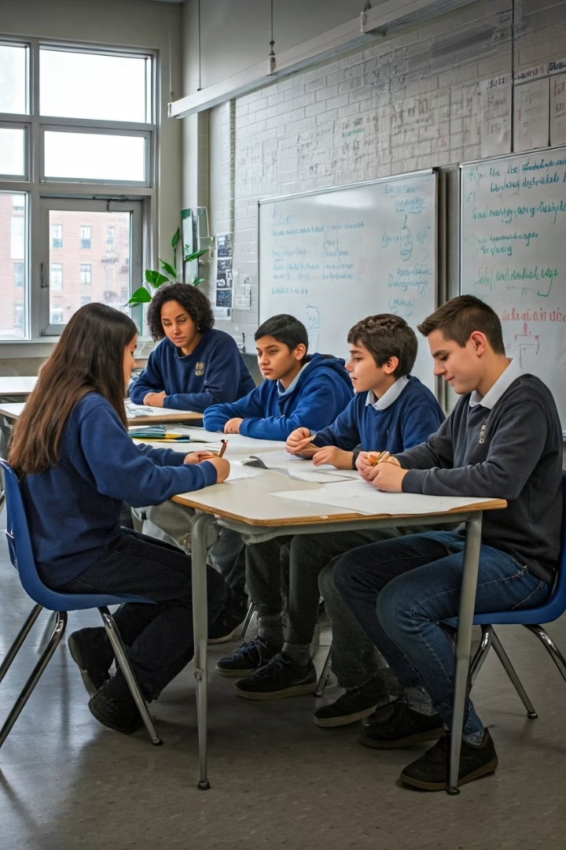

Module 2: Introduction to the 6 Cs of Global Competencies
This unit explores essential skills for success in a rapidly changing world. It introduces the six core competencies: Critical Thinking, Communication, Collaboration, Creativity, Character, and Citizenship.
by Adebukola Oyewole

Slide 2


Learning Objectives
1
Define the 6 Cs
Understand and describe each global competency.
2
Identify Examples
Recognize the 6 Cs in various contexts.
3
Apply the 6 Cs
Design engaging learning activities.
4
Importance of the 6 Cs/ Reflect on Growth
Assess personal strengths and areas for development.
by Adebukola Oyewole

Slide 3
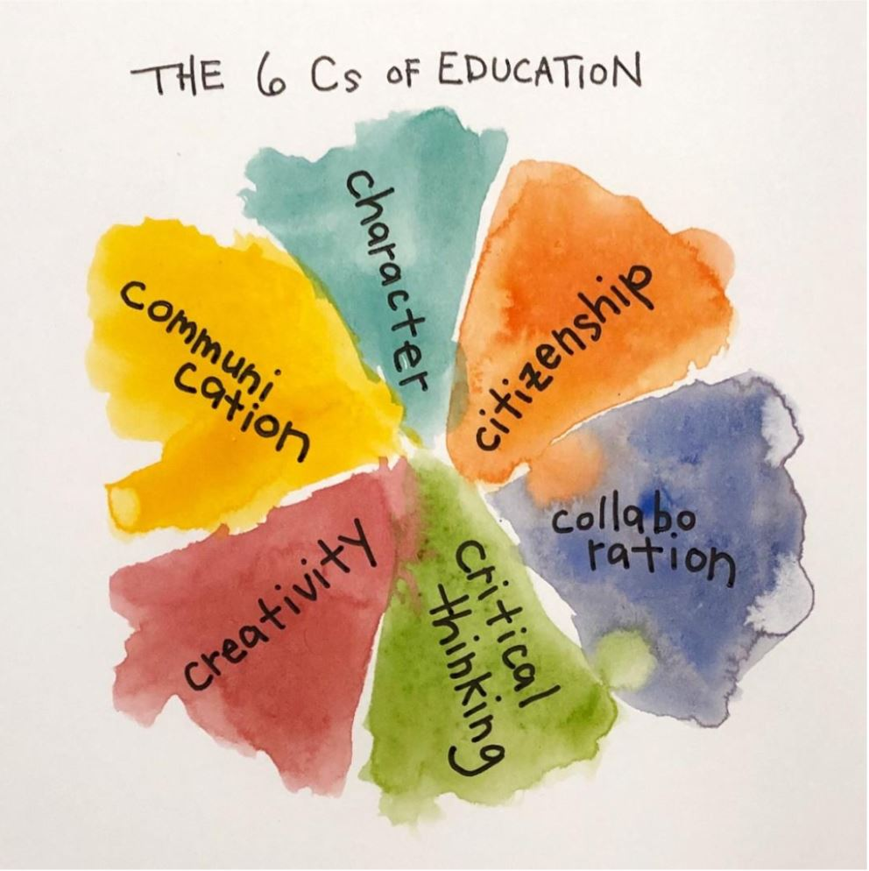
by Adebukola Oyewole

Slide 4
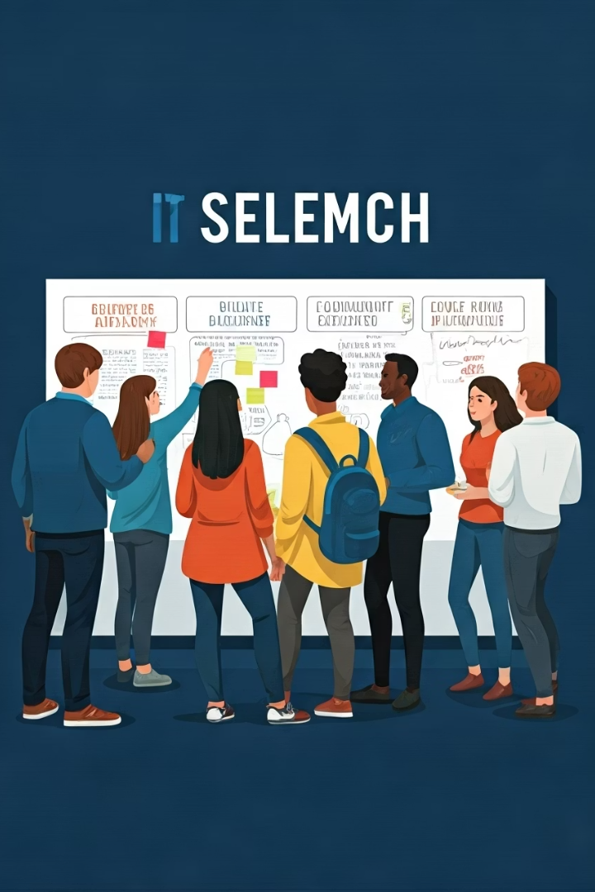



Critical Thinking & Problem Solving
Analyze Information
Evaluate evidence thoughtfully.
Apply Reasoning
Solve real-world problems.
Design Solutions
Address local school or community issues.
Example: A student examines multiple sources before writing a research paper to ensure accuracy and objectivity.
Application: Use evidence-based reasoning in problem-solving. Ask “why” and “how” questions to go beyond surface understanding. Weigh pros and cons before making a decision.

Slide 5
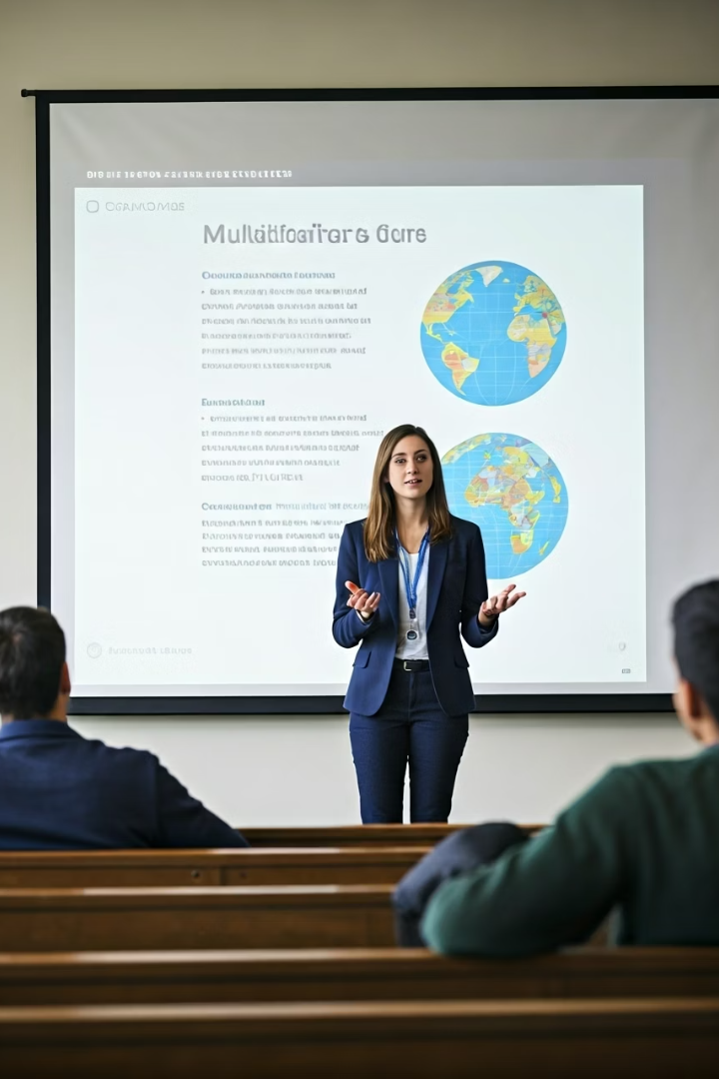



Communication
Express Ideas Clearly
Utilize diverse formats effectively.
Practice Active Listening
Engage in respectful dialogue.
Present on Global Issues
Create multimedia presentations.
Example: A teacher uses stories, visuals, and real-life examples to explain a concept to students.
Application: Practice active listening and feedback. Adapt tone and style to suit the audience. Use visual aids to enhance understanding.

Slide 6
Collaboration
Work Effectively
Value Diversity
Team Research Project
Achieve shared goals in teams.
Manage conflict constructively.
Collaborate on a presentation.
Example: A group of engineers works together to design a sustainable housing project.
Application: Share roles and responsibilities based on strengths.
Resolve conflicts constructively.
Value and integrate diverse perspectives.
by Adebukola Oyewole

Slide 7






Creativity & Innovation
Example: A designer creates an eco-friendly product from recycled materials.
Application: Brainstorm multiple solutions to a challenge. Combine existing ideas in new ways. Experiment with approaches without fear of failure.
Develop Original Ideas
Foster unique perspectives.
Take Risks
Embrace new approaches.
Iterate Designs
Refine solutions. Create prototypes.
by Adebukola Oyewole

Slide 8




Character Education
Example: A student admits to a mistake in an assignment and works to correct it.
Application: Show perseverance in challenging tasks. Treat others with respect and empathy. Make decisions guided by strong moral values.
Demonstrate Integrity
Act with honesty and strong moral principles.
Practice Empathy
Understand and share feelings of others.
Cultivate Resilience
Bounce back from challenges.
Ethical Decision-Making
Journal on classroom dilemmas.
by Adebukola Oyewole

Slide 9






Citizenship
Example: Volunteering to clean up a local beach to protect marine life.
Application: Participate in community improvement projects. Stay informed about local and global issues. Advocate for fairness, equity, and sustainability.
Act Responsibly
Contribute ethically to society.
Understand Roles
In local and global communities.
Plan Service Project
Align with UN SDGs.
by Adebukola Oyewole

Slide 10

Templates for Classroom Use
6 Cs Reflection
Project Planning
Facilitate self-assessment and growth awareness.
Structure student projects effectively.
Peer Feedback
Encourage constructive collaboration.
These templates scaffold student thinking and promote collaborative learning.

Slide 11
Overall Significance in Curriculum Development
Future-readiness: The 6 Cs ensure students are equipped with both academic and life skills needed for a fast-changing, interconnected world.
Holistic education: Moves learning beyond academics to include social, emotional, and ethical development.
Global competitiveness: Produces graduates who can thrive in international work environments and address global challenges.
Curriculum balance: Helps educators integrate skills across subjects, creating rich, interdisciplinary learning experiences.
by Adebukola Oyewole

Slide 12

Reflection & Next Steps
1
Reflect
Integrate 6 Cs into teaching.
2
Apply
Incorporate into curriculum planning.
3
Facilitate
Student self-assessments.
4
Explore
Cross-curricular opportunities.
by Adebukola Oyewole

Slide 13
Module 2: The 6 Cs of Global Competencies:
Short Answer: Define each of the 6 Cs of Global Competencies and give one practical example of how it can be demonstrated in a classroom or community setting.
Scenario-Based: You are working on a group project to solve a local environmental issue. How would you apply Collaboration and Critical Thinking to ensure the project’s success?
Reflective: Which of the 6 Cs do you consider your strongest, and which needs the most improvement? Provide reasons and describe one action you can take to improve the weaker competency.
Application: Design a short learning activity that integrates Creativity and Communication. Explain how the activity will help students build both skills.
Case Study: A student in your class often struggles to participate in group work due to shyness. Which of the 6 Cs would you focus on to help the student engage more, and what strategies would you use?
by Adebukola Oyewole

