Slide 1

Adebukola Oyewole, a versatile professional in education for over 14 years. She is a seasoned teacher passionate about fostering academic growth with experience spanning from nurturing preschoolers to guiding elementary school students.
Additionally, She serves as an educational consultant at E-Fusion Academy, offering valuable insights and innovative solutions to schools and institutions seeking to enhance their educational practices.
Embracing the digital landscape, Adebukola extends her reach as an online tutor, providing personalized learning experiences to students worldwide. Her dedication to student success, coupled with her expertise, makes her a trusted figure in the education community.

Slide 2


Curriculum Design and Development for 21st Century Educators
A comprehensive, self-paced online course structured across three progressive levels designed for Primary and Secondary School Educators, Curriculum Leaders, and Instructional Designers.
by Adebukola Oyewole

Slide 3
Course Structure
Level 3: Advanced
Level 2: Intermediate
Curriculum Leadership and Innovation
Level 1: Beginner
Designing and Implementing Curriculum
Foundations of Curriculum Design
Each level builds core knowledge, practical skills, and advanced leadership competencies needed to design and implement future-ready curriculum frameworks.
by Adebukola Oyewole

Slide 4

Level 1: Foundations of Curriculum Design
Curriculum Literacy
Curriculum Models
Define key curriculum terms and differentiate among various curriculum types
Identify and explain major approaches including subject-, learner-, and problem-centered
Global Competencies
Understand the 6 Cs and their relevance to 21st-century learning

Slide 5

Level 1: Skills & Outcomes
Additional Learning Outcomes
Skills Acquired
Curriculum literacy
Apply foundational instructional design principles (Bloom's Taxonomy, UDL, Constructivism)
Planning fundamentals
Outcome alignment
Introduction to global competencies
Conduct basic needs assessment
Align curriculum goals with learning outcomes

Slide 6




Level 2: Designing and Implementing Curriculum
Competency Integration
Project-Based Learning
Integrate the 6 Cs into curriculum units using practical classroom strategies
Design and apply interdisciplinary and project-based learning experiences
Technology Integration
Inclusive Design
Incorporate educational technology effectively, promoting digital literacy and citizenship
Design inclusive curricula that meet diverse learner needs, including those with learning differences
by Adebukola Oyewole

Slide 7
Level 2: Skills Acquired
Competency-based design
1
Digital integration
2
Inclusive strategies
3
Interdisciplinary planning
4
Project-based learning
5
by Adebukola Oyewole

Slide 8

Level 3: Curriculum Leadership and Innovation
Evaluation
Evaluate curriculum effectiveness using data, tools, and stakeholder feedback
Leadership
Lead curriculum innovation and reform initiatives within institutions
Global Alignment
Align curriculum with global trends, ethical considerations, and education policy
Future Skills
Design learning experiences that foster entrepreneurship, adaptability, and lifelong learning
by Adebukola Oyewole

Slide 9
Level 3: Advanced Skills
Leadership in curriculum reform
Policy alignment
Strategic planning
Innovation in education
Future-focused curriculum development
by Adebukola Oyewole

Slide 10
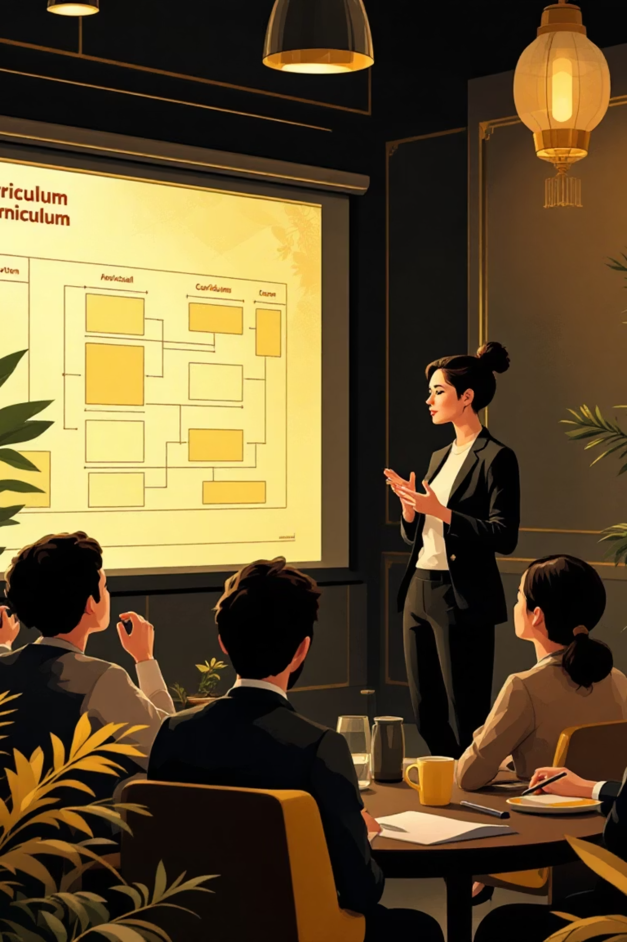
Full Course Outcomes
Confidently design, implement, and lead curriculum initiatives that are inclusive, digital-ready, and globally relevant
Build learning environments that equip students with critical 21st-century competencies
Position yourself as a curriculum innovator and change agent in your institution and community

Slide 11
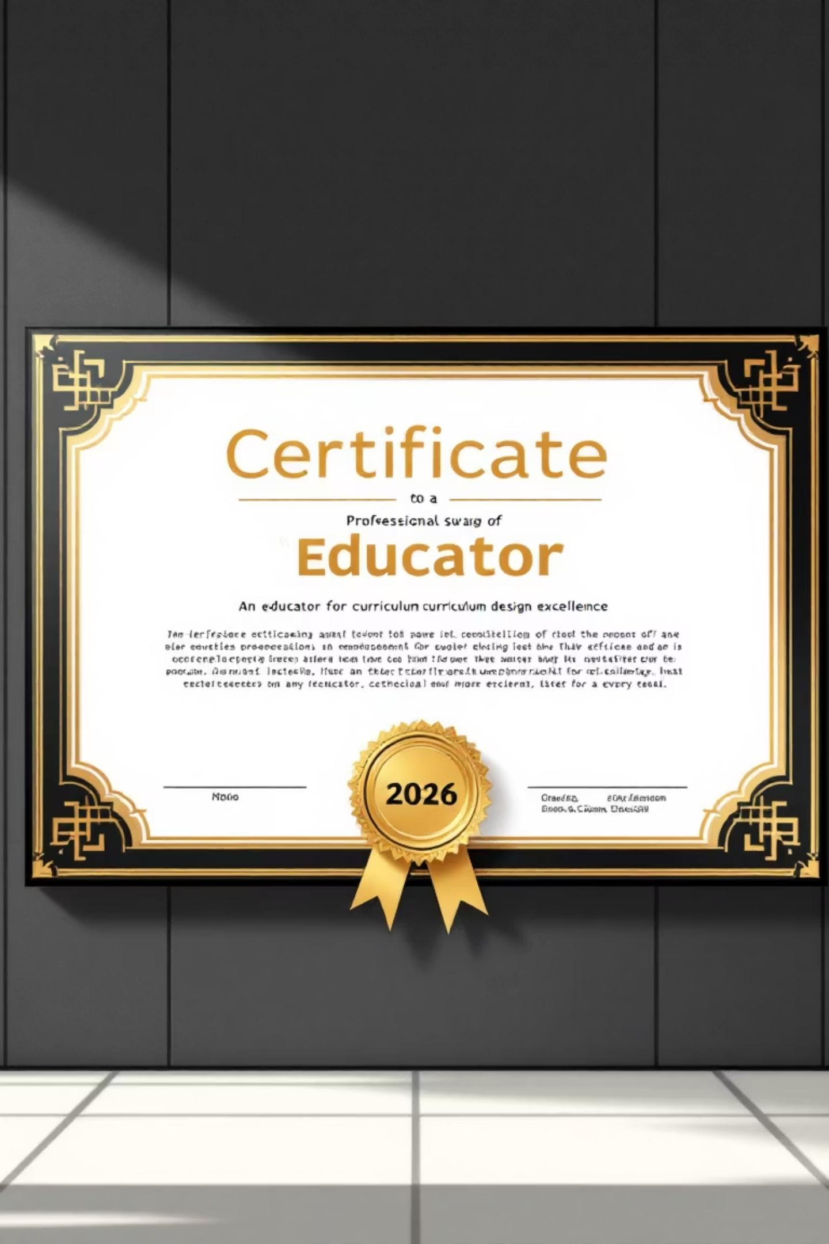
Certification
Participants receive a Certificate of Completion at the end of each level
Demonstrate your expertise and commitment to educational excellence
by Adebukola Oyewole

