Slide 1

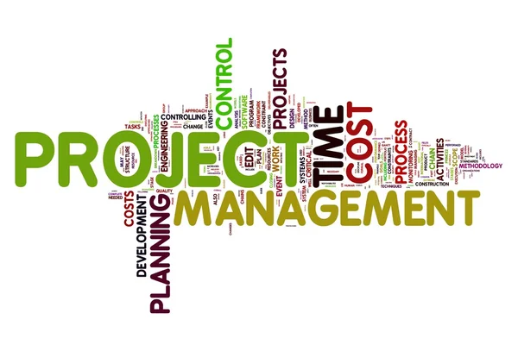
Module-9:1
PROJECT MANAGEMENT SKILLS FOR EDUCATION CONSULTANTS
Introduction to Project Management for Education Consultants.
Project management is a structured approach to planning, organizing, and managing resources to achieve specific goals within a defined timeline. For education consultants, project management is crucial for handling tasks like curriculum development, school improvement initiatives, or professional development programs. This section provides an overview of project management, its importance in education consulting, the project lifecycle, and the essential skills required for effective project management.

Slide 2
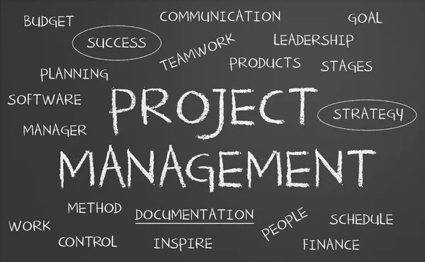
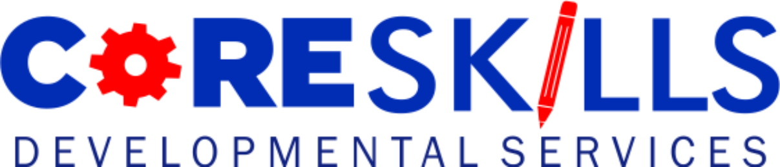
Module-9:1
PROJECT MANAGEMENT SKILLS FOR EDUCATION CONSULTANTS
A. Understanding Project Management
Project management involves applying knowledge, skills, tools, and techniques to project activities to meet the project objectives efficiently and effectively.
Definition: A project is a temporary endeavor undertaken to create a unique product, service, or result.
Importance for Education Consultants:
Helps deliver client projects on time and within budget.
Ensures clarity and alignment on objectives and outcomes.
Enhances efficiency by organizing resources and timelines.
Reduces risks through structured planning and monitoring.

Slide 3

Module-9:1
PURPOSE OF PROJECT MANAGEMET IN EDUCATION CONSULTING
B. Significance in Education Consulting
Education consultants often handle complex, multi-faceted projects that involve various stakeholders and require careful coordination. Examples include:
Designing and implementing teacher training programs.
Leading accreditation or compliance projects for schools.
Developing curriculum aligned with specific educational standards.
Launching community outreach or engagement initiatives.
Effective project management ensures that such projects are executed successfully, achieving the desired results while maintaining quality and accountability.

Slide 4
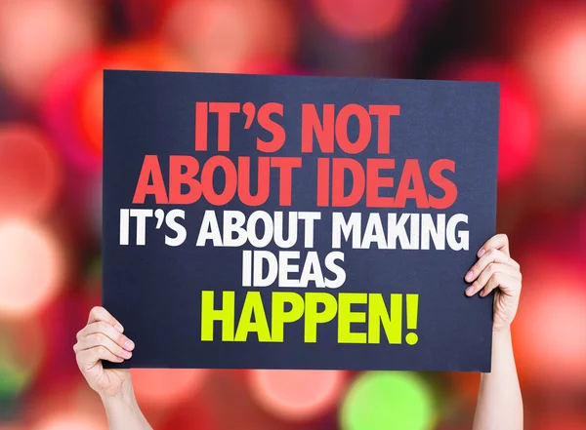
Module-9:1
PURPOSE OF PROJECT MANAGEMET IN EDUCATION CONSULTING
C. Execution
Purpose: Implement the project plan and manage team activities.
Key Activities: Assign tasks to team members and provide necessary resources.
Monitor progress and address challenges in real-time.
Communicate regularly with stakeholders.
Example for Consultants: Conducting workshops or training sessions as part of a professional development program.

Slide 5
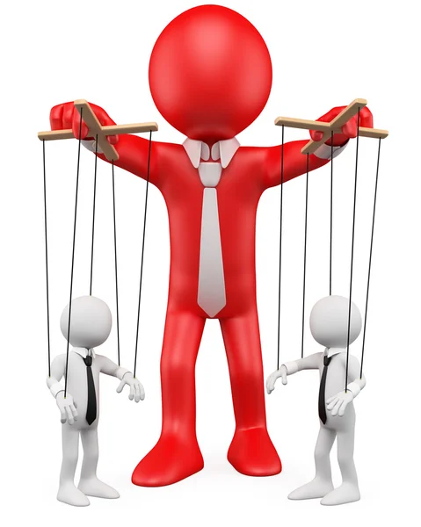
Module-9:1
PURPOSE OF PROJECT MANAGEMET IN EDUCATION CONSULTING
D. Monitoring and Controlling
Purpose: Track progress and ensure alignment with the project plan.
Key Activities: Measure performance using key metrics (e.g., timelines, budgets).
Identify deviations from the plan and make adjustments.
Report updates to stakeholders.
Example for Consultants: Evaluating teacher feedback during a training program to adjust content delivery.

Slide 6
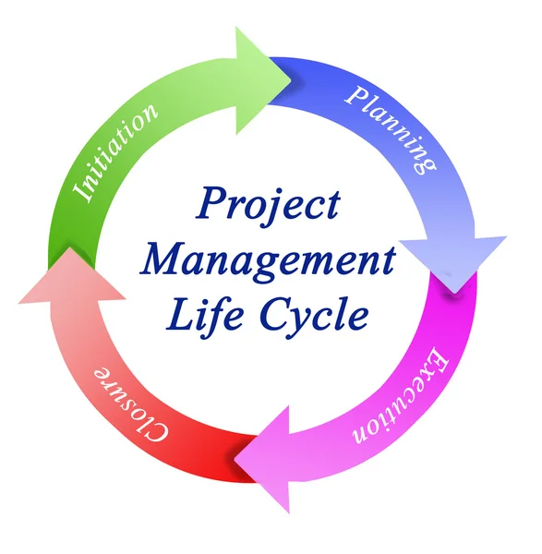
Module-9:1
PURPOSE OF PROJECT MANAGEMET IN EDUCATION CONSULTING
E. Closure
Purpose: Formally conclude the project and review its success.
Key Activities: Deliver final outcomes (e.g., reports, presentations, tools).
Gather feedback from stakeholders.
Document lessons learned and project results.
Example for Consultants: Presenting findings and recommendations after a school needs assessment.

Slide 7
Module-9:1
PROJECT MANAGEMENT SKILLS
3. Key Skills for Project Management
Successful project management requires a combination of technical and interpersonal skills. As education consultants work with diverse stakeholders, the following skills are particularly important:
A. Leadership
Importance: Inspires and motivates team members to achieve project goals.
Applications: Providing clear direction and support to team members.
Making decisions that align with the project’s objectives.
Leading by example and maintaining accountability.
B. Communication
Importance: Ensures clear understanding and alignment among stakeholders.
Applications: Creating detailed project documentation (e.g., plans, updates).
Facilitating meetings to discuss progress and address challenges.
Managing stakeholder expectations and resolving conflicts.

Slide 8
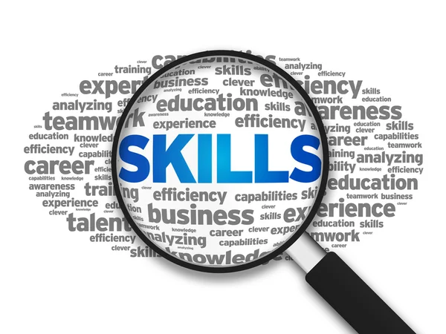
Module-9:1
PROJECT MANAGEMENT SKILLS
C. Time Management
Importance: Keeps the project on track to meet deadlines.
Applications: Prioritizing tasks to ensure efficient use of resources.
Setting realistic deadlines and adhering to the timeline.
Avoiding delays by proactively identifying potential bottlenecks.
D. Problem-Solving
Importance: Enables the consultant to address unexpected challenges effectively.
Applications: Identifying the root cause of issues and implementing solutions.
Managing risks and adjusting the project plan as needed.
Maintaining focus on objectives despite obstacles.

Slide 9
Module-9:1
PROJECT MANAGEMENT SKILLS
Research:
Understand the school’s history, student demographics, and community values.
Analyze current staff composition and identify areas where diversity or expertise may need enhancement.
Define Priorities:
Work with clients to determine what matters most—academic performance, student well-being, innovation, or operational excellence.
Tailor Recruitment Efforts:
Develop recruitment materials (e.g., job descriptions, advertisements) that clearly reflect the school’s identity and attract candidates who share their vision.
Key Takeaways:
A thorough recruitment needs assessment sets the foundation for effective hiring by pinpointing exactly what the school requires.
Recruitment strategies must align with a school’s unique mission, vision, and culture to ensure successful long-term hires.
Adapting approaches to the institution’s context—whether urban or rural, public or private—enhances the relevance and appeal of recruitment campaigns.
By focusing on these elements, consultants help schools build cohesive teams that contribute to their success and enhance the learning environment.

Slide 10
Module-9:1
PROJECT MANAGEMENT SKILLS
Practical Example: Education Consultant Project Management
Scenario:
A school hires an education consultant to develop a STEM curriculum for middle schools.
How Project Management Helps:
1.Initiation: The consultant meets with school leaders to understand their vision and goals for the STEM program.
2.Planning: A detailed plan is created, outlining curriculum development stages, resource needs, and deadlines.
3.Execution: The consultant collaborates with teachers to design and test lesson plans, providing training on STEM tools.
4.Monitoring: Regular check-ins ensure the curriculum aligns with standards and addresses teacher feedback.
5.Closure: The final curriculum is delivered, and a post-implementation review is conducted to identify strengths and areas for improvement.

Slide 11

Module-9:1
PRACTICAL STEPS FOR CONSULTANTS FOR EFFECTIVE RECRUITMENT
Project management is a critical skill for education consultants, enabling them to deliver complex projects efficiently and effectively. By understanding the project lifecycle—initiation, planning, execution, monitoring, and closure—and mastering key skills such as leadership, communication, time management, and problem-solving, consultants can ensure the success of their initiatives while fostering strong relationships with clients and stakeholders.

Slide 12
Module-9:2
PROJECT INITIATION AND STAKEHOLDERS ENGAGEMENT
1. Defining Project Goals and Objectives
A. Importance of Clear Goals
Setting clear, measurable, and achievable goals is crucial to ensure that all efforts are directed toward meaningful outcomes. In the context of education consulting:
Goals guide the project’s direction and scope.
Well-defined goals help measure success and justify resource allocation.
They ensure that all stakeholders have a shared understanding of the project’s purpose.
9.2: Project Initiation and Stakeholder Engagement
The initiation phase of project management is the foundation for the success of any project. It involves defining clear goals, identifying stakeholders, and ensuring their engagement in the process. For education consultants, this phase is critical to aligning projects with educational outcomes and gaining stakeholder buy-in. This module outlines how to define project goals, identify stakeholders, and engage them effectively.

Slide 13
Module-9:2
PROJECT INITIATION AND STAKEHOLDERS ENGAGEMENT
B. How to Define Goals and Objectives
To set goals that align with educational outcomes, use the SMART framework:
1.Specific: Clearly state what the project aims to achieve.
Example: “Improve student literacy rates in grade 4 by 10% within one academic year.”
2.Measurable: Include metrics to track progress and success.
Example: “Train 50 teachers on new reading strategies and evaluate their implementation through classroom observations.”
3.Achievable: Ensure the goals are realistic given the resources and constraints.
Example: Focus on a manageable number of schools or teachers.
4.Relevant: Align the goals with broader educational priorities or school improvement plans.
Example: Link the literacy project to national curriculum standards.
5.Time-Bound: Set deadlines for completion.
Example: “Complete teacher training by June and begin implementation in September.”
C. Aligning Goals with Educational Outcomes
Student Outcomes: Goals should prioritize student learning, skills development, and well-being.
Teacher Development: Focus on building teacher capacity to implement sustainable change.
School Performance: Address systemic challenges like resource allocation or curriculum gaps.

Slide 14
Module-9:2
PROJECT INITIATION AND STAKEHOLDERS ENGAGEMENT
2. Stakeholder Identification and Engagement
A. Identifying Stakeholders
Stakeholders are individuals or groups who have an interest in or influence over the project. For education consultants, stakeholders can include:
1.Internal Stakeholders:
School Administrators: Principals, department heads.
Teachers: Classroom educators and subject specialists.
Students: Direct beneficiaries of educational projects.
2.External Stakeholders:
Parents and Guardians: Representing the community's voice.
Educational Authorities: District officials, policymakers, or accreditation bodies.
Funders: Organizations or donors financing the project.
3.Support Staff: IT staff, librarians, or non-teaching staff involved in implementation.

Slide 15
Module-9:2
PROJECT INITIATION AND STAKEHOLDERS ENGAGEMENT
B. Mapping Stakeholder Roles
Understanding the roles and influence of each stakeholder helps in effective engagement:
Decision-Makers: Approve the project’s scope and budget (e.g., school board).
Implementers: Directly execute project activities (e.g., teachers, staff).
Beneficiaries: Receive the outcomes of the project (e.g., students, parents).
Advisors: Provide expertise or guidance (e.g., academic consultants, local experts).
C. Techniques for Effective Stakeholder Engagement
Stakeholder engagement involves proactive communication and involvement to gain their support and ensure project success.
1. Communication Strategies
Tailor Messages to Stakeholders:
Use different communication styles for different groups (e.g., technical details for funders, simplified summaries for parents).
Regular Updates:
Share progress reports through newsletters, emails, or meetings.
Example: Monthly updates on a curriculum revision project to inform stakeholders about milestones achieved.
Feedback Mechanisms:
Use surveys, suggestion boxes, or focus groups to gather stakeholder opinions.

Slide 16
Module-9:2
PROJECT INITIATION AND STAKEHOLDERS ENGAGEMENT
2. Involvement Techniques
Workshops and Training:
Involve teachers and administrators in workshops to co-create solutions.
Example: Collaborative design of a professional development program.
Stakeholder Meetings:
Hold planning and review meetings to discuss goals, progress, and challenges.
Advisory Committees:
Form committees that include representatives from all key stakeholder groups.
Example: A literacy project steering committee with teachers, parents, and district officials.
3. Conflict Resolution
Identify Conflicts Early:
Anticipate and address concerns (e.g., resistance to change or differing priorities).
Mediate Solutions:
Facilitate discussions to find common ground and compromise.

Slide 17
Module-9:2
PROJECT INITIATION AND STAKEHOLDERS ENGAGEMENT
Practical Example: Stakeholder Engagement in Action
Scenario:
An education consultant is hired to implement a digital learning initiative in secondary schools.
Steps to Initiate and Engage Stakeholders:
1.Define Goals:
Goal: Introduce interactive learning tools to improve math proficiency by 15% in one year.
2.Identify Stakeholders:
Internal: School administrators, math teachers, IT staff, students.
External: Parents, district education officers, technology vendors.
3.Engage Stakeholders:
Conduct focus groups with teachers and students to understand their needs.
Organize parent meetings to explain the benefits and address concerns.
Collaborate with IT staff to ensure technical readiness.

Slide 18
Module-9:2
PROJECT INITIATION AND STAKEHOLDERS ENGAGEMENT
A comprehensive plan is developed with stakeholder input, increasing buy-in and ensuring smoother implementation.
Project initiation and stakeholder engagement are critical for setting a solid foundation for educational projects. By defining SMART goals and aligning them with educational outcomes, consultants can provide clear direction for their projects. Identifying and engaging stakeholders ensures collaborative effort, addressing concerns early, and leveraging collective expertise. Together, these practices pave the way for successful and impactful education projects.

Slide 19

Module-9:3
PROJECT PLANNING AND METHODOLOGIES
9.3: Project Planning and Methodologies
Project planning is a critical step in project management that lays the foundation for successful execution. It involves defining the project scope, setting timelines, budgeting, allocating resources, and selecting the right management methodology. For education consultants, a well-crafted project plan ensures clarity, efficiency, and alignment with educational goals. This note outlines how to create a comprehensive project plan, explores key project management methodologies, and provides guidance on selecting the right approach.

Slide 20
Module-9:3
PROJECT PLANNING AND METHODOLOGIES
1. Creating a Comprehensive Project Plan
A project plan is a formal document that outlines how a project will be executed, monitored, and closed. It includes details such as scope, timelines, resources, and budget.
A. Developing Project Scope Statements
Definition: The project scope outlines the boundaries of the project, including deliverables, objectives, and constraints.
Steps to Create a Scope Statement:
Define Deliverables:
Clearly describe the outputs of the project (e.g., curriculum, workshops, reports).
Identify Objectives: Specify what the project aims to achieve (e.g., improved student performance, teacher skill enhancement).
Set Boundaries: Define what is included and excluded in the project to avoid scope creep.
List Success Criteria: Determine how success will be measured (e.g., completion of tasks on time, stakeholder satisfaction).
Example: "The project will develop a STEM curriculum for middle schools, including lesson plans and teacher guides, to be delivered within six months."
B. Creating Timelines
Purpose: Timelines help track progress and ensure the project stays on schedule.
Steps to Develop a Timeline: Break down the project into phases or milestones (e.g., initiation, planning, implementation, review).
Assign deadlines to each task or milestone.
Use tools like Gantt charts or project management software to visualize timelines.

Slide 21
Module-9:3
PROJECT PLANNING AND METHODOLOGIES
Example
Month 1: Needs assessment and stakeholder consultations.
Month 2-4: Curriculum design and pilot testing.
Month 5-6: Implementation and evaluation.
C. Budgeting and Resource Allocation
Budgeting: Estimating the cost of completing the project.
Include costs for personnel, materials, travel, and contingencies.
Example: -N-5,000,000 allocated for teacher training workshops.
Resource Allocation: Assigning resources such as team members, tools, and materials to specific tasks.
Ensure optimal utilization to avoid bottlenecks.
Example: Allocate 2 instructional designers for curriculum development.

Slide 22
Module-9:3
PROJECT PLANNING AND METHODOLOGIES
2. Project Management Methodologies
Project management methodologies provide frameworks for planning, executing, and monitoring projects. Choosing the right methodology depends on the nature and scope of the project.
A. Overview of Common Methodologies
1.Waterfall Methodology:
Description: A linear, sequential approach where each phase is completed before moving to the next.
Key Features:
Structured and predictable.
Best for projects with well-defined requirements.
Applications in Education Consulting:
Developing a fixed curriculum or accreditation process.
Example: Designing a compliance report for a school district.
Advantages:
Clear stages and deliverables.
Easier to track progress.
Limitations:
Inflexible; difficult to adapt if requirements change.

Slide 23
Module-9:3
PROJECT PLANNING AND METHODOLOGIES
2.Agile Methodology:
Description: A flexible, iterative approach that prioritizes collaboration and adaptability.
Key Features:
Work is divided into short cycles (sprints).
Frequent feedback and adjustments.
Applications in Education Consulting:
Developing a dynamic teacher training program.
Example: Iteratively designing and testing lesson plans.
Advantages:
Highly adaptive to changes.
Encourages stakeholder engagement.
Limitations:
Requires consistent collaboration and communication.
3.Hybrid Methodology:
Description: Combines elements of both Waterfall and Agile approaches.
Key Features: Use Waterfall for high-level planning and Agile for execution.
Applications in Education Consulting:
Large-scale projects with both fixed and flexible components.
Example: Using Waterfall for timeline planning and Agile for resource development.
Advantages: Balances structure with flexibility.
Limitations:
Can be complex to manage.

Slide 24
Module-9:3
PROJECT PLANNING AND METHODOLOGIES
3. Selecting the Right Methodology for Education Consulting Projects
Factors to Consider
1.Project Complexity:
Simple Projects: Waterfall may suffice for straightforward tasks.
Complex Projects: Agile is better for dynamic, evolving needs.
2.Stakeholder Involvement:
High stakeholder input favors Agile.
Minimal input may lean towards Waterfall.
Flexibility Needs:
If project requirements are likely to change, Agile or Hybrid is more suitable.

Slide 25
Module-9:3
PROJECT PLANNING AND METHODOLOGIES
4.Time Constraints:
Agile allows quicker adaptations to meet tight deadlines.
Example of Methodology Selection
Scenario: A consultant is hired to improve a school’s digital literacy program.
Requirements Known: Use Waterfall for setting goals and deliverables.
Ongoing Feedback Needed: Use Agile for pilot testing and iterative improvement.
Practical Example: Project Plan for Teacher Training Initiative
Scope Statement:
●Develop and deliver a professional development program on inclusive teaching strategies to 100 teachers within three months.
Timeline:
Phase 1: Needs Assessment (2 weeks).
Phase 2: Program Design (6 weeks).
Phase 3: Training Delivery (4 weeks).
Phase 4: Post-Training Evaluation (2 weeks).

Slide 26
Module-9:3
PROJECT PLANNING AND METHODOLOGIES
5.Budget and Resources:
5,000,000 for materials, trainers, and evaluation tools.
Allocate 3 trainers and 2 support staff.
Methodology:
Use Hybrid: Waterfall for planning and training schedule.
Agile for designing and refining training content based on teacher feedback.
Creating a comprehensive project plan ensures clarity and direction, while effective budgeting and resource allocation maximize efficiency. Understanding project management methodologies like Waterfall, Agile, and Hybrid allows education consultants to choose the approach that best suits the project’s complexity and flexibility needs. By combining structured planning with adaptive execution, consultants can deliver impactful educational projects.

Slide 27
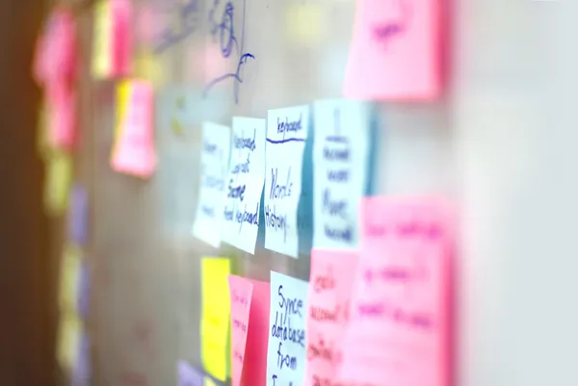
Module-9:4
MANAGING PROJECT CREEP
9.4: Managing Project Creep
Project creep, also known as scope creep, is a common challenge in project management where the project's scope expands beyond its original objectives. This often happens due to unplanned changes, poor communication, or inadequate planning. For education consultants, managing project creep is essential to ensure projects are completed on time, within budget, and with the intended outcomes.

Slide 28
Module-9:4
MANAGING PROJECT CREEP
1. Understanding Project Creep
A. Defining Project Creep
●Definition: Project creep occurs when additional tasks, features, or objectives are added to a project without proper evaluation or adjustment to resources and timelines.
●Example in Education: A project initially focused on designing a literacy program for Grade 3 is expanded to include Grades 4 and 5 without revising the budget or timeline.
B. Causes of Project Creep
1.Poor Scope Definition:
Vague or incomplete project scope statements.
Example: Failing to specify the exact deliverables for a teacher training program.
2.Uncontrolled Stakeholder Requests:
Adding extra tasks at stakeholders’ requests without formal approval.
Example: A school principal asking for additional curriculum modules late in the project.
3. Lack of Change Management Processes:
Absence of a formal procedure to evaluate and approve changes.
4.Inadequate Communication:
Misunderstandings among team members or stakeholders about project objectives.
5.Over-Enthusiasm or Perfectionism:
Adding more features than originally planned to “enhance” the project.

Slide 29
Module-9:4
MANAGING PROJECT CREEP
C. Recognizing Signs of Project Creep
1.Shifting Goals: Frequent changes in project objectives without proper documentation or justification.
2.Unplanned Tasks: Additional work emerging that was not part of the original plan.
3.Resource Strain: Team members or resources stretched thin due to added responsibilities.
4.Timeline Delays: Missed milestones caused by accommodating unplanned changes.
2. Strategies to Prevent and Manage Project Creep
A. Techniques for Maintaining Project Scope and Objectives
1.Clear Scope Definition:
Develop a detailed project scope statement outlining: Deliverables, Boundaries, Success criteria

Slide 30
Module-9:4
MANAGING PROJECT CREEP
Example: A teacher training project scope might specify, “Train 50 teachers on inclusive teaching strategies within three months, focusing exclusively on Grades 1-3.”
2.Set Realistic Goals:
Use the SMART framework to ensure goals are Specific, Measurable, Achievable, Relevant, and Time-Bound.
3.Develop a Change Management Plan:
Create a formal process to evaluate, approve, or reject change requests.
Include: Cost-benefit analysis for each request.
Documentation of approved changes.
Example: Require stakeholders to submit a written request for additional training sessions, including justification.
B. Effective Communication Practices
1.Establish Communication Channels: Use clear and consistent communication methods such as regular team meetings, progress reports, and email updates.
2.Clarify Roles and Responsibilities: Ensure all team members and stakeholders understand their roles and the project’s boundaries.
3.Involve Stakeholders Early: Gather input during the planning phase to minimize changes later.
Example: Conduct focus groups with teachers before finalizing the content of a professional development program.

Slide 31
Module-9:4
MANAGING PROJECT CREEP
C. Documentation Practices
1.Maintain a Project Log:
Record all decisions, changes, and justifications.
Use tools like project management software (e.g., Asana, Trello) for tracking.
2.Create a Change Request Form:
Standardize how changes are proposed and evaluated.
Example: Include fields for:
Description of the change.
Impact on timeline, budget, and resources.
3.Track Progress Against the Plan:
Use Gantt charts or dashboards to monitor tasks and milestones.
Compare actual progress with the planned schedule to identify deviations.
________________________________________
D. Managing Project Creep When It Happens
1.Prioritize Changes: Assess the impact of each change request on the project’s success.
Example: Approve changes that directly enhance student outcomes, but reject those adding non-essential features.
2.Renegotiate Scope: If additional tasks are essential, renegotiate the scope, budget, or timeline with stakeholders.
Example: Extend the project timeline if new curriculum modules are added.
3.Communicate Impact: Clearly explain the consequences of scope changes to stakeholders, such as increased costs or delays.
4.Use Contingency Plans: Allocate a contingency budget or buffer time in the initial plan to accommodate minor changes.
________________________________________

Slide 32
Module-9:4
MANAGING PROJECT CREEP
Practical Example: Managing Project Creep in an Education Consulting Project
Scenario:
A consultant is hired to develop a new STEM curriculum for middle schools.
Original Scope:
Deliver lesson plans for 8th-grade math and science within six months.
Signs of Project Creep:
1.Stakeholders request adding modules for 7th grade after initial consultations.
2.The principal suggests incorporating additional digital resources for online learning.
Actions to Prevent Creep:
1.Refer to Scope Statement: Highlight that the project scope focuses only on 8th grade.
2.Evaluate Requests: Assess whether the 7th-grade modules align with project goals.
Determine if digital resources are essential for 8th-grade curriculum delivery.
3.Communicate with Stakeholders: Inform stakeholders about the impact of changes on timeline and budget.
Propose an additional phase for 7th-grade modules as a separate project.

Slide 33
Module-9:4
MANAGING PROJECT CREEP
Project creep can derail education consulting projects if not managed proactively. By clearly defining the scope, implementing effective communication and documentation practices, and having a formal process for evaluating changes, consultants can maintain control over their projects. When scope changes occur, prioritizing, renegotiating, and transparently communicating their impact helps prevent disruptions and ensures the project achieves its intended outcomes.

Slide 34
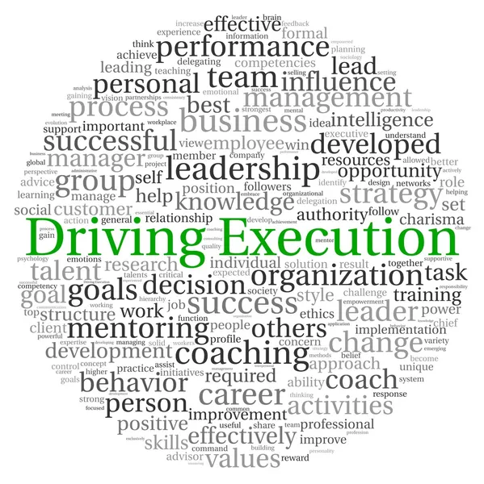
Module-9:5
EXECUTING THE PROJECT
Executing a project involves putting the project plan into action to achieve the desired outcomes. For education consultants, this phase includes following best practices for implementation, effectively managing a team, and ensuring optimal resource allocation.
A structured approach to execution ensures that the project stays on track and meets its objectives.

Slide 35
Module-9:5
EXECUTING THE PROJECT
1. Project Execution Strategies
A. Best Practices for Implementing the Project Plan
1.Follow the Project Plan: Use the scope, timelines, and milestones defined during the planning phase as your roadmap.
Monitor progress regularly to ensure alignment with the plan.
2.Communicate Consistently: Keep stakeholders and team members informed through regular updates, meetings, and reports.
Use communication tools like Slack, Microsoft Teams, or email for transparency.
3.Set Clear Priorities: Focus on high-impact tasks first to ensure that critical deliverables are completed on time.
4.Maintain Flexibility: Be prepared to adapt to unforeseen challenges while staying within the project's overall scope.
5.Monitor and Control Risks: Anticipate potential obstacles and have mitigation strategies ready.
Example: If a delay in receiving resources is likely, reallocate tasks to maintain progress.

Slide 36
Module-9:5
EXECUTING THE PROJECT
B. Building and Leading a Project Team
1.Defining Roles and Responsibilities:
Clearly outline each team member's role to avoid confusion and duplication of efforts.
Example: Project Manager: Oversees execution and ensures alignment with the plan.
Subject Matter Expert: Provides specialized knowledge (e.g., curriculum design).
Administrative Assistant: Handles scheduling, documentation, and logistics.
2.Establishing a Collaborative Environment: Encourage open communication and active participation.
Use team-building activities to foster trust and cooperation.
3.Providing Training and Support: Equip team members with the skills and resources they need to perform their roles effectively.
Example: Offer workshops on project management tools or curriculum development techniques.
4.Tracking Team Performance: Use key performance indicators (KPIs) to monitor individual and team contributions.
Provide constructive feedback and recognition to motivate the team.
5.Conflict Resolution: Address disputes promptly and fairly to maintain a positive working environment.
Example: Mediate disagreements about task assignments or priorities.
________________________________________

Slide 37
Module-9:5
EXECUTING THE PROJECT
2. Resource Management
A. Techniques for Effective Resource Allocation
1.Identify Available Resources
Include personnel, materials, equipment, and budget in your resource inventory.
Example: For a teacher training program, list trainers, training materials, venues, and technology.
2.Assign Resources Strategically:
Match tasks with the most suitable resources based on expertise, availability, and project needs.
Example: Assign instructional design tasks to curriculum specialists, not administrative staff.
3.Prioritize Resource Allocation:
Focus on critical tasks and milestones when distributing limited resources.
Example: Prioritize purchasing essential teaching tools over optional materials.
4.Monitor Resource Usage: Regularly review how resources are being used to identify inefficiencies or shortages.
Use project management software to track resource allocation and availability.
5.Adjust Resource Allocation as Needed: Reassign resources in response to project changes or unexpected challenges.
Example: If a key team member becomes unavailable, redistribute tasks among remaining team members.
________________________________________

Slide 38
Module-9:5
EXECUTING THE PROJECT
B. Managing Resources Efficiently
1.Optimize Budget Utilization: Monitor expenditures to ensure that they align with the project budget.
Identify cost-saving opportunities without compromising quality.
Example: Use virtual meeting platforms instead of in-person workshops to save on travel costs.
2.Leverage Technology: Use tools like Asana, Trello, or Microsoft Project to streamline resource management.
Example: Use Gantt charts to track task progress and resource dependencies.
3.Prepare for Contingencies: Allocate a portion of the budget and resources as a contingency to handle unexpected needs.
Example: Reserve 10% of the project budget for unforeseen expenses like additional training sessions.

Slide 39
Module-9:5
EXECUTING THE PROJECT
Practical Example: Executing a Professional Development Workshop
Scenario:
An education consultant is managing a project to deliver a professional development workshop for teachers on using technology in the classroom.
Execution Steps:
1.Follow the Project Plan: Deliverables: Workshop materials, training sessions, post-training evaluation.
Timeline: 6 weeks from preparation to completion.
2.Build and Lead the Team:
Assign roles:
Trainer: Delivers the workshop.
Content Developer: Creates training materials.
Logistics Coordinator: Arranges venue and technology.
3.Allocate Resources:
Budget: 5,000 for venue, materials, and trainer fees.
Technology: Use projectors, laptops, and online tools like Google Classroom.

Slide 40
Module-9:5
EXECUTING THE PROJECT
Monitor Progress:
Track milestones such as material preparation, session scheduling, and participant registration.
Hold weekly meetings to address any issues.
5.Adjust as Needed:
If venue availability becomes an issue, switch to an online platform like Zoom.
4. Tools for Project Execution
Project Management Software:
Tools like Trello, Monday.com, or Asana for task management and progress tracking.
2.Communication Platforms:
Use tools like Zoom or Microsoft Teams for virtual meetings and updates.
3.Resource Tracking Tools:
Budget management tools like Excel or QuickBooks to track expenditures.
Conclusion
Effective execution of a project involves adhering to the project plan, managing a cohesive team, and ensuring efficient use of resources. By following best practices, education consultants can navigate challenges, deliver high-quality outcomes, and maintain stakeholder satisfaction. Balancing structured management with adaptability ensures that projects are completed successfully, even in dynamic environments.

Slide 41

Module-9:6
MONITORING AND ANALYZING PROJECT PROGRESS
9.6: Monitoring and Analyzing Project Progress
Monitoring and analyzing project progress is a crucial aspect of project management that ensures the project stays on track to achieve its goals. For education consultants, this involves tracking performance through measurable indicators, using tools to monitor progress, and analyzing data to refine and adjust the project plan based on insights and stakeholder feedback.

Slide 42
Module-9:6
MONITORING AND ANALYZING PROJECT PROGRESS
1. Tracking Project Performance
A. Key Performance Indicators (KPIs) for Educational Projects
KPIs are quantifiable measures used to evaluate project success. For educational projects, relevant KPIs may include:
1.Completion Metrics: Percentage of milestones achieved on schedule.
Example: Completing 75% of curriculum development tasks within the first month.
2.Outcome-Based Metrics: Improvement in student performance after implementing a new program.
Example: A 20% increase in test scores for students receiving new STEM materials.
3.Engagement Metrics: Participant attendance rates in teacher training sessions.
Example: 90% attendance for all scheduled workshops.
4.Budget Utilization:
Percentage of the budget spent versus the planned allocation.
Example: Spending within 95% of the approved budget.
5.Stakeholder Satisfaction:
Feedback ratings from stakeholders (teachers, students, administrators).
Example: Achieving an 85% satisfaction score in post-project surveys.

Slide 43
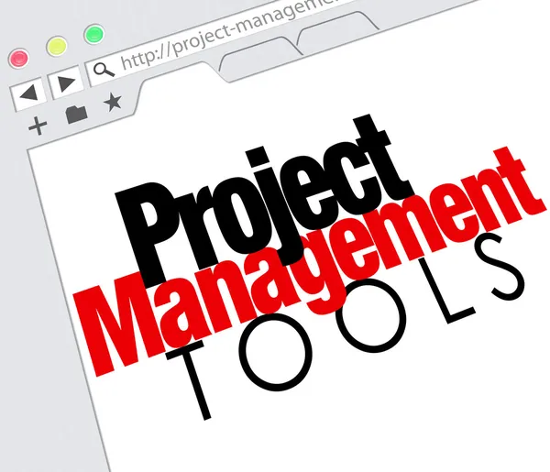
Module-9:6
MONITORING AND ANALYZING PROJECT PROGRESS
B. Tools for Monitoring Progress
1.Gantt Charts: Visual timeline tools for tracking tasks, dependencies, and deadlines.
Example: Use Gantt charts to track the completion of teacher training modules and ensure alignment with the timeline.
2.Project Management Software: Tools like Trello, Asana, or Microsoft Project for real-time task tracking and team collaboration.
Benefits: Assign tasks with deadlines, monitor task completion, generate progress reports.
3.Dashboards: Centralized platforms to view key metrics and overall project performance at a glance.
Example: Use Power BI or Tableau to visualize data trends and identify potential delays.
4.Status Reports: Regular updates summarizing progress, challenges, and next steps. Frequency: Weekly or bi-weekly for medium-scale projects.

Slide 44
Module-9:6
MONITORING AND ANALYZING PROJECT PROGRESS
2. Conducting Project Analysis
A. Techniques for Analyzing Project Data and Performance
1.Variance Analysis: Compare planned versus actual performance to identify gaps.
Example: If the planned timeline for developing training materials was one month, but completion took six weeks, investigate the reasons for the delay.
2.Trend Analysis: Assess patterns in data to predict future performance.
Example: Monitoring declining attendance rates in training sessions to identify engagement issues.
3.Root Cause Analysis:
Examine the underlying causes of project delays or issues.
Example: Investigate whether insufficient resources, unclear instructions, or external factors caused a missed milestone.
4.Stakeholder Feedback:
Collect qualitative data through surveys, focus groups, or interviews.
Example: Ask teachers to rate the relevance of training materials and use their feedback for improvement.
________________________________________

Slide 45
Module-9:6
MONITORING AND ANALYZING PROJECT PROGRESS
B. Adjusting Plans Based on Analysis and Feedback
1.Revising Timelines: Extend deadlines for tasks requiring more time than initially planned.
Example: Adjust the timeline to allow an additional two weeks for curriculum development after analyzing workload.
2.Reallocating Resources: Shift resources (e.g., budget, personnel) to high-priority areas.
Example: Assign additional trainers to ensure workshop sessions meet demand.
3.Updating Deliverables: Refine project outputs based on feedback or unforeseen challenges.
Example: Modify teacher training content to include digital tools after receiving requests from participants.
4.Enhancing Communication: Improve communication strategies to address misunderstandings or unclear expectations.
Example: Increase the frequency of stakeholder updates when significant changes occur.

Slide 46
Module-9:6
MONITORING AND ANALYZING PROJECT PROGRESS
3. Practical Example: Monitoring and Analyzing a Literacy Improvement Project
Scenario:
An education consultant is managing a project to improve literacy outcomes in elementary schools.
Steps:
1.Set KPIs: Completion of teacher workshops within three months.
80% of students in pilot classrooms improving reading levels by one grade.
2.Monitor Progress:
Use a Gantt chart to track milestones such as material development, training sessions, and post-assessment.
Track budget utilization using project management software.
3.Analyze Performance: Conduct variance analysis: Identify that training sessions took longer due to unforeseen teacher absences.
Gather feedback: Teachers suggest adding digital literacy tools.
4.Adjust Plans: Extend workshop sessions by two weeks. Include a new training module on using digital tools.

Slide 47
Module-9:6
BENEFITS MONITORING AND ANALYZING PROJECT PROGRESS
5. Conclusion
Monitoring and analyzing project progress is critical to the success of education consulting projects. By setting clear KPIs, utilizing effective tools, and conducting thorough analyses, consultants can track performance, make data-informed decisions, and adjust plans as needed. Incorporating stakeholder feedback into this process ensures that the project remains aligned with its goals and delivers meaningful outcomes.
Benefits of Effective Monitoring and Analysis
1.Ensures Accountability: Team members and stakeholders are clear about their roles and responsibilities.
2.Identifies Challenges Early: Detect issues before they escalate, minimizing project delays or resource wastage.
3.Improves Decision-Making: Data-driven insights lead to informed decisions about adjustments.
4.Increases Stakeholder Confidence: Demonstrating progress and responsiveness builds trust and satisfaction.

Slide 48
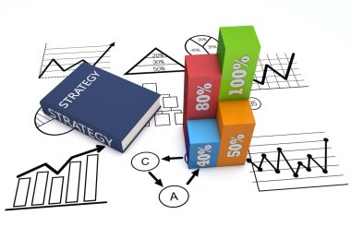
Module-9:7
PROJECT CLOSURE AND EVALUATION
9.7: Project Closure and Evaluation
Project closure and evaluation are critical steps in the project management process, marking the formal conclusion of a project and providing an opportunity to reflect, evaluate, and document lessons for future endeavors.
For education consultants, this phase ensures the project meets its objectives, stakeholders are satisfied, and insights are recorded for continuous improvement.

Slide 49
Module-9:7
PROJECT CLOSURE AND EVALUATION
A. Steps for Formal Project Closure and Handover
1.Verify Deliverables: Confirm that all project deliverables have been completed according to the agreed-upon standards and objectives.
Example: Ensure that all teacher training materials are developed, distributed, and implemented as planned.
2.Conduct Final Reviews: Organize a final project review meeting with stakeholders to validate outcomes and address unresolved issues.
Example: Present the project's impact on student performance metrics to school administrators.
3.Handover Responsibilities:
Transfer project outputs, documentation, and tools to stakeholders or the organization for sustained use.
Example: Provide a comprehensive guide on maintaining and updating a new digital curriculum.

Slide 50
Module-9:7
PROJECT CLOSURE AND EVALUATION
4.Obtain Formal Approval:
Secure written confirmation from stakeholders that the project has met its objectives and is considered complete.
Example: Obtain a sign-off from the school board after a final presentation of results.
5.Release Resources:
Conclude team roles, reallocate unused resources, and formally close contracts with external vendors or consultants.
B. Conducting Project Evaluations and Collecting Stakeholder Feedback
1.Post-Project Evaluation: Assess the project against initial goals, timelines, and budgets.
Example: Measure whether the training workshops improved teacher competencies as planned.
2.Gather Stakeholder Feedback: Use surveys, interviews, or focus groups to collect feedback from participants and stakeholders.
Example: Distribute post-project surveys to teachers who attended the training.
3.Analyze Outcomes: Compare results to the KPIs established during the planning phase.
Example: If the target was a 20% improvement in student test scores, analyze whether this was achieved.

Slide 51

Module-9:7
PROJECT CLOSURE AND EVALUATION
2. Documenting Lessons Learned
A. Importance of Documenting Successes and Challenges
1.Inform Future Projects: Record strategies that worked well to replicate success in future projects.
Example: Highlight the effectiveness of hybrid training sessions for teacher development.
2.Avoid Repeating Mistakes:
Document challenges faced and solutions implemented to learn from them.
Example: Note that unclear task delegation led to delays in material development and suggest improvements.
3.Enhance Organizational Knowledge: Create a repository of experiences to support decision-making and training for other consultants.

Slide 52
Module-9:7
USING ASSESSMENT TOOLS AND TECHNIQUES
4. Creating a Repository of Best Practices for Education Consultants
1.Organize by Category: Sort lessons learned by themes like stakeholder engagement, budgeting, or resource allocation.
Example: Develop a section on best practices for conducting virtual workshops.
2.Make It Accessible: Use digital platforms like shared drives, wikis, or project management tools to store and access documents.
Example: Store case studies and evaluation reports in a cloud-based repository.
3.Update Regularly: Integrate insights from each project to keep the repository dynamic and up-to-date.
________________________________________
3. Tools and Resources for Effective Project Management
A. Tools for Project Closure
1.Project Management Software:
Tools like Asana, Microsoft Project, or Monday.com for organizing closure tasks and timelines.
2.Feedback Collection Tools:
Use Google Forms, Type form, or SurveyMonkey to gather feedback from stakeholders.
B. Resources for Documenting Lessons
1.Templates: Pre-designed templates for lessons learned, evaluation reports, and project documentation.
Example: Use a standardized format for recording successes and challenges.
2.Case Study Guides: Use established frameworks to develop detailed case studies showcasing project outcomes.
________________________________________

Slide 53
Module-9:7
PROJECT CLOSURE AND EVALUATION
4. Practical Example: Closing and Evaluating a Digital Learning Project
Scenario: An education consultant implements a digital learning platform in a group of schools.
Steps:
1.Verify Deliverables: Ensure the platform is fully functional, teachers are trained, and students have access.
2.Handover: Provide administrators with user manuals, training videos, and login credentials.
3.Collect Feedback: Distribute surveys to teachers, students, and parents to evaluate satisfaction with the platform.
4.Document Lessons Learned: Record that initial resistance from teachers was mitigated by providing one-on-one support sessions.
5.Evaluate Results: Analyze data showing a 30% improvement in student engagement metrics.

Slide 54
Module-9:7
PROJECT CLOSURE AND EVALUATION
5. Benefits of Effective Project Closure and Evaluation
1.Ensures Accountability: A structured closure process demonstrates professionalism and commitment.
2.Enhances Future Success: Documented lessons provide a valuable resource for improving future projects.
3.Builds Stakeholder Trust: A thorough evaluation and transparent communication strengthen relationships with stakeholders.
6. Conclusion
Project closure and evaluation are vital for ensuring that education consulting projects achieve their goals and deliver sustained impact. By following a structured closure process, gathering stakeholder feedback, and documenting lessons learned, consultants can refine their approaches, enhance their professional reputation, and contribute to the ongoing success of educational initiatives.

Slide 55
Module-9:8
TOOLS AND RESOURCES FOR EFFECTIVE PROJECT MANAGEMENT
9.8: Overview of Project Management Tools
Project management tools are essential for organizing, planning, and executing projects efficiently. For education consultants, these tools streamline collaboration, resource allocation, and progress tracking. Additionally, continuous professional development and building a supportive network of consultants ensure long-term success.
1. Introduction to Popular Project Management Tools
A. Trello
●Overview: A visual, card-based tool for task management.
Organized through boards, lists, and cards to represent projects, stages, and individual tasks.
●Features: Drag-and-drop interface.
Customizable boards for different project phases.
Integration with apps like Google Drive and Slack.
●Best For: Simple task tracking and small to medium-sized projects.
Example: Planning teacher training sessions by creating cards for each task (e.g., curriculum design, logistics, scheduling).

Slide 56
Module-9:8
TOOLS AND RESOURCES FOR EFFECTIVE PROJECT MANAGEMENT
B. Asana
Overview: A versatile tool for team collaboration and project tracking.
Features: Task assignments with deadlines, timeline views to visualize progress,customizable project templates.
Best For: Larger projects requiring detailed task delegation and deadline tracking.
Example: Coordinating multiple consultants working on curriculum development and assessment creation.
C. Microsoft Project
Overview: A comprehensive project management software for advanced planning and analysis.
Features: Gantt charts, resource allocation tools, and budget tracking.
Advanced reporting features.
Best For: Complex projects with multiple dependencies.
Example: Managing a multi-school digital learning implementation project with detailed budgets and timelines.

Slide 57
Module-9:8
TOOLS AND RESOURCES FOR EFFECTIVE PROJECT MANAGEMENT
D. Other Notable Tools
1.Monday.com: Highly visual platform for task tracking and team communication.
Suitable for projects that require regular updates and check-ins.
2.Smartsheet: Combines the simplicity of spreadsheets with project management features.
Ideal for managing budgets and timelines in educational consulting.
3.Basecamp: Focused on team collaboration with message boards, to-do lists, and file sharing.
Great for small teams managing one or two projects.

Slide 58
Module-9:8
SELECTING THE RIGHT TOOLS FOR YOUR CONSULTING NEEDS
2. Selecting the Right Tools for Your Consulting Needs
Factors to Consider:
1.Project Complexity: Simple tools like Trello work for straightforward tasks, while Microsoft Project is better for complex initiatives.
2.Team Size: For small teams, Asana or Trello is sufficient; larger teams may need tools like Monday.com.
3.Budget: Free tools like Trello or Asana’s basic version are great for limited budgets.
For larger budgets, consider Microsoft Project or premium plans of other tools.
4.Integration Needs: Ensure compatibility with tools like Google Workspace, Slack, or Zoom.
5.Ease of Use: Choose a tool that matches the technical proficiency of your team.

Slide 59
Module-9:8
CONTINIOUS PROFESSIONAL DEVELOPMENT
A. Resources for Ongoing Learning in Project Management
1.Online Courses: Platforms like Coursera, Udemy, and LinkedIn Learning offer courses on project management methodologies (e.g., Agile, Scrum).
Example: Take an "Introduction to Agile Project Management" course for dynamic educational projects.
2.Certifications: Project Management Professional (PMP):
A globally recognized certification for advanced project management skills.
Certified Scrum Master (CSM): Ideal for consultants adopting Agile methodologies.
3.Webinars and Workshops: Attend industry-specific sessions to stay updated on trends and best practices.
4.Books and Blogs: Read foundational texts like "The Lean Startup" by Eric Ries or "Making Things Happen" by Scott Berkun.
5.Networking Events: Join conferences or meetups to learn from peers and industry leaders.
B. Benefits of Continuous Development
1.Stay Current: Adapt to evolving project management trends.
2.Boost Efficiency: Learn new tools and techniques to streamline project workflows.
3.Enhance Credibility: Certifications and knowledge increase your professional standing with clients.

Slide 60
Module-9:8
CONTINIOUS PROFESSIONAL DEVELOPMENT
B. Techniques for Networking
1.Online Communities:
Join LinkedIn groups or forums like EdTech conferences to connect with peers.
Example: Participate in discussions on best practices for digital learning implementation.
2.Professional Associations:
Become a member of organizations like the Association of Educational Consultants (AEC).
3.Workshops and Seminars:
Attend events to meet industry experts and build relationships.
4.Social Media Engagement:
Follow thought leaders and engage with their content to build visibility.
C. Leveraging Your Network
1.Collaborative Projects: Co-develop resources or share responsibilities in complex initiatives.
2.Referrals: Gain new clients through recommendations from your network.
3.Learning Opportunities: Stay informed about tools, methodologies, and trends from your peers.

Slide 61
Module-9:8
PRACTICAL EXAMPLE
Practical Example: Integrating Tools and Networking for Success
Scenario:
An education consultant is managing a project to introduce STEM education in underfunded schools.
Steps:
1.Select Tools: Use Trello for task tracking and Google Forms to collect stakeholder feedback.
2.Continuous Learning: Attend a workshop on STEM curriculum planning and adapt new ideas to the project.
3.Network: Collaborate with another consultant specializing in STEM pedagogy to enhance project quality.
The effective use of project management tools, ongoing professional development, and building a strong professional network are key to success for education consultants. By selecting tools suited to specific needs, staying updated with industry trends, and leveraging relationships with other consultants, professionals can enhance their efficiency, adaptability, and overall impact on educational initiatives.

Slide 62
Module-9:8
ASSESSMENT QUESTIONS
Define the key phases of the project management lifecycle and describe how each phase applies to an educational project (e.g., implementing a new learning program).
A school district hires you to design and execute a teacher training program within a tight deadline. How would you develop a project timeline, allocate resources, and ensure the project stays on track?
You notice signs of project creep while working on curriculum development for a school. Identify these signs and explain the steps you would take to address and prevent further scope changes.
Choose a project management tool (e.g., Trello, Asana, or Microsoft Project) and describe how you would use it to plan, execute, and monitor a project to implement a digital classroom in a school.

Slide 63
Module-9:8
ASSESSMENT QUESTIONS
5. How would you identify and engage key stakeholders in an educational consulting project? Provide examples of techniques you would use to maintain effective communication throughout the project.
6.During the execution of a STEM-focused curriculum project, you face resistance from teachers who feel the changes are unnecessary. What steps would you take to address this resistance while keeping the project on schedule?
7. Describe the key performance indicators (KPIs) you would track to monitor the progress and success of a project aimed at improving student literacy rates. Explain how you would use these metrics to adjust the project if needed.
8. After completing an educational project, what methods would you use to evaluate its success, gather stakeholder feedback, and document lessons learned for future initiatives? Provide specific tools or techniques you would employ.

