Slide 1

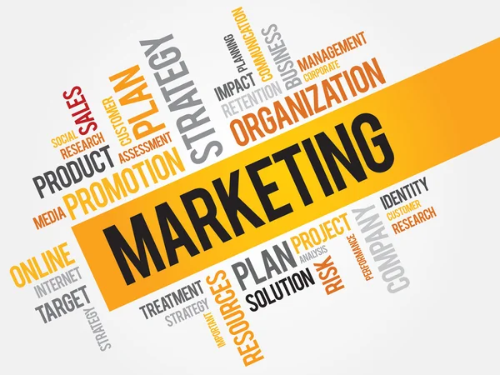
Module-7:1
MARKETING CLIENT ACQUISITION AND RETENTION FOR EDUCATION CONSULTANTS
Marketing is essential for education consultants to establish a strong presence, attract clients, and build lasting relationships. By understanding the education consulting landscape and leveraging effective marketing strategies, consultants can differentiate themselves in a competitive market.
1. Understanding the Education Consulting Landscape
Education consulting is a dynamic field involving guidance to students, parents, schools, and organizations in areas such as career planning, college admissions, curriculum design, and more.
Key Characteristics:
1.Diverse Clientele:
Students seeking academic or career advice.
Parents looking for guidance on school selection.
Institutions requiring strategic planning or teacher training.
Corporations developing educational programs for employees.

Slide 2

Module-7:1
MARKETING CLIENT ACQUISITION AND RETENTION FOR EDUCATION CONSULTANTS
Wide Range of Services
College admissions counseling.
Curriculum planning and school improvement consulting.
Test preparation guidance.
Study abroad consulting.
Highly Competitive:
Numerous consultants and agencies offer overlapping services.
Clients often choose based on reputation, success stories, or unique expertise.
Challenges in the Landscape
Evolving educational trends and policies.
Differentiating in a saturated market.
Building trust with clients.

Slide 3
Module-7:1
MARKETING CLIENT ACQUISITION AND RETENTION FOR EDUCATION CONSULTANTS
2. The Role of Marketing in Client Acquisition and Retention
Marketing is not just about promoting services; it’s about creating value for clients and maintaining strong relationships. For education consultants, marketing helps:
●Communicate expertise and credibility.
●Reach potential clients through targeted channels.
●Retain existing clients by fostering trust and satisfaction.
Marketing Strategies for Education Consultants
A. Client Acquisition
1.Building a Strong Online Presence
Website: Create a professional, user-friendly site showcasing services, client testimonials, and case studies.
Search Engine Optimization (SEO):Optimize content to rank high on search engines for terms like “college admissions consultant” or “study abroad guidance.”
Social Media Marketing: Use platforms like LinkedIn, Instagram, and Facebook to share success stories, expert tips, and client engagement activities.
2. Content Marketing: Write blogs, create e-books, or produce videos that address common client concerns (e.g., “Top Tips for Acing College Admissions Essays”).
Host webinars or workshops on topics like career planning or curriculum design.

Slide 4
Module-7:1
MARKETING CLIENT ACQUISITION AND RETENTION FOR EDUCATION CONSULTANTS
3.Paid Advertising
Use targeted ads on Google or social media platforms to reach specific demographics (e.g., parents of high school juniors).
4.Networking
Partner with schools, coaching centers, or local organizations.
Attend education fairs and conferences to connect with potential clients.
5.Testimonials and Referrals: Showcase success stories from past clients.
Offer referral discounts to satisfied clients who bring new business.
B. Client Retention
1.Personalized Services: Customize solutions based on each client’s unique needs.
Offer follow-up services, such as guidance post-admission or ongoing academic monitoring.
2.Regular Communication: Send newsletters with educational updates or tips.
Maintain active social media channels to engage clients.
3.Customer Feedback: Use surveys to gather insights about client satisfaction and areas for improvement.

Slide 5
Module-2:1
MARKETING CLIENT ACQUISITION AND RETENTION FOR EDUCATION CONSULTANTS
4.Value-Added Offers: Provide free resources like college application templates, scholarship guides, or test preparation materials.
5.Loyalty Programs: Reward long-term clients or those who refer others with discounts or exclusive services.
________________________________________
Differentiating Through Marketing
1. Highlight Unique Selling Points (USPs):
●Expertise in specific regions or education systems (e.g., U.S. admissions, IB curriculum).
●Exceptional success rates (e.g., percentage of students admitted to top universities).
●Specialized services like visa assistance for study abroad clients.
2. Brand Positioning:
●Develop a clear brand message, such as “Empowering students to achieve their dreams.”
●Ensure consistency across all marketing channels.
3. Leveraging Technology:
●Use tools like CRM (Customer Relationship Management) software to manage leads and client interactions.
●Offer virtual consulting services for remote clients.
________________________________________

Slide 6

Module-7:1
MARKETING CLIENT ACQUISITION AND RETENTION FOR EDUCATION CONSULTANTS
Marketing plays a pivotal role in the success of education consultants by helping them attract and retain clients while establishing themselves as leaders in their field.
By understanding the landscape, targeting the right audience, and delivering exceptional value, consultants can thrive in an increasingly competitive market.

Slide 7

Module-7:2
IDENTIFYING YOUR TARGET MARKET
Identifying the right target market is essential for education consultants to provide tailored services, efficiently use resources, and build long-lasting relationships. This process involves defining the ideal client, understanding their needs, and using market research techniques to refine strategies.
1. Defining Your Ideal Client
An ideal client profile serves as a blueprint for whom you want to serve and how you can best meet their needs.
Steps to Define Your Ideal Client:
1.Segment Your Market:
Break down the market into categories based on factors like:
■Demographics: Age, location, income level, and education background.
■Psychographics: Interests, values, and motivations.
■Behavioral Traits: How they seek and consume educational consulting services.

Slide 8

Module-7:2
IDENTIFYING YOUR TARGET MARKET
2.Focus on Niche Areas:
Specialize in a specific service, such as:
■College admissions consulting.
■Curriculum development for schools.
■Study abroad guidance.
■Career counseling.
3.Create Client Personas:
Develop detailed profiles of hypothetical ideal clients, including:
■Student Persona: A high school junior seeking U.S. college admissions help.
■Parent Persona: A parent looking for study abroad guidance for their child.
■Institution Persona: A school needing teacher training or curriculum enhancement.

Slide 9
Module-7:2
IDENTIFYING YOUR TARGET MARKET
2. Understanding Client Pain Points
Pain points are the challenges or concerns that your clients face. Addressing these effectively helps build trust and demonstrates value.
Common Client Pain Points in Education Consulting:
1.Students:
Confusion about career paths or college selection.
Stress over entrance exams, essays, or deadlines.
Lack of clarity about study abroad processes, such as visas or scholarships.
2.Parents:
Worry about affordability or return on investment for education.
Anxiety over finding the right school or program for their child.
Need for reliable guidance in unfamiliar systems (e.g., IB vs. AP curriculum).
3.Institutions:
Struggles with modernizing curriculum or aligning it with new standards.
Need for professional development for teachers.
Gaps in achieving desired student outcomes.
How to Address Pain Points:
Provide clear, actionable solutions (e.g., a step-by-step college application checklist).
Offer expert advice and success stories to reassure clients.
Ensure transparent communication and regular updates throughout the process.

Slide 10
Module-7:2
IDENTIFYING YOUR TARGET MARKET
3. Market Research Techniques
Market research helps identify your target audience’s characteristics, preferences, and needs. It provides data-driven insights to refine services and marketing strategies.
Techniques for Effective Market Research:
A. Primary Research
●Directly collect information from your target market.
1.Surveys: Use online tools like Google Forms or SurveyMonkey.
Ask questions about clients' goals, challenges, and preferences.
2.Interviews
Conduct one-on-one interviews with students, parents, or institutional representatives.
3.Focus Groups:
Gather small groups to discuss their needs and expectations.
B. Secondary Research
●Leverage existing resources to gather insights.
1.Online Databases: Access reports from educational organizations, think tanks, or government agencies.
2.Competitor Analysis: Study what other consultants are offering, their pricing, and their marketing strategies.
3.Industry Trends: Follow trends in education policies, popular study destinations, or in-demand careers.
C. Digital Analytics: Track online behavior to understand audience preferences.
1.Website Analytics: Use tools like Google Analytics to monitor visitor demographics and behaviors.

Slide 11
Module-7:2
IDENTIFYING YOUR TARGET MARKET
2:Social Media Insights: Platforms like Facebook and LinkedIn provide detailed audience analytics.
3.Search Trends: Use tools like Google Trends to discover what prospective clients are searching for.
Applying the Research Results:
1. Refine Services: Adjust offerings based on identified client needs, such as including financial planning workshops for study abroad students.
2.Tailor Marketing Strategies: Use the language, tone, and channels that resonate with your audience (e.g., Instagram for students, newsletters for parents).
3.Prioritize Efforts: Focus resources on the most promising client segments or geographic areas.
Conclusion
By defining your ideal client, understanding their pain points, and leveraging market research, you can effectively identify and serve your target market. This ensures that your education consulting services are aligned with client needs, making them more impactful and valued.

Slide 12

Module-7:3
BUILDING A STRONG VALUE PROPOSITION
A strong value proposition is critical for distinguishing your education consulting services from competitors. It defines the unique benefits you offer and why clients should choose you over others. Crafting and communicating a compelling Unique Value Proposition (UVP) can help you attract and retain clients effectively.
1. Crafting Your Unique Value Proposition (UVP)
A UVP is a concise statement that explains how your services solve a specific problem, deliver unique benefits, and add value to your clients.
Steps to Craft Your UVP:
A. Understand Your Audience
●Identify your ideal client personas and their most pressing needs.
●Consider the pain points and goals of students, parents, or institutions you serve.

Slide 13

Module-7:3
BUILDING A STRONG VALUE PROPOSITION
B. Identify Your Unique Strengths
●Reflect on what sets you apart from competitors, such as:
Expertise in specific education systems or admissions processes.
Proven track record of success (e.g., high college acceptance rates).
Personalized, hands-on approach to consulting.
Specialized services (e.g., financial aid guidance, scholarship assistance).
C. Focus on Outcomes
●Highlight the results clients can expect from your services, such as:
Improved student academic performance.
Successful placement in top universities or programs.
Efficient and stress-free application processes.
D. Keep It Clear and Concise
●Aim for a single sentence or short paragraph.
●Avoid jargon and use simple, compelling language.

Slide 14
Module-7:3
BUILDING A STRONG VALUE PROPOSITION
2. Communicating Your UVP Effectively
Once you’ve crafted your UVP, the next step is to ensure it reaches your target audience in a compelling way.
A. Include Your UVP in Marketing Materials
1.Website
Display your UVP prominently on the homepage.
Create a dedicated section outlining how your services provide unique value.
2.Social Media
Use your UVP as part of your bio or in regular posts to reinforce your brand.
Share testimonials and success stories that align with your UVP.
3.Printed Collateral: Feature your UVP in brochures, flyers, and business cards for in-person networking.
UVP Formula: [Who you serve] + [The problem you solve] + [The unique way you solve it] + [The benefits clients receive].
Example UVPs
For students: “Helping high school students secure admission to top universities through personalized guidance and proven strategies.”
For parents: “Simplifying the school selection process with expert advice tailored to your child’s needs.”
For institutions: “Empowering schools to deliver modern, effective curriculums through customized training and development programs.”

Slide 15
Module-7:3
BUILDING A STRONG VALUE PROPOSITION
B. Incorporate Your UVP in Communication
1.Sales Pitch
Use your UVP as the foundation of your elevator pitch when meeting potential clients.
Clearly explain the problem you solve and the benefits clients can expect.
2.Consultations
Reinforce your UVP during initial discussions to build credibility and trust.
3.Follow-ups
Send tailored emails that reiterate your UVP and address specific client needs.
C. Leverage Storytelling
●Share success stories and case studies that demonstrate the impact of your services.
●Use relatable examples that align with the concerns of your audience.
D. Engage Through Testimonials and Reviews
●Highlight feedback from satisfied clients that reflects your UVP.
●Feature reviews on your website, social media, and other platforms to build trust.

Slide 16
Module-7:3
BUILDING A STRONG VALUE PROPOSITION
E. Adapt for Different Audiences
Customize how you present your UVP based on the audience:
For students: Emphasize career outcomes and academic growth.
For parents: Emphasize on peace of mind and reliable guidance.
For institutions: Focus on efficiency and measurable results.
A strong UVP is the cornerstone of your education consulting business. By crafting a clear and compelling UVP and effectively communicating it across all touchpoints, you can attract the right clients, build trust, and stand out in a competitive market.
Remember to revisit and refine your UVP periodically to stay aligned with evolving client needs and market trends.

Slide 17
Module-7:4
DEVELOPING A COMPREHENSIVE MARKETING PLAN FOR EDUCATION CONSULTING
A comprehensive marketing plan helps education consultants effectively reach and engage their target audience. It involves creating a strategy tailored to your goals and selecting the right channels to maximize impact.
1. Creating a Marketing Strategy
A marketing strategy outlines your approach to achieving your business goals by addressing who, what, and how you will market your services.
Key Elements of a Marketing Strategy:
A. Define Your Goals
●Set specific, measurable, achievable, relevant, and time-bound (SMART) objectives.
●Examples:
Increase website traffic by 20% in six months.
Secure 10 new clients within the next quarter.
Boost engagement on social media by 30% within three months.
B. Identify Your Target Audience
●Define your ideal client personas (students, parents, institutions).
●Understand their needs, pain points, and preferred communication channels.

Slide 18
Module-7:4
DEVELOPING A COMPREHENSIVE MARKETING PLAN FOR EDUCATION CONSULTING
C. Position Your Services
●Highlight your Unique Value Proposition (UVP) to differentiate yourself.
●Tailor messaging to emphasize the specific benefits clients will receive.
D. Develop Key Messages
●Craft clear and consistent messages for all marketing materials.
Examples:
“Simplify your child’s college application process with expert guidance.”
“Helping schools create future-ready curriculums through personalized solutions.”
E. Budget Allocation
●Determine how much you will spend on marketing and allocate resources across different channels.
●Prioritize channels with the highest ROI.

Slide 19
Module-7:4
DEVELOPING A COMPREHENSIVE MARKETING PLAN FOR EDUCATION CONSULTING
2. Choosing Marketing Channels
Selecting the right channels ensures your message reaches your target audience effectively.
A. Digital Marketing Channels
1.Website
Act as your digital storefront with clear information about your services.
Include client testimonials, success stories, and a blog for added value.
2.Search Engine Optimization (SEO)
Optimize your site for keywords like “college admissions consultant” or “study abroad guidance.”
Use location-specific keywords for local audiences.
3.Social Media
Platforms like Instagram, Facebook, and LinkedIn allow targeted engagement.
Share success stories, live sessions, and educational tips.
4.Email Marketing
Use newsletters to stay connected with past, current, and prospective clients.
Share updates, tips, and exclusive offers.
5.Online Ads: Use Google Ads or social media ads to reach specific demographics.

Slide 20
Module-7:4
DEVELOPING A COMPREHENSIVE MARKETING PLAN FOR EDUCATION CONSULTING
B. Traditional Marketing Channels
1.Networking and Referrals
Attend education fairs, conferences, and community events.
Partner with schools, coaching centers, and local organizations.
2.Print Media
Use brochures, flyers, and posters for offline promotion.
Advertise in local newspapers or magazines targeting parents and students.
3.Word of Mouth:
Encourage satisfied clients to refer your services.
Offer referral discounts or rewards to incentivize word-of-mouth marketing.
C. Hybrid Marketing Approaches
1.Workshops and Webinars:
Host free sessions on topics like career planning or application strategies.
Combine online platforms (Zoom, YouTube) with in-person events.
2.Partnerships:
Collaborate with tutoring centers, language schools, or educational NGOs.

Slide 21
Module-7:4
DEVELOPING A COMPREHENSIVE MARKETING PLAN FOR EDUCATION CONSULTING
3. Steps to Develop Your Comprehensive Marketing Plan
Step 1: Conduct a SWOT Analysis
●Strengths: What do you do best (e.g., personalized services, high success rate)?
●Weaknesses: What areas need improvement (e.g., online visibility)?
●Opportunities: What market trends or gaps can you leverage?
●Threats: What challenges do competitors or the market pose?
Step 2: Outline Target Audiences and Channels
●Define your audience segments (e.g., high school students, parents, institutions).
●Choose the most effective channels to engage each group.
Step 3: Create a Marketing Calendar
●Plan campaigns and activities month-by-month.
●Include events like admissions deadlines, back-to-school promotions, or exam seasons.

Slide 22
Module-7:4
DEVELOPING A COMPREHENSIVE MARKETING PLAN FOR EDUCATION CONSULTING
Step 4: Set Metrics for Success
Track performance using metrics like:
Website traffic and lead conversion rates.
Social media engagement (likes, shares, comments).
ROI from advertising campaigns.
Step 5: Execute, Monitor, and Refine
Launch campaigns and monitor results regularly.
Adjust strategies based on analytics and feedback.
Developing a comprehensive marketing plan involves defining clear goals, crafting a strategy that aligns with your target audience’s needs, and selecting the most effective channels to reach them. By following this structured approach, education consultants can enhance visibility, attract more clients, and achieve long-term success in a competitive market.

Slide 23
Module-7:5
LEVERAGING DIGITAL MARKETING FOR EDUCATION CONSULTING
Leveraging Digital Marketing for Education Consultants
Digital marketing is a powerful tool for education consultants to increase visibility, build credibility, and attract clients. By optimizing your online presence through websites, content marketing, and social media, you can effectively reach and engage your target audience.
1. Website Optimization for Education Consultants
A well-designed website serves as the foundation of your digital marketing efforts. It is often the first point of contact for potential clients.
Key Elements of Website Optimization:
A. User-Friendly Design
●Ensure your website is easy to navigate, visually appealing, and mobile-friendly.
●Organize information into clear sections, such as About Us, Services, Testimonials, and Contact.

Slide 24
Module-7:5
LEVERAGING DIGITAL MARKETING FOR EDUCATION CONSULTING
B SEO (Search Engine Optimization)
●Use keywords that clients might search for, such as “education consultant near me,” “college admissions help,” or “study abroad guidance.”
●Include location-specific . terms if your services cater to a specific region.
●Add meta descriptions and alt text for images to improve search engine ranking.
C. Content That Builds Trust
●Showcase:
○Testimonials: Success stories from satisfied clients.
○Case Studies: Detailed examples of how you’ve helped past clients achieve their goals.
○FAQs: Address common questions and concerns.
D. Call-to-Action (CTA)
●Use clear and compelling CTAs, such as:
○“Schedule a Free Consultation.”
○“Download Our College Application Checklist.”
○“Contact Us Today.”

Slide 25
Module-7:5
LEVERAGING DIGITAL MARKETING FOR EDUCATION CONSULTING
Key Strategies:
A. Blogging
●Write articles on topics relevant to your audience, such as:
“Top Tips for Writing a College Admissions Essay.”
“How to Choose the Right Study Abroad Program.”
“Scholarships Every Student Should Know About.”
Focus on actionable advice, insights, and trends in education.
B. E-books and Guides
●Offer free downloadable resources in exchange for email sign-ups:
Examples:
“The Ultimate Guide to SAT/ACT Preparation.”
“Step-by-Step Guide to College Applications.”
Use these resources to capture leads and nurture potential clients.
E. Contact Information
●Make it easy for clients to reach you: Include a contact form, email address, phone number, and links to social media.
Use a live chat feature for immediate assistance.
F. Performance Optimization
●Ensure fast loading times, as slow websites can deter visitors.
●Regularly update content to keep it relevant and engaging.
2. Content Marketing Strategies
Content marketing helps establish you as an expert in the education consulting field while providing value to your audience.

Slide 26
Module-7:5
LEVERAGING DIGITAL MARKETING FOR EDUCATION CONSULTING
C. Video Content
Create short, engaging videos on platforms like YouTube or Instagram, such as:
Tips for acing interviews.
Explainers on visa processes for studying abroad.
Behind-the-scenes of your consulting process.
D. Webinars and Workshops
Host live or recorded sessions on topics like:
Career counseling.
Admissions strategies for specific universities.
How parents can support their child’s academic journey.
E. Email Marketing
Send newsletters with:
Education updates.
Tips and resources.
Announcements for upcoming events or promotions.
________________________________________
3. Social Media Marketing
Social media platforms allow education consultants to connect with clients, build relationships, and grow their brand.
Key Social Media Platforms and Strategies:
A. Instagram
Post visually appealing content, such as:
Inspirational success stories of past clients.
Infographics with tips for students.
Behind-the-scenes of workshops or consultations.
Use reels and stories for quick, engaging updates.
B. Facebook
Create a business page with all your contact information and services.
Share posts, testimonials, and upcoming events.
Join parenting groups or education-related forums to connect with potential clients.

Slide 27
Module-7:5
LEVERAGING DIGITAL MARKETING FOR EDUCATION CONSULTING
C. LinkedIn
Build a professional profile showcasing your expertise.
Share articles, blogs, or achievements to establish authority.
Network with schools, educators, and other consultants.
D. YouTube
Post longer-form content, such as:
Detailed guides on admissions processes.
Testimonials from satisfied clients.
Recorded webinars or Q&A sessions.
E. TikTok (Optional for Younger Audiences)
Share short, engaging videos:
Quick study tips.
Fun facts about universities.
Application myths debunked.
Tips for Social Media Success:
1.Consistency: Post regularly to keep your audience engaged.
2.Hashtags: Use relevant hashtags to increase visibility (#CollegeCounseling, #StudyAbroadTips).
3.Engagement: Respond to comments, messages, and questions promptly.
4. Integrating Digital Marketing Efforts
Cross-Promotion: Share blogs or videos on social media to drive traffic to your website.
Analytics: Use tools like Google Analytics, social media insights, or email open rates to monitor performance and adjust strategies.
Retargeting: Use ads to re-engage visitors who left your website without taking action.

Slide 28

Module-7:5
LEVERAGING DIGITAL MARKETING FOR EDUCATION CONSULTING
Leveraging digital marketing involves optimizing your website, delivering valuable content, and engaging with your audience on social media.
By integrating these efforts into a cohesive strategy, education consultants can effectively reach their target market, build trust, and grow their client base.

Slide 29
Module-7:6
BUILDING CLIENT RELATIONSHIPS FOR EDUCATION CONSULTING
Strong client relationships are at the core of a successful education consulting business. Building trust, networking effectively, and fostering collaborative partnerships help enhance client satisfaction, boost referrals, and create long-term success.
1. Building Strong Client Relationships
A. Establish Trust from the Beginning
1.Be Transparent: Clearly outline your services, pricing, and process.
Set realistic expectations for outcomes.
2.Demonstrate Expertise
Share success stories, certifications, and industry knowledge.
Offer free initial consultations to showcase your abilities.
B. Maintain Open Communication
1.Listen Actively:
Understand client concerns, needs, and goals.
Ask clarifying questions to show attentiveness.

Slide 30
Module-7:6
BUILDING CLIENT RELATIONSHIPS FOR EDUCATION CONSULTING
2.Regular Updates:
Provide progress reports, milestones, and actionable feedback.
Use tools like email, messaging apps, or client portals for updates.
C. Provide Personalized Solutions
Tailor recommendations based on the client’s unique situation, such as:
Custom college lists based on a student’s interests and goals.
Specialized support for school curriculum development.
D. Exceed Expectations
Go the Extra Mile:
Provide additional resources, like study guides or interview tips.
Celebrate client milestones (e.g., admission success).
Be Accessible:
Respond promptly to queries and concerns.
Offer flexible scheduling for consultations.

Slide 31
Module-7:6
BUILDING CLIENT RELATIONSHIPS FOR EDUCATION CONSULTING
2. Networking Strategies
Networking allows education consultants to expand their reach, establish credibility, and connect with potential clients or partners.
A. In-Person Networking
1.Attend Events
Join education fairs, workshops, and seminars to meet students, parents, and educators.
Participate in local community events to connect with families.
2.Join Professional Organizations
Become a member of associations like NACAC (National Association for College Admission Counseling) or IECA (Independent Educational Consultants Association).
Engage in meetings and conferences to build industry relationships.
3.Organize Workshops
Host events on topics like “How to Write the Perfect College Essay” or “Study Abroad Essentials.”
Invite schools or community organizations to collaborate.

Slide 32
Module-7:6
BUILDING CLIENT RELATIONSHIPS FOR EDUCATION CONSULTING
B. Online Networking
1.Social Media Engagement:
Join relevant groups on LinkedIn, Facebook, or Instagram.
Share valuable content and comment on discussions to build your presence.
2.Email Outreach:
Send introductory emails to potential collaborators, such as schools or tutoring centers.
Follow up with past clients to encourage referrals or repeat business.
3.Participate in Forums:
Engage in education-focused platforms like Reddit, Quora, or niche industry forums.
3. Creating Collaborative Partnerships
Collaborative partnerships enhance your offerings, expand your network, and increase your credibility.
A. Partner with Schools and Institutions
1.Curriculum Support:
Offer consulting services for curriculum design, teacher training, or student development programs.
2.Workshops and Events:
Collaborate to host events like college fairs or career counseling sessions.

Slide 33
Module-7:6
BUILDING CLIENT RELATIONSHIPS FOR EDUCATION CONSULTING
3.Referral Agreements
Establish mutual referral systems where schools recommend your services to families.
B. Collaborate with Tutoring and Coaching Centers
Work with SAT/ACT prep centers, language schools, or extracurricular activity providers.
Offer package deals combining consulting services with test prep or skill-building.
C. Team Up with Other Education Professionals
Financial Planners: Help families plan for tuition and scholarships.
2.Career Counselors: Collaborate to align college choices with long-term career goals.
3.Immigration Consultants:
Assist with visa processing for study-abroad clients.
D. Engage with Technology Partners
1.EdTech Tools: Use tools like application trackers or virtual learning platforms to enhance client experiences.
2.CRM Systems: Partner with CRM providers to manage client relationships and streamline operations.

Slide 34
Module-7:6
BUILDING CLIENT RELATIONSHIPS FOR EDUCATION CONSULTING
4. Sustaining Relationships for Long-Term Success
A. Stay Connected
1.Follow-Up Post-Service:
Check in periodically with former clients to maintain rapport.
Celebrate their achievements, such as college acceptances or career milestones.
2.Social Media Interaction:
Engage with clients by liking or commenting on their posts.
Share their success stories (with permission) on your platforms.
B. Encourage Referrals and Testimonials
1.Referral Incentives:
Offer discounts or perks for clients who refer others to your services.
2.Request Reviews: Ask satisfied clients to leave testimonials on your website, Google, or LinkedIn.
C. Adapt to Evolving Needs
Stay updated on industry trends and educational policies.
Continuously enhance your services to align with changing client expectations.

Slide 35
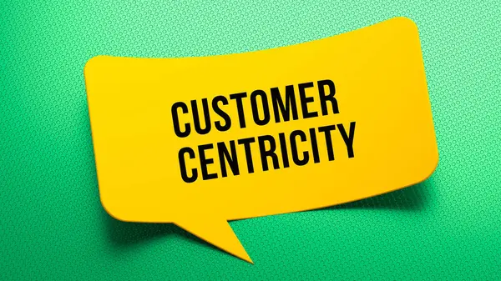
Module-7:6
BUILDING CLIENT RELATIONSHIPS FOR EDUCATION CONSULTING
Building strong client relationships, leveraging networking opportunities, and creating collaborative partnerships are essential for sustained growth as an education consultant.
By prioritizing trust, open communication, and personalized solutions, you can foster loyalty and expand your influence within the education community. These efforts not only enhance client satisfaction but also establish your reputation as a trusted and impactful consultant.

Slide 36
Module-7:7
CLIENT ACUQUISITION TACTICS FOR EDUCATION CONSULTANTS
How to Offer Free Consultations:
1.Structure the Consultation:
Limit the session to 20–30 minutes.
Use the time to:
■Understand client needs.
■Highlight your services and potential outcomes.
■Answer key questions.
2.Make it Easy to Book:
Use scheduling tools like Calendly or Acuity to streamline the process.
Promote consultation offers on your website, social media, and emails.
3.Follow Up:
After the consultation, send a thank-you email summarizing the discussion and next steps.
Include a call-to-action (CTA) encouraging them to sign up for your services.

Slide 37

Module-7:7
CLIENT ACUQUISITION TACTICS FOR EDUCATION CONSULTANTS
B. Workshops
Hosting workshops positions you as an authority and engages a larger audience at once.
Benefits of Free Workshops:
1.Showcase Expertise:
Provide valuable insights on a specific topic.
Establish yourself as a thought leader in your field.
2.Generate Leads:
Collect contact information from participants for follow-ups.
3.Create Brand Awareness:
Reach potential clients who may not have considered consulting services before.

Slide 38
Module-7:7
CLIENT ACUQUISITION TACTICS FOR EDUCATION CONSULTANTS
How to Host Workshops
1.Choose Relevant Topics:
Focus on issues your audience cares about, such as:
■“Top Tips for College Applications.”
■“How to Choose the Best School for Your Child.”
■“Navigating Study Abroad Programs.”
2.Promote Effectively:
Advertise workshops on your website, social media, and through email campaigns.
Offer free registration with a sign-up form to collect participant details.
3.Engage During the Event:
Use interactive elements like Q&A sessions or polls.
Share examples or case studies for added impact.
4.Follow Up:
Send participants thank-you emails and additional resources.
Offer a discounted service package as a workshop follow-up incentive.

Slide 39
Module-7:7
CLIENT ACUQUISITION TACTICS FOR EDUCATION CONSULTANTS
2. Utilizing Email Marketing
Email marketing is a cost-effective way to nurture leads, build relationships, and convert prospects into clients.
A. Building an Email List
1.Collect Emails Strategically:
Use website sign-up forms offering free resources (e.g., e-books or guides).
Collect emails during free consultations or workshops.
2.Segment Your Audience:
Group contacts based on their interests or stage in the client journey (e.g., prospective clients, current clients, or past clients).
B. Crafting Effective Email Campaigns
1.Welcome Emails:
Send an automated email immediately after someone joins your list.
Include a brief introduction, your services, and a call-to-action (e.g., “Book a Free Consultation”).

Slide 40
Module-7:7
CLIENT ACUQUISITION TACTICS FOR EDUCATION CONSULTANTS
2.Educational Emails
Share useful content, such as:
■Blog posts (e.g., “5 Mistakes to Avoid in College Applications”).
■Checklists (e.g., “The Ultimate Study Abroad Packing List”).
Position yourself as a valuable resource for their education journey.
3.Promotional Emails
Announce limited-time offers, discounts, or upcoming workshops.
Use CTAs like “Reserve Your Spot” or “Sign Up Now.”
C. Personalization and Consistency
1.Personalized Messages:
Address recipients by name and tailor content based on their preferences.
Example: “Hi Sarah, here are 3 tips to ace your college essay this year.”
2.Consistent Schedule:
Send emails regularly (e.g., biweekly or monthly) to stay top-of-mind.
Use a mix of educational and promotional content.

Slide 41
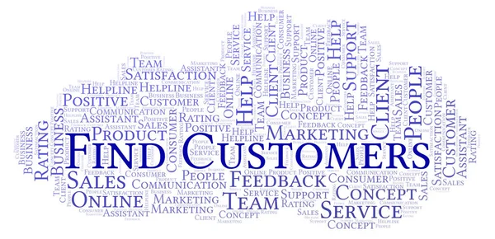
Module-7:7
CLIENT ACUQUISITION TACTICS FOR EDUCATION CONSULTANTS
D. Tools for Email Marketing
Use platforms like Mailchimp, Constant Contact, or Convert Kit to manage your campaigns.
Track metrics like open rates, click-through rates, and conversions to refine your strategy.
By offering free consultations or workshops and utilizing email marketing effectively, education consultants can attract new clients and showcase their expertise. These strategies not only build trust and credibility but also create opportunities for long-term client relationships. Integrating these tactics into your overall marketing plan will help you grow your business and establish a strong presence in the education consulting industry.

Slide 42
Module-7:8
RETAINING CLIENTS THROUGH EXCEPTIONAL SERVICE
7.8: Retaining Clients Through Exceptional Service
Retaining clients is vital for the sustained success of education consultants. By consistently delivering high-quality service and value, gathering feedback, and leveraging testimonials, you can build lasting relationships and a strong reputation.
1. Delivering Quality and Value
Providing exceptional service ensures clients feel their investment is worthwhile, fostering loyalty and encouraging referrals.
A. Understand Client Needs
●Conduct a thorough assessment of each client’s goals, challenges, and priorities.
●Offer personalized solutions tailored to their specific requirements, such as:
Customized college application strategies.
Step-by-step plans for academic improvement.
B. Stay Knowledgeable and Updated
●Keep abreast of the latest trends in education, admissions policies, and curriculum changes.
●Attend industry workshops, seminars, and professional development programs to refine your skills.

Slide 43
Module-7:8
RETAINING CLIENTS THROUGH EXCEPTIONAL SERVICES
C. Exceed Expectations
Go beyond the standard service:
Provide extra resources (e.g., checklists, templates, or guides).
Send reminders for important deadlines, such as application submissions or scholarship opportunities.
Deliver results ahead of schedule whenever possible.
D. Communicate Regularly
Maintain consistent communication through emails, calls, or progress updates.
Be responsive to client inquiries, addressing their concerns promptly and professionally.
2. Gathering Feedback
Feedback allows you to refine your services, meet client expectations, and demonstrate your commitment to continuous improvement.
A. Importance of Feedback
1.Identify Strengths and Weaknesses:
Understand what clients value most about your services.
Pinpoint areas for improvement to enhance client satisfaction.

Slide 44
Module-7:8
RETAINING CLIENTS THROUGH EXCEPTIONAL SERVICES
2.Build Trust
Actively seeking feedback shows clients that their opinions matter.
3.Stay Competitive:
Adjust your offerings to align with evolving client needs and market trends.
B. How to Gather Feedback
1.Surveys:
Send online surveys using tools like Google Forms or SurveyMonkey.
Include questions about their experience, satisfaction levels, and suggestions for improvement.
Example Questions:
■“How would you rate the quality of our services?”
■“What could we do to make your experience better?”
2.One-on-One Discussions:
Schedule follow-up meetings or calls to discuss their experience.
Ask open-ended questions to encourage detailed responses.
3.Post-Service Check-Ins:
Follow up a few weeks or months after completing your service to gauge long-term satisfaction.
________________________________________

Slide 45
Module-7:8
RETAINING CLIENTS THROUGH EXCEPTIONAL SERVICES
3. Leveraging Testimonials
Testimonials are a powerful tool for building credibility and attracting new clients.
A. Why Testimonials Matter
1.Establish Trust:
Real experiences from satisfied clients validate your expertise and reliability.
2.Increase Conversion Rates:
Potential clients are more likely to choose your services when they see positive feedback from others.
3.Boost Marketing Efforts:
Testimonials can be shared across your website, social media, and promotional materials.
B. How to Request Testimonials
1.Timing Matters:
Ask for testimonials immediately after a successful service outcome, such as an admission acceptance or completed project.
2.Be Specific:
Provide prompts or questions to guide their response:
“What was the most valuable aspect of our service?”
“How did we help you achieve your goals?”
3.Make it Easy:
Provide a simple format, such as an online form or email template.

Slide 46
Module-7:8
RETAINING CLIENTS THROUGH EXCEPTIONAL SERVICES
C. Showcasing Testimonials
1.On Your Website:
Create a dedicated “Success Stories” or “Testimonials” page.
Use quotes with names, photos, or videos (with client permission).
2.Social Media: Share testimonials as posts or stories, tagging the client if they’re comfortable.
3.Marketing Materials: Include testimonials in brochures, emails, or presentation slides.
4. Strategies for Client Retention
A. Stay Engaged After the Service Ends
Send occasional updates or resources, such as education news, articles, or tips.
Offer exclusive discounts for repeat services or referrals.
B. Recognize Milestones
Celebrate achievements like college acceptances or scholarships.
Send congratulatory messages or small tokens of appreciation, like e-cards or gift vouchers.
C. Build a Community
Create forums, groups, or events where past and current clients can share experiences and resources.
Example: Host alumni meet-ups or webinars for former clients.

Slide 47
Module-7:8
RETAINING CLIENTS THROUGH EXCEPTIONAL SERVICES
4. Strategies for Client Retention
A. Stay Engaged After the Service Ends
Send occasional updates or resources, such as education news, articles, or tips.
Offer exclusive discounts for repeat services or referrals.
B. Recognize Milestones
Celebrate achievements like college acceptances or scholarships.
Send congratulatory messages or small tokens of appreciation, like e-cards or gift vouchers.
C. Build a Community
Create forums, groups, or events where past and current clients can share experiences and resources.
Example: Host alumni meet-ups or webinars for former clients.
C. Showcasing Testimonials
1.On Your Website:
Create a dedicated “Success Stories” or “Testimonials” page.
Use quotes with names, photos, or videos (with client permission).
2.Social Media
Share testimonials as posts or stories, tagging the client if they’re comfortable.
3.Marketing Materials:
Include testimonials in brochures, emails, or presentation slides.

Slide 48
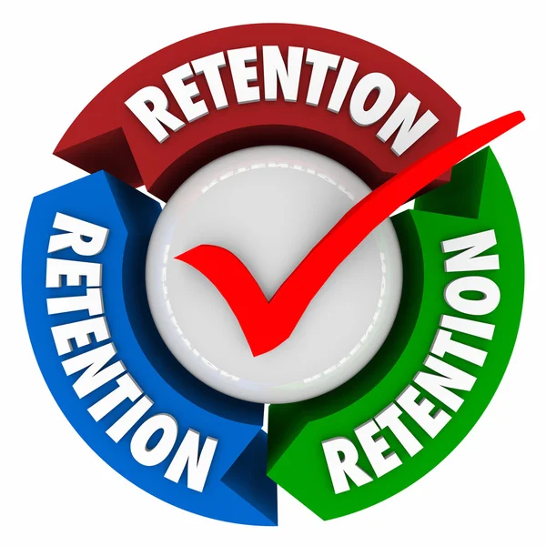
Module-7:8
RETAINING CLIENTS THROUGH EXCEPTIONAL SERVICES
Retaining clients through exceptional service involves consistently delivering quality, gathering feedback, and leveraging testimonials.
By focusing on personalization, communication, and continuous improvement, education consultants can build long-term relationships and a stellar reputation. This not only ensures repeat business but also drives organic growth through word-of-mouth and client advocacy.

Slide 49
Module-7:9
RETAINING CLIENTS THROUGH EXCEPTIONAL SERVICES
Client loyalty programs and ongoing engagement strategies are crucial for building strong, lasting relationships. These approaches help retain clients, foster trust, and encourage referrals, ultimately leading to sustainable growth for education consultants.
1. Implementing a Client Loyalty Program
Loyalty programs reward returning clients and encourage long-term collaboration by offering tangible benefits or exclusive perks.
A. Why Loyalty Programs Matter
1.Boost Retention: A well-designed loyalty program incentivizes clients to return for additional services.
2.Encourage Referrals: Satisfied clients who feel valued are more likely to recommend your services to others.
3.Strengthen Relationships: Offering rewards demonstrates appreciation, fostering goodwill and trust.

Slide 50

Module-7:9
RETAINING CLIENTS THROUGH EXCEPTIONAL SERVICES
B. Types of Loyalty Programs
1.Discounts for Repeat Services: Offer a percentage discount for clients who use your services multiple times.
Example: “Get 10% off when you enroll your second child for consultation.”
2.Point-Based Systems: Clients earn points for using services or attending workshops, redeemable for discounts or free resources.
Example: “Earn 5 points for every service session. Collect 20 points for a free college application review.”
3.Exclusive Perks: Provide early access to workshops, priority booking, or complimentary services for loyal clients.
Example: “Receive a free essay critique after completing three consultations.”

Slide 51

Module-7:9
RETAINING CLIENTS THROUGH EXCEPTIONAL SERVICES
4. Referral Rewards
C. How to Implement a Loyalty Program
1.Define Clear Rules: Clearly explain how clients can earn and redeem rewards.
2.Promote the Program: Advertise loyalty perks on your website, social media, and during consultations.
3.Track Participation: Use CRM tools or loyalty apps to manage client rewards and engagement.
4.Evaluate Effectiveness: Collect feedback to refine the program and ensure it meets client expectations.

Slide 52
Module-7:9
RETAINING CLIENTS THROUGH EXCEPTIONAL SERVICES
2. Regular Follow-Up and Communication
Consistent communication builds trust, ensures client satisfaction, and fosters a sense of connection.
A. Importance of Regular Follow-Up
1.Maintain Relationships: Stay connected even after the service ends to show ongoing care and support.
2.Ensure Satisfaction: Address concerns and ensure clients are happy with the outcomes of your service.
3.Encourage Repeat Business: Keep your services top-of-mind for future needs.
B. Follow-Up Strategies
1.Check-Ins Post-Service: Reach out periodically to see how clients are progressing.
Example: “How is your child adjusting to their new school? Let me know if you need further support.”
2.Milestone Celebrations: Congratulate clients on achievements such as admissions offers, scholarships, or successful applications.
Example: Send an e-card or a handwritten note celebrating their accomplishment.
3.Offer Continued Support: Provide updates or additional resources, such as education news, upcoming workshops, or relevant articles

Slide 53
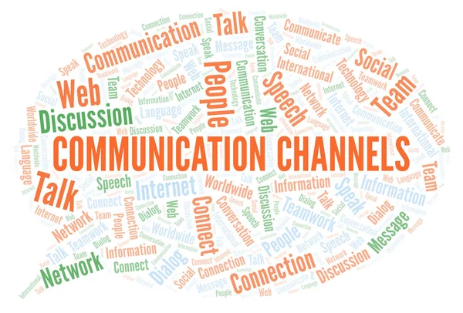
Module-7:9
RETAINING CLIENTS THROUGH EXCEPTIONAL SERVICES
C. Effective Communication Channels
1.Email Newsletters: Send regular updates, tips, and offers to your client list. Include content like blog posts, testimonials, and upcoming events.
2.Personalized Messages: Use CRM tools to tailor messages to each client’s interests or needs.
Example: “Hi Jane, I thought you’d find this guide on study-abroad visas helpful.”
3.Social Media Engagement: Interact with clients through comments, likes, and direct messages.
Share success stories or updates to keep them engaged.
4.Feedback Surveys: Use surveys to gather insights on their experience and how you can improve.

Slide 54
Module-7:9
RETAINING CLIENTS THROUGH EXCEPTIONAL SERVICES
D. Communication Best Practices
1.Be Proactive: Don’t wait for clients to reach out—initiate conversations regularly.
2.Be Genuine and Approachable: Use a friendly, professional tone to make clients feel valued.
3.Respect Boundaries:
Avoid overloading clients with messages; maintain a balance between staying engaged and being considerate of their time.
Implementing a client loyalty program and maintaining regular communication are essential for fostering long-term relationships. Loyalty programs reward repeat clients and encourage referrals, while consistent engagement keeps your services relevant and appreciated. Together, these strategies build trust, strengthen connections, and ensure sustained growth for your education consulting business.

Slide 55

Module-7:10
MEASURING SUCCESS AND ADAPTING STRATEGIES
Measuring Success and Adapting Strategies in Education Consulting
Continuous measurement and adaptation of your marketing and business strategies are crucial for maintaining growth, improving outcomes, and staying competitive. This involves tracking key metrics, refining your approach based on data, and staying informed about evolving industry trends.
1. Tracking Marketing Metrics
Measuring the effectiveness of your marketing efforts helps identify what’s working and where adjustments are needed.
A. Why Track Metrics?
1.Evaluate ROI: Determine whether your investments in marketing efforts are delivering results.
2.Identify Strengths and Weaknesses: Highlight areas of success and pinpoint underperforming strategies.
3.Make Data-Driven Decisions: Use insights to adjust your approach and allocate resources efficiently.

Slide 56
Module-7:10
MEASURING SUCCESS AND ADAPTING STRATEGIES
B. Key Marketing Metrics to Track
1.Website Analytics:
Traffic: Number of visitors to your site.
Bounce Rate: Percentage of visitors who leave after viewing one page.
Conversion Rate: Percentage of visitors taking desired actions
(e.g., signing up for consultations).
Tools: Google Analytics, HubSpot.
2.Email Marketing Metrics:
Open Rate: Percentage of recipients who open your emails.
Click-Through Rate (CTR): Percentage of recipients who click links in your emails.
Unsubscribe Rate: Percentage of people who opt out of your email list.
Tools: Mailchimp, Constant Contact.
3.Social Media Engagement:
Likes, Shares, and Comments: Measure how engaging your posts are.
Follower Growth: Track increases in your social media audience.
Tools: Hootsuite, Buffer.

Slide 57
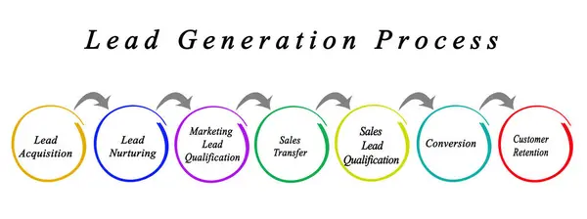
Module-7:10
MEASURING SUCCESS AND ADAPTING STRATEGIES
4.Lead Generation Metrics
Lead-to-Customer Conversion Rate: Percentage of leads who become paying clients.
Cost per Lead (CPL): The cost to generate one lead.
Tools: CRM systems like Salesforce or Zoho.
5.Client Retention Metrics
Repeat Business Rate: Percentage of clients returning for additional services.
Client Lifetime Value (CLV): The total revenue generated by a client over their time with your business.
C. How to Use Metrics Effectively
1.Set Clear Goals: Define measurable objectives (e.g., “Increase website traffic by 20% in 6 months”).
2.Analyze Trends: Look for patterns in data to understand what drives success or challenges.
3.Review Regularly: Schedule periodic evaluations to ensure your strategies remain aligned with your goals.

Slide 58
Module-7:10
MEASURING SUCCESS AND ADAPTING STRATEGIES
2. Adapting and Evolving Your Strategies
Adapting strategies based on performance data and market conditions is essential for sustained success.
A. When to Adapt Strategies
1.Declining Metrics: Adjust when key metrics, such as engagement or conversions, show a downward trend.
2.Market Changes: Respond to shifts in client needs, preferences, or external factors like education policy updates.
3.Introduction of New Tools or Platforms: Incorporate emerging technologies or platforms to stay competitive.
B. How to Adapt Strategies
1.Experiment with New Tactics: Test new marketing channels (e.g., podcasts, webinars) or approaches (e.g., influencer collaborations).
2.Refine Targeting: Use data to identify high-performing audience segments and focus efforts there.
3.Enhance Messaging: Update your value proposition or promotional content to address evolving client pain points.
4.Reallocate Resources: Shift budgets and time from underperforming areas to those yielding better results.

Slide 59
Module-7:10
MEASURING SUCCESS AND ADAPTING STRATEGIES
B. How to Stay Current
1.Follow Industry News: Subscribe to education blogs, newsletters, and journals (e.g., Education Week, Inside Higher Ed).
2.Join Professional Networks: Participate in organizations like NACAC (National Association for College Admission Counseling) or IECA (Independent Educational Consultants Association).
3.Attend Conferences and Webinars: Stay informed through events that discuss emerging trends and best practices.
4.Engage in Social Media Communities: Join groups and forums on platforms like LinkedIn, Facebook, or Reddit.
5.Monitor Competitors: Analyze what successful competitors are doing and identify potential areas for improvement.
3. Staying Current with Industry Trends
Remaining informed about trends ensures you can proactively adjust your offerings and marketing strategies.
A. Why Stay Updated?
1.Maintain Relevance: Offer services and solutions that align with current client needs.
2.Gain Competitive Advantage: Stay ahead of competitors by leveraging emerging tools and practices.
3.Identify Opportunities: Spot trends that open new service areas or revenue streams.

Slide 60
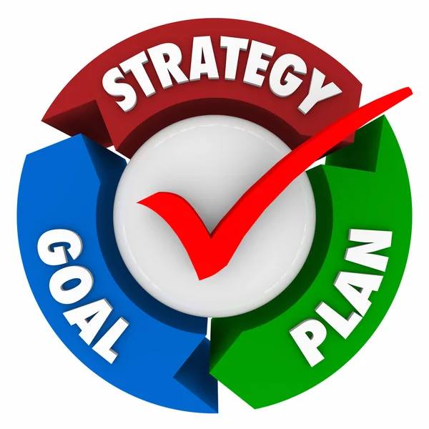
Module-7:10
MEASURING SUCCESS AND ADAPTING STRATEGIES
Measuring success and adapting strategies involve tracking metrics, evolving based on data, and staying informed about trends in education consulting.
These practices ensure that your marketing efforts remain effective, your business stays competitive, and your clients continue to see value in your services. By committing to ongoing evaluation and adaptation, you can position your business for long-term success.

Slide 61
Module-7
ASSESSMENT QUESTIONS
Define your ideal client persona. What key characteristics should it include?
What strategies will you implement to create your unique value proposition?
Describe three strategies you would use to retain clients and encourage repeat business. How would you assess their success?
Which marketing channels would you prioritize for reaching potential education consulting clients, and how would you measure their effectiveness?
Describe the key components of your marketing strategy. Which channels will you focus on?
How will you measure the success of your marketing efforts? List at least three metrics.

